Slide 1

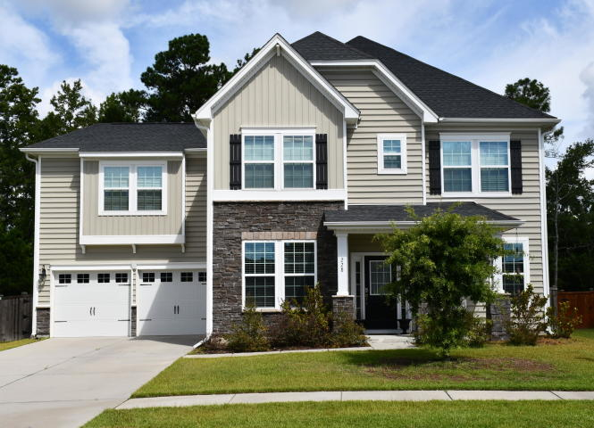
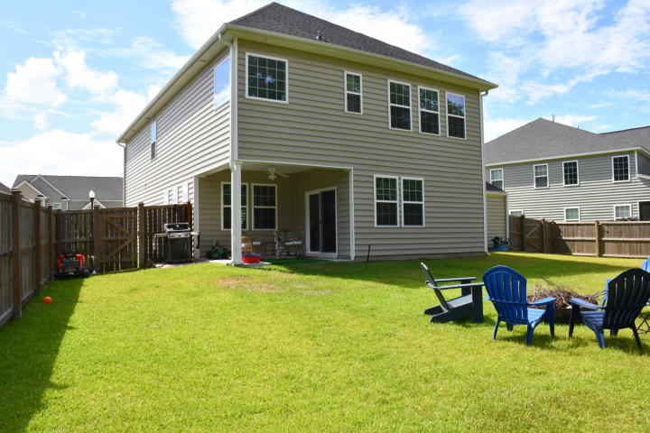
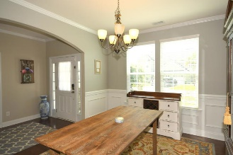
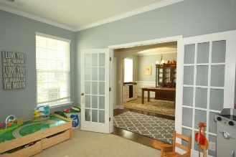
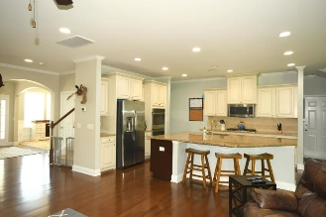
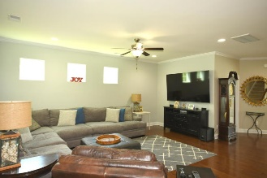
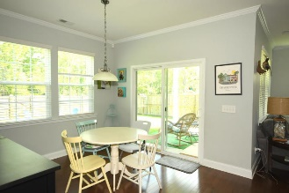

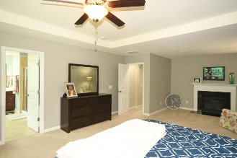
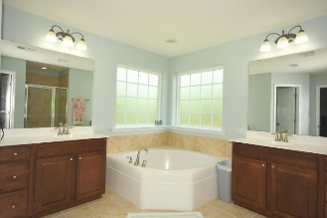
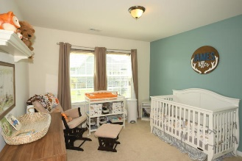
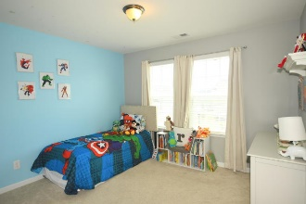
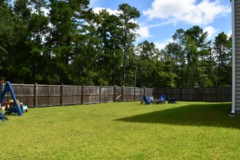
Cane Bay Beauty
4 Bed, 4 Bath, Office & FROG
Debbie Cromer
ABR, RSPS, REALTOR, CRS
(843) 437-6342
debbie@debbiecromer.com
www.mylowcountryhomes.com
228 Lindera Preserve Boulevard
Cane Bay Plantation | Summerville, SC 29486 | MLS# 20020531 | $359,000
Great curb appeal and room for everyone with 4 bedrooms + FROG + Office! Upon entering you notice the formal dining room on one side of the entry hall and an office/playroom on the other side. The hall opens to a gourmet kitchen featuring a large island, gas cook top, double wall ovens and built in microwave, an awesome walk in pantry with tons of storage and the breakfast room. Upstairs you find the spacious master bedroom with a seating area complete with fireplace as well as a luxury bath and walk in closet. Two of the secondary bedrooms share a jack and jill bath. There is also a fourth bedroom and a full hall bath. A large FROG finishes off the upstairs. The backyard is fully fenced and backs up to protected woods. Don't miss this amazing 4 year new home!
Virtual Tour: https://my.matterport.com/show/?m=36YBo2zvY6v
Video Tour: http://www.eproptour.com/tour/play.htm?vid=yourcanebayhome
Century 21 Properties Plus | 1090 Park West Blvd; Ste 3 | Mount Pleasant, SC 29466

