Slide 1
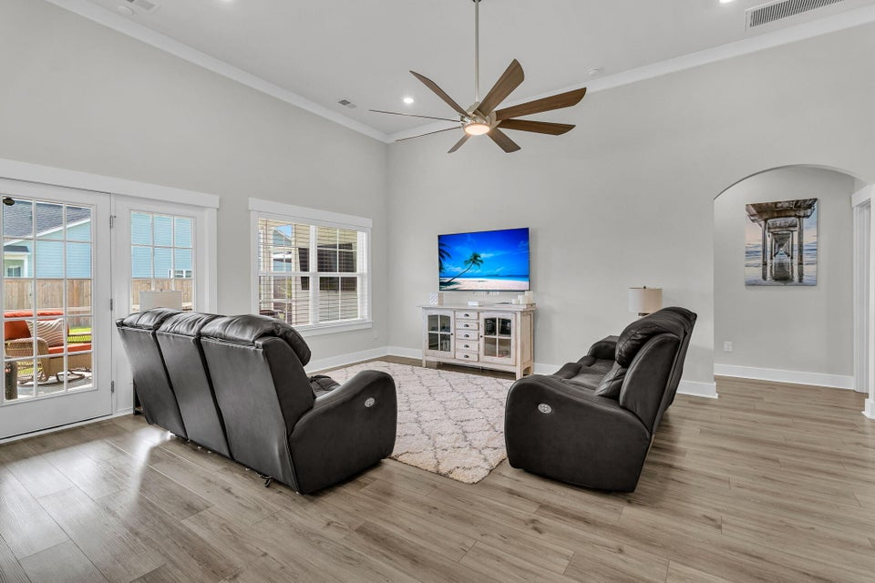
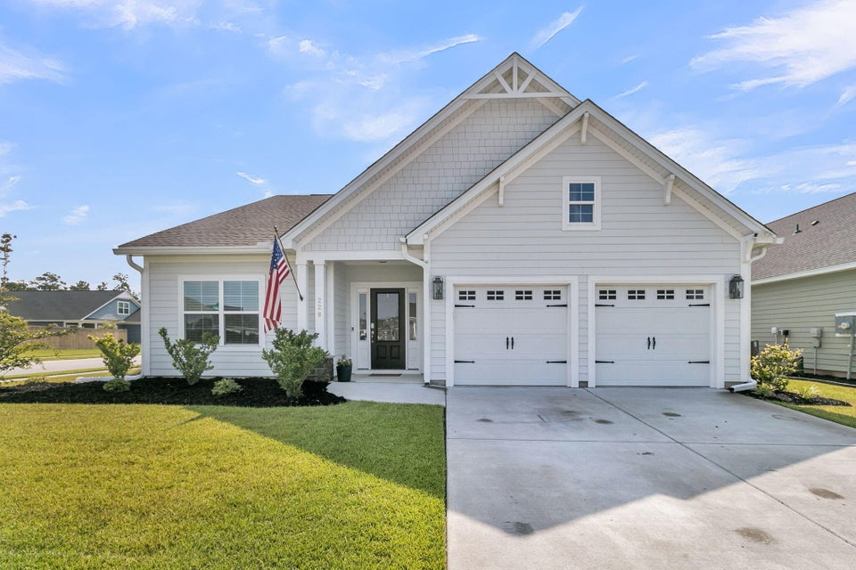
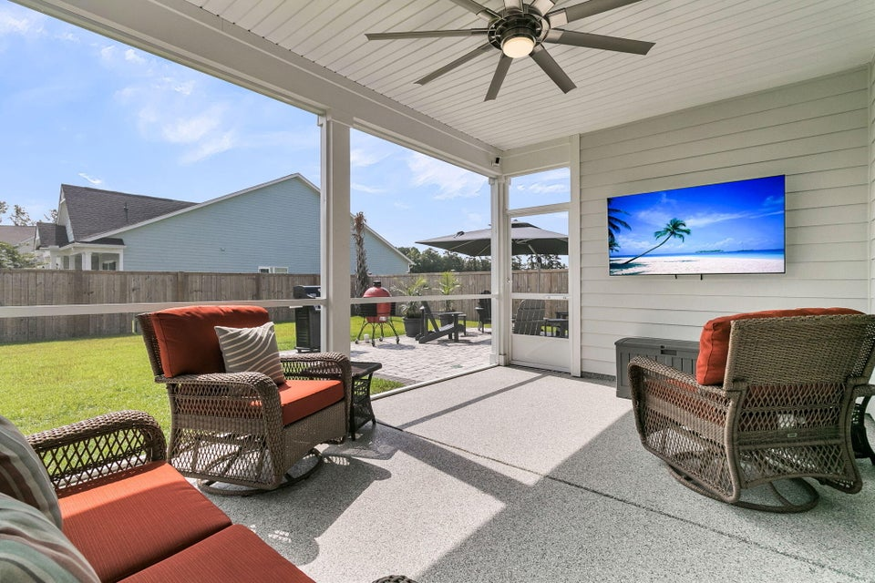
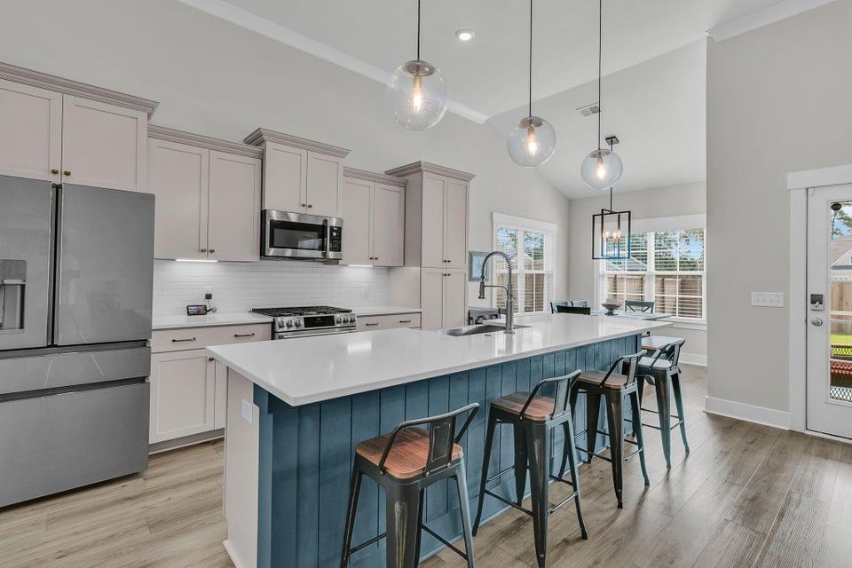
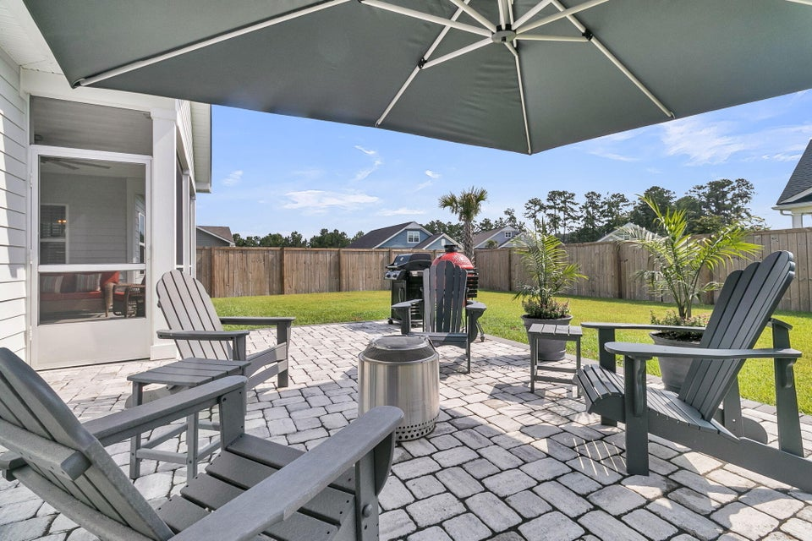
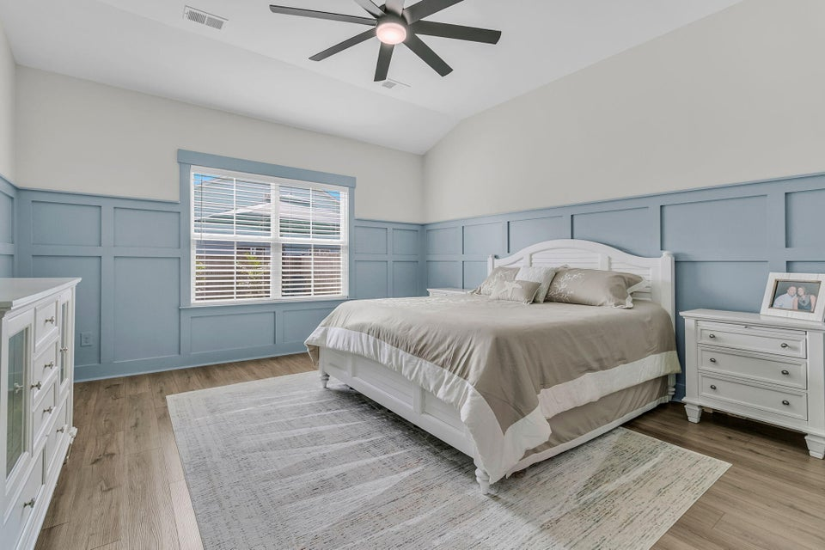
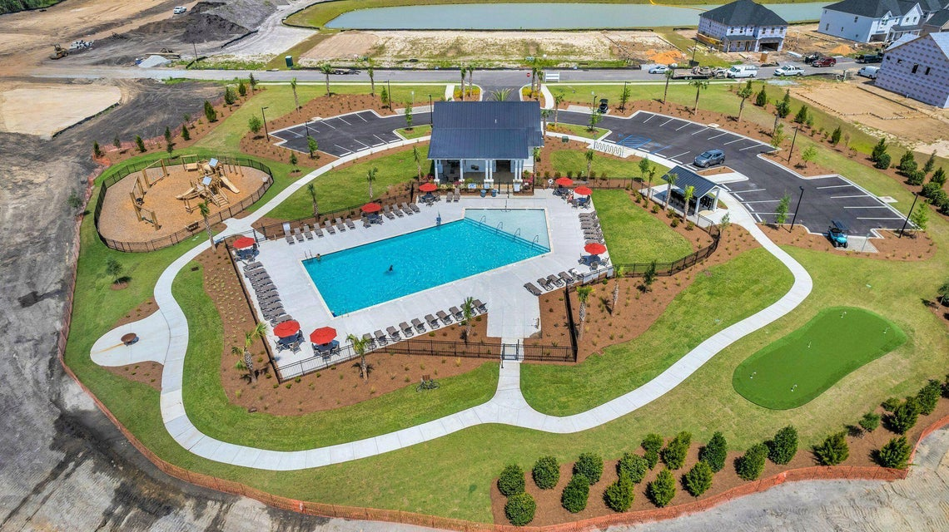
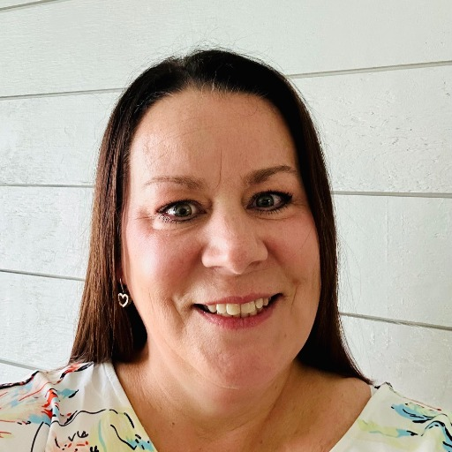

Seller is Offering Buyer Up To $6,000 in Closing Cost If Closed By 3/31/2026
228 Fiddleback Drive
Hewing Farms
Summerville, SC 29486
MLS# 25033142 | $455,000
Discover this immaculate 2023-built home offering exceptional craftsmanship, thoughtful upgrades, and an unbeatable location—just a golf cart ride to all your favorite spots. Situated on one of the largest and most private lots in the area, this 3-bedroom, 2-bath home stands apart for buyers who value quality over square footage. While larger homes may exist, few offer this level of detail, finish, privacy, and move-in readiness. Inside, the home features 12-foot ceilings in the main living area, custom trim work throughout, upgraded lighting, under-cabinet lighting, and ceiling fans in every room. The chef's kitchen is anchored by top-of-the-line GE Café Series appliances, a large island with a stainless apron sink, and premium finishes designed for both beauty and function.
The laundry room continues the attention to detail with GE Profile front-loading washer and dryer with pedestals, plus added cabinetry for storage and organization. The garage is equally impressive, featuring durable polyaspartic flooring, a Level 2 EV charger, and a 50-amp generator outlet with interlock, providing peace of mind and modern convenience. The screened-in porch also offers polyaspartic flooring, while a spacious 16x20 patio creates an ideal outdoor living and entertaining space. Additional highlights include a full irrigation system with app controls, a comprehensive Ring security system (window and door contacts, motion sensors, and glass-break detectors), and a 6-foot privacy fence with a large double gate offering access from HOA common space - rare for the neighborhood.
This home is one of the very few single-family properties in the vicinity with only one neighboring home, delivering privacy that is increasingly hard to find. Every upgrade has already been completed - no additional money needs to be spent after closing. Truly move-in ready and available for a quick close.
*Owner is a licensed SC Real Estate Agent*
Stacey Croston
540-533-2148
stacey.croston@exprealty.com
https://staceycroston.exprealty.com/

