Slide 1
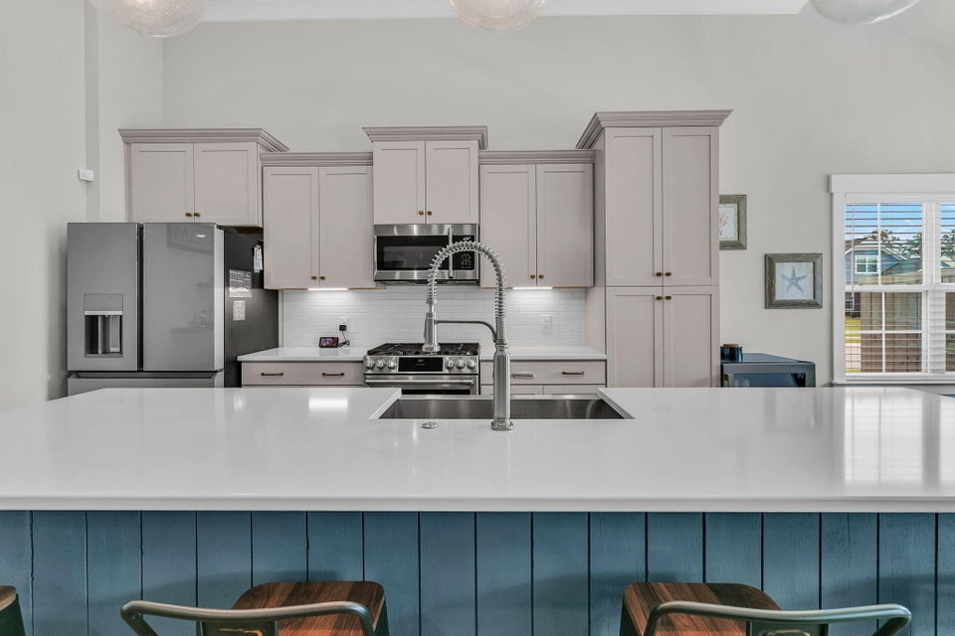
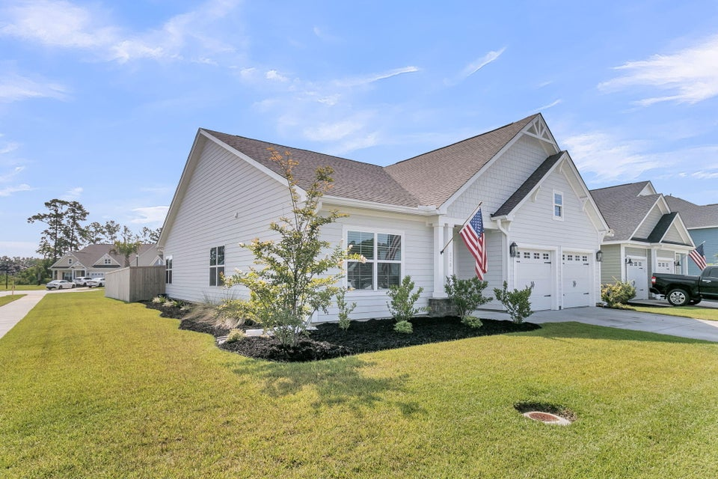
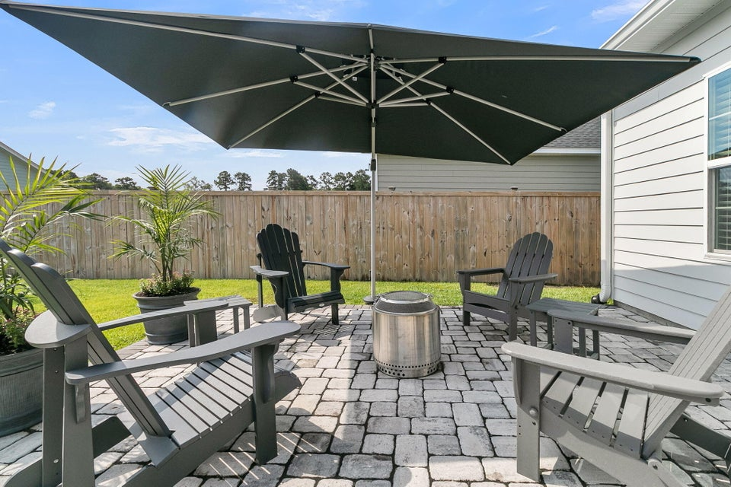
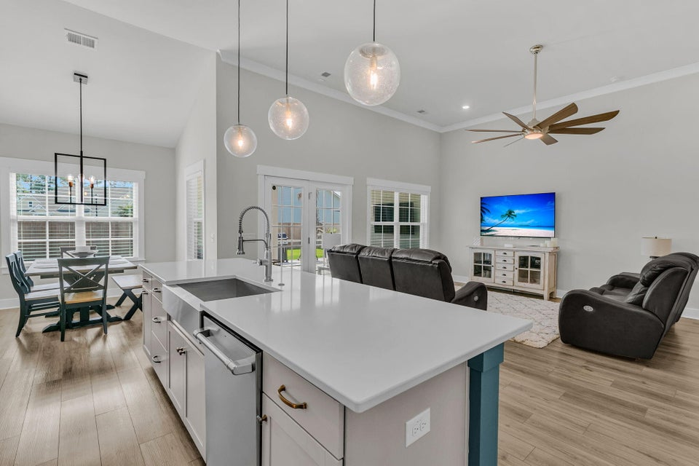
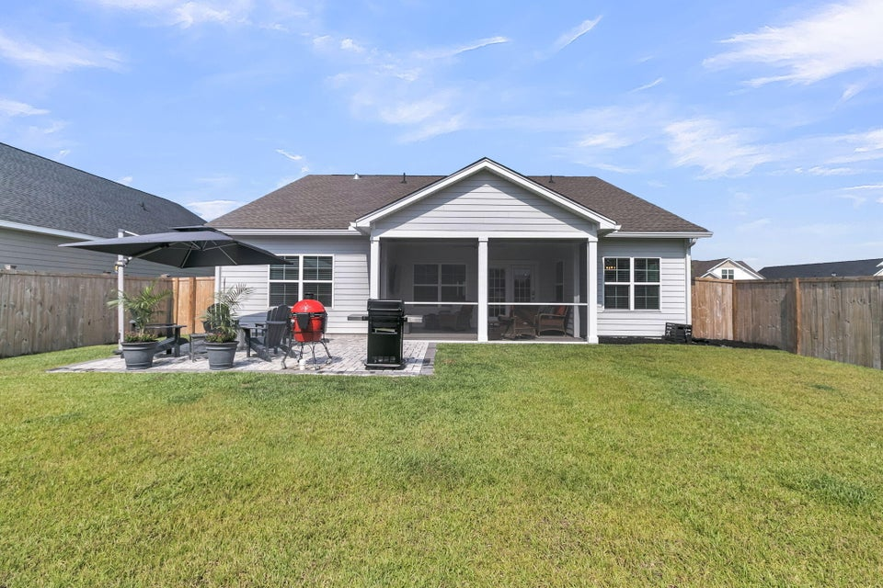
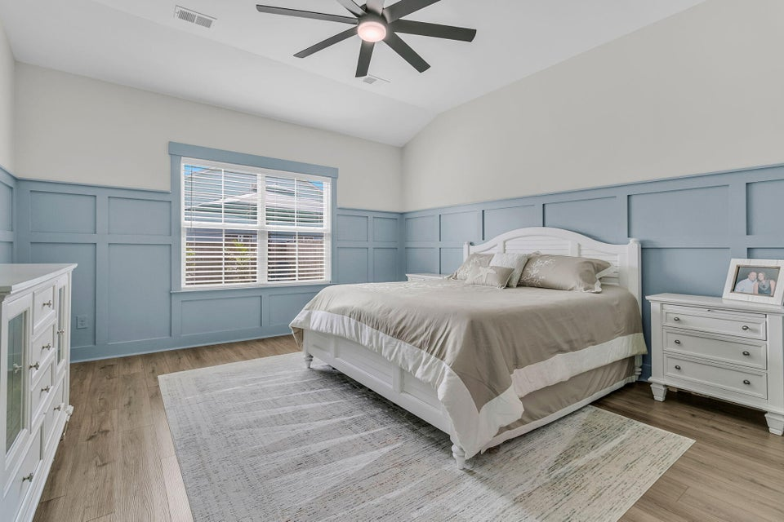
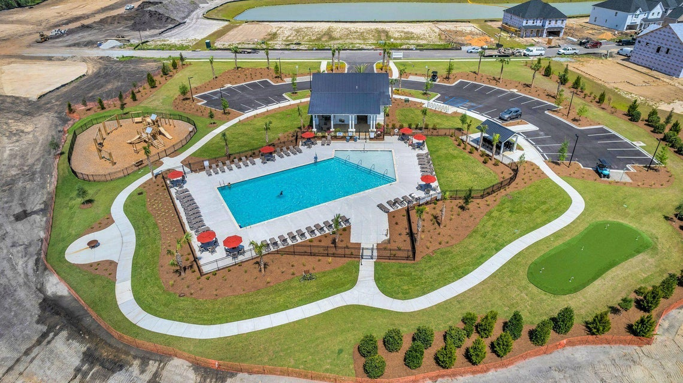


New Price!
228 Fiddleback Drive
Hewing Farms
Summerville, SC 29486
MLS# 25033142 | $439,900
Discover this immaculate 2023-built home offering exceptional craftsmanship, thoughtful upgrades, and an unbeatable location--just a golf cart ride to all your favorite spots. Situated on one of the largest and most private lots in the area, this 3-bedroom, 2-bath home stands apart for buyers who value quality over square footage. While larger homes may exist, few offer this level of detail, finish, privacy, and move-in readiness. Inside, the home features 12-foot ceilings in the main living area, custom trim work throughout, upgraded lighting, under-cabinet lighting, and ceiling fans in every room. The chef's kitchen is anchored by top-of-the-line GE Café Series appliances, a large island with a stainless apron sink, and premium finishes designed for both beauty and function.
The laundry room continues the attention to detail with added cabinetry for storage and organization. The garage is equally impressive, featuring durable polyaspartic flooring, a Level 2 EV charger, and a 50-amp generator outlet with interlock, providing peace of mind and modern convenience. The screened-in porch also offers polyaspartic flooring, while a spacious 16x20 patio creates an ideal outdoor living and entertaining space. Additional highlights include a full irrigation system with app controls, a comprehensive Ring security system (window and door contacts, motion sensors, and glass-break detectors), and a 6-foot privacy fence with a large double gate offering access from HOA common space rare for the neighborhood.
This home is one of the very few single-family properties in the vicinity with only one neighboring home, delivering privacy that is increasingly hard to find. Every upgrade has already been completed no additional money needs to be spent after closing. Truly move-in ready and available for a quick close.
*Owner is a licensed SC Real Estate Agent*
Stacey Croston
540-533-2148
stacey.croston@exprealty.com
https://staceycroston.exprealty.com/

