Slide 1
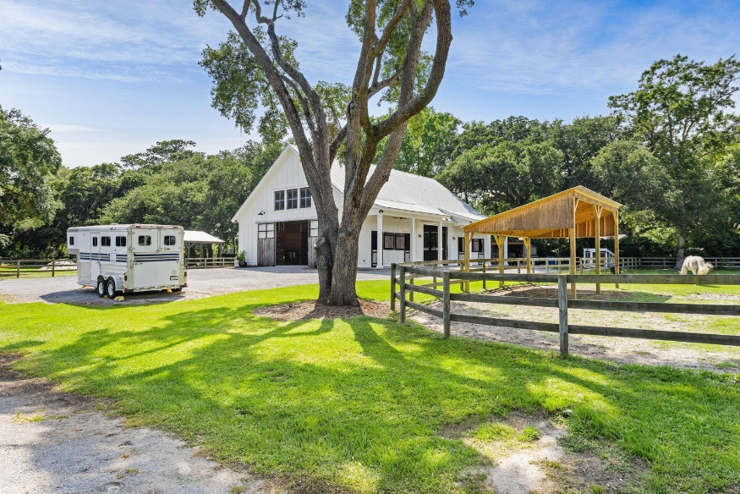
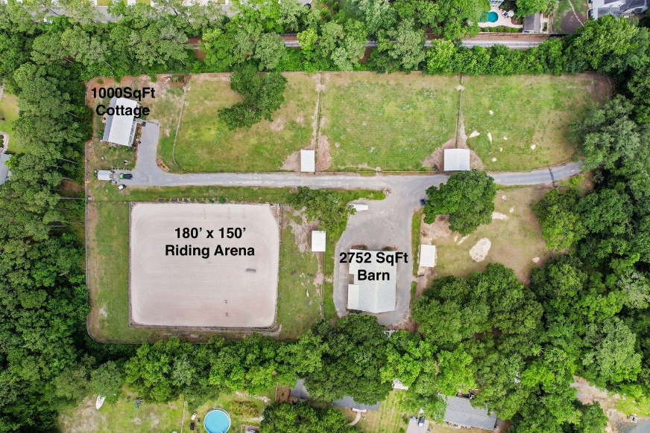
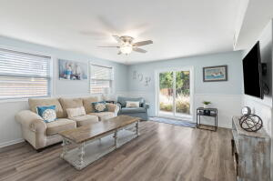
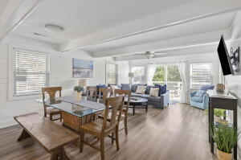
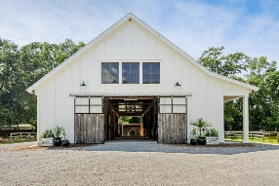
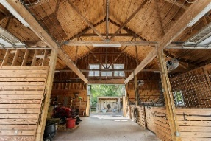
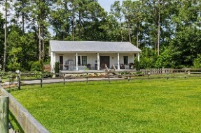
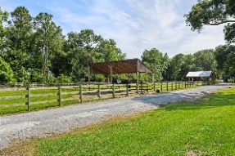
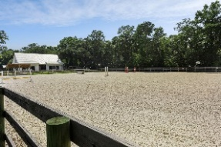
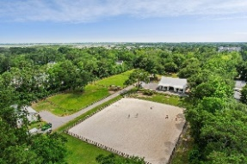
2290 N Palmetto Fort Drive
Palmetto Fort | Mount Pleasant, SC 29466 | MLS# 23013966 | $4,295,000
Darrell Creek Elevated Home With Elevator & Salt Pool
Horse Farm in the Heart of Mt Pleasant ~ New Price!
Extraordinary, one-of-a-kind, 5-acre farm in the middle of Mt Pleasant! This beautifully designed, custom-built horse farm is adjacent to Oyster Point off Rifle Range Rd and includes a beautiful 1 bedroom/2 full bath, 1000 sqft caretaker's cottage; 2752 sqft custom barn with five 12' x 14' stalls; 180' X 150' riding arena with professional-grade GGT (German Geo Textile) footing and drainage system installed by East-West Arena Construction; five impeccably maintained, rotated pastures with large run-ins; and two chicken coops. A thick buffer of trees surrounds the property making it very private. The property was designed and built with a focus on pasture and arena drainage, which is often overlooked on farms in the Lowcountry. The owners prioritized drainage and arena quality to promote horse hoof health and the overall well being of the horses. As you drive through the automatic gate, a canopy of live oaks welcomes you to the farm. The long driveway is flanked by beautiful fenced pastures on the left and right. As you continue down the drive, you'll see the barn ahead on the left, the riding arena just past the barn on the left, and the caretaker's cottage straight back. Numerous raised flower beds adorn the perimeter of the barn and the driveway, and the perimeter of the cottage is beautifully landscaped and includes a raised vegetable/herb garden.
CUSTOM BARN CONSTRUCTION DETAILS:
-- 2752 sqft (64' x 43')
-- Hardie plank board and batten exterior and metal roof
-- In the rear, 4 stalls with 8'H Dutch doors leading outside
-- In the front, 1 stall, climate-controlled tack room, and large open storage area for farm equipment, hay, etc
-- Each of the five stalls has a dedicated wall mounted fan and five ceiling fans are mounted in the center aisle.
-- Two 14' aisles cross through the middle of the barn with double 7'W x 10'H sliding barn doors on all 4 sides allow for amazing cross breezes
-- Interior of barn and stalls finished with pressure-treated pine board and batten
-- Stalls have decorative metal upper grills with metal framed stall doors
-- Wash rack outside of barn with hot and cold water
-- Water spigots and electrical outlets throughout barn
-- Barn is on city water and pastures on well water
CUSTOM CARETAKER'S COTTAGE DETAILS:
1 Bed/2 Bath, 1000 sqft. The exterior complements that of the barn with Hardie plank board and batten and metal roof. Enter from the full-length, rocking chair front porch into the family room. Note the vaulted ceiling with decorative exposed beams and hardwood floors. To the right is the kitchen with island and breakfast bar. Through sliding barn doors to the left, you'll find the large bedroom with hardwood floors and 10' smooth ceilings. The en suite bath features tile floors, custom vanity, shower with tile floor and surround, linen closet, and laundry closet. A second, self-contained full bath is accessible from the front porch and could serve as a future pool bath and/or dedicated farm guest bath.
ARENA FOOTING DETAILS
-- GGT (German Geo Textile) Footing is made up of polyester fibers and sand
-- Increased impact resistance
-- Protection for joints and ligaments
-- Prevents muscle fatigue for the horse
-- Prevents compacting of arena surface
-- High water storage capability
-- Drains quickly and easily
-- Allows for riding in all weather conditions
-- Reduced dust
-- Less maintenance
-- Long lasting due to high quality fibers, high tensile strength, and UV rating
There is nothing like this property in Mt Pleasant. Location is less than 3 miles to Town Center shopping and dining, less than 4 miles to I-526, and less than 4 miles to the beach!
Check out the listing for more details and photos!
Andrea Rogers
(843) 532-3010 | andrearogers1@gmail.com | www.andrearogersrealtor.com
AgentOwned Preferred Group | 1400-G Palm Blvd | Isle Of Palms, SC 29451

