Slide 1
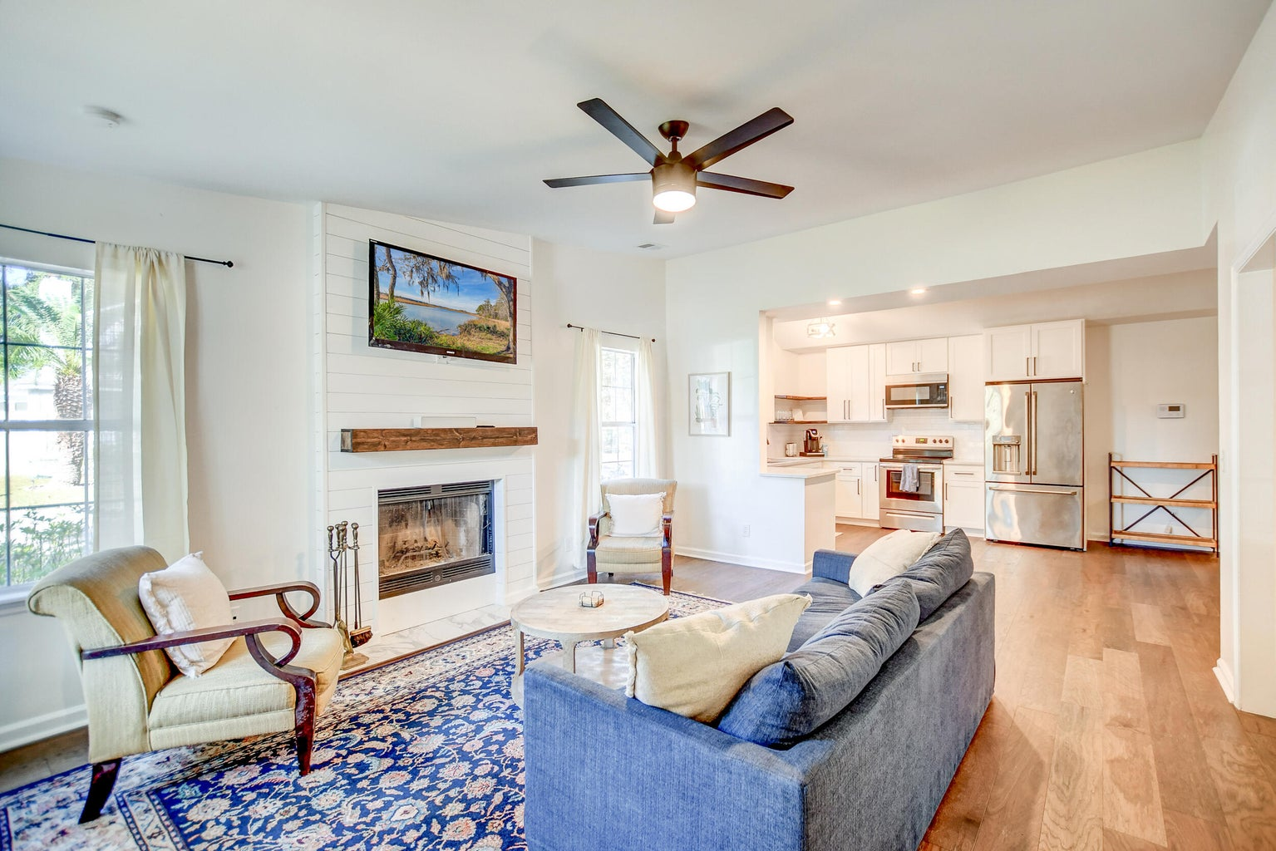



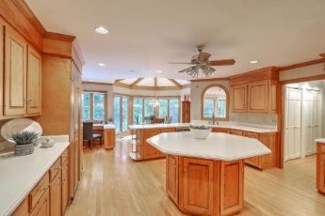
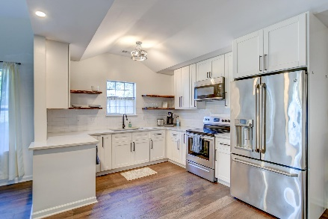



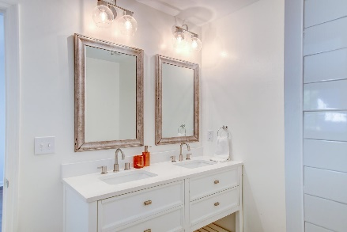

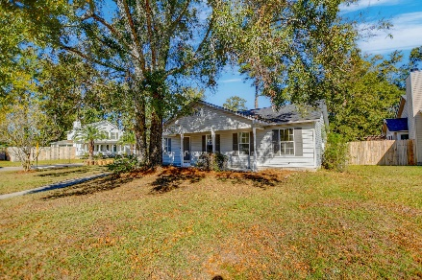
Parkshore Marshfront
Welcome to your new home with no HOA
2297 Boulder Court
The Timbers | North Charleston, SC 29406 | MLS# 23025360 | $395,000
This charming single-story residence is nestled on a generous corner lot adorned with majestic, mature trees, and can be a great personal home or potentially an investment property. Step onto the inviting front porch and into a world of comfort and elegance. As you enter, you'll be greeted by an abundance of natural light that fills the open floor plan, accentuated by vaulted ceilings and stunning wide plank flooring. The living room is the epitome of coziness, boasting a delightful fireplace adorned with a shiplap surround, perfect for those chilly evenings. This space seamlessly flows into the eat-in area and the jaw-dropping kitchen, which features sleek floating shelves, quartz countertops, pristine white cabinets, and stainless steel appliances.
Retreat to the exquisite owner's suite, adorned with a vaulted ceiling and direct access to the deck and backyard, allowing for effortless indoor-outdoor living. The en suite bathroom is a sanctuary of its own, showcasing a dual sink vanity and a luxurious, spacious step-in shower.
Additionally, two well-appointed bedrooms, a full bathroom, and a conveniently located laundry room add to this thoughtfully designed home. Outside, the expansive fully fenced backyard provides the ideal setting for outdoor gatherings and activities, ensuring privacy and security.
This property currently doesn't require flood insurance. The property also includes a two-car garage, providing ample storage space and ensuring hassle-free parking. With its convenient location, this home is only 1.8 miles from I-26 and Trident Medical Center, 6.7 miles from I-526, and 9.2 miles from Charleston International Airport.
This home is a rare find that seamlessly combines comfort, style, and a great location. Don't miss this opportunity to make this exquisite residence your new sanctuary! Schedule your showing today!
Caroline Treece ctreece@mattoneillteam.com 843-754-0050

