Slide 1
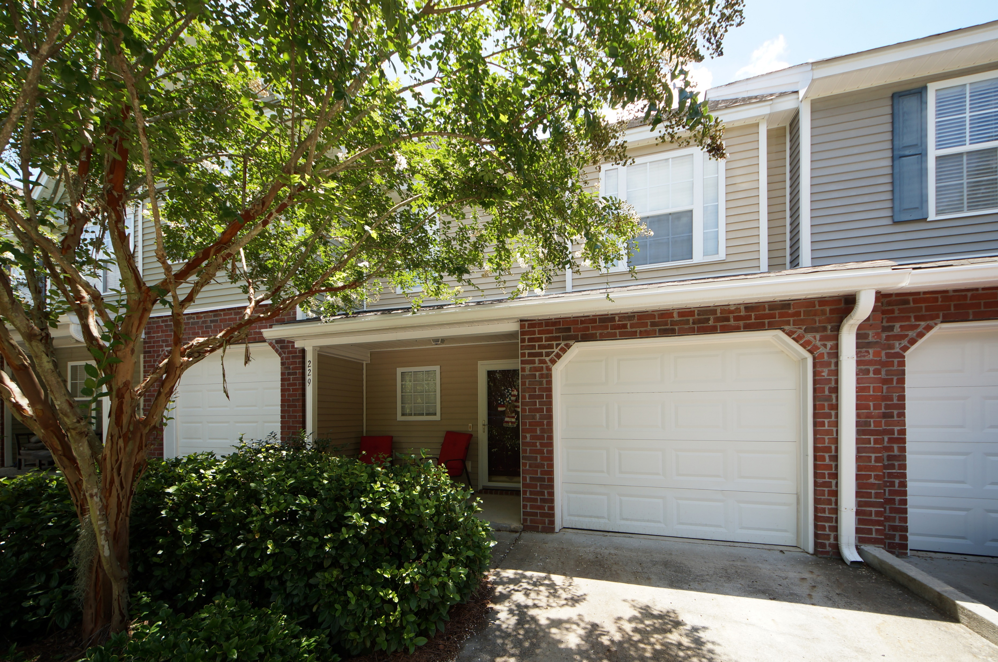
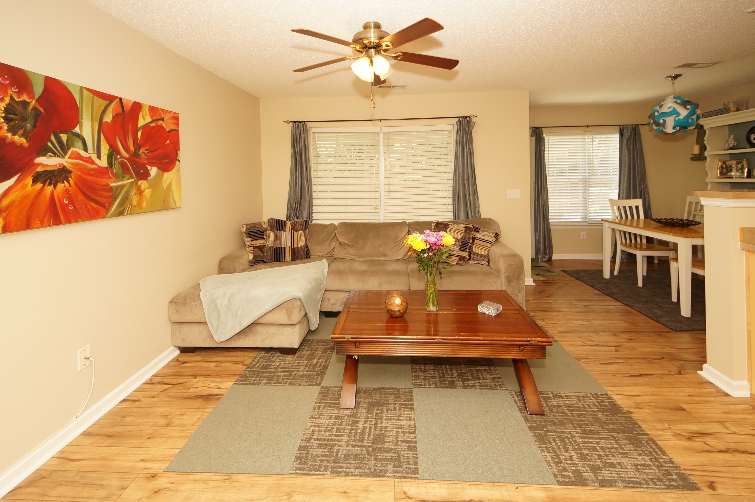
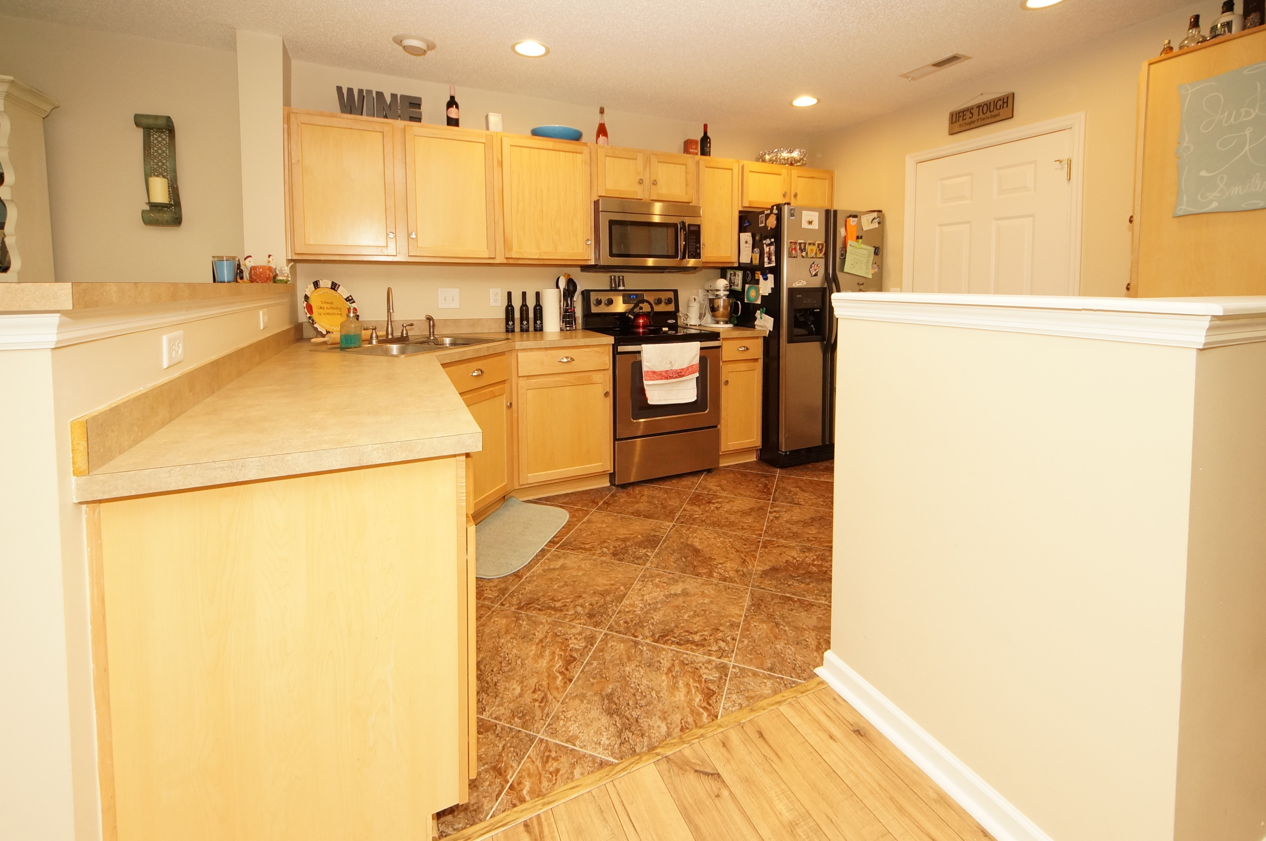
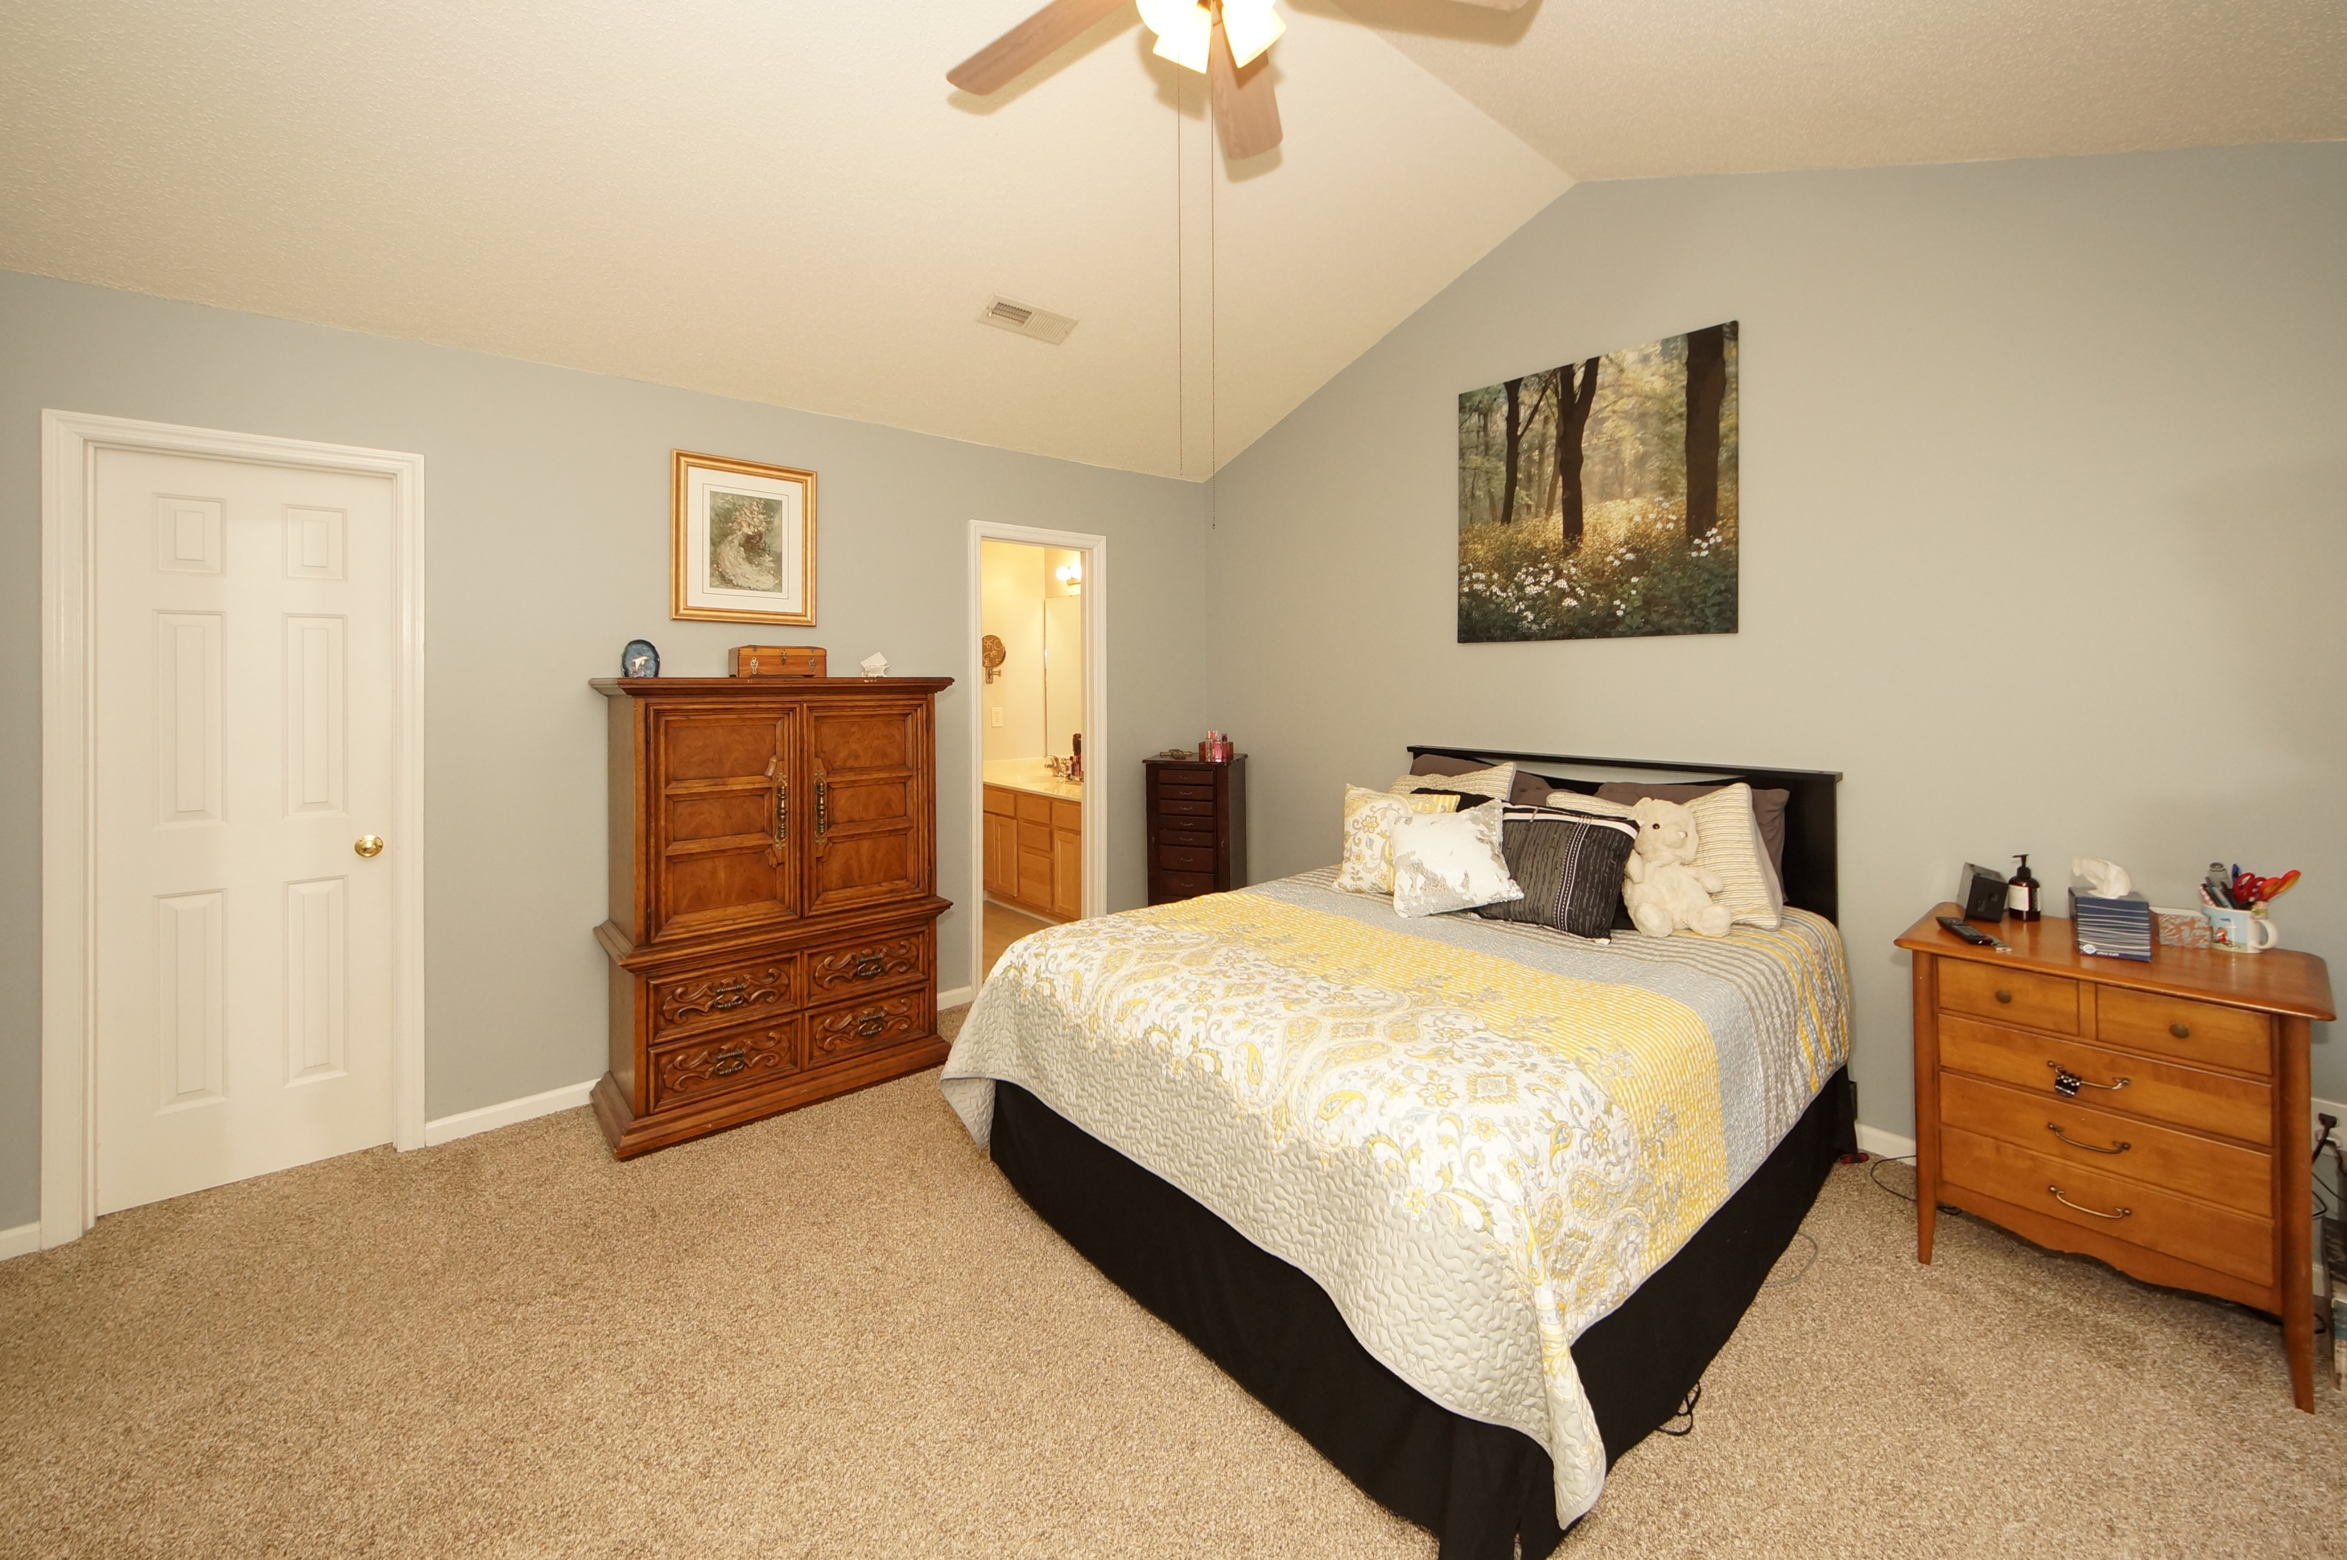


229 Darcy Avenue
Persimmon Hill Townhouses :: Goose Creek
MLS# 18012271 :: $142,0002 Bed / 2 Bath
New to the Market!
Dual Masters
Enjoy convenient living owning a town home with 2 Master Suites!
Seller has professionally painted with chic colors, new carpet and this home is on a private lot situated on a cul-de-sac.
Screen porch, single car garage, neighborhood pool and convenient location to shopping make this home a must buy!
Connie White, Broker
843-532-3356
conniesyouragent@gmail.com
Charleston Homes · 597 Old Mt. Holly Road · Suite 301 · Goose Creek, SC 29445

