Slide 1
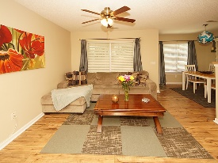
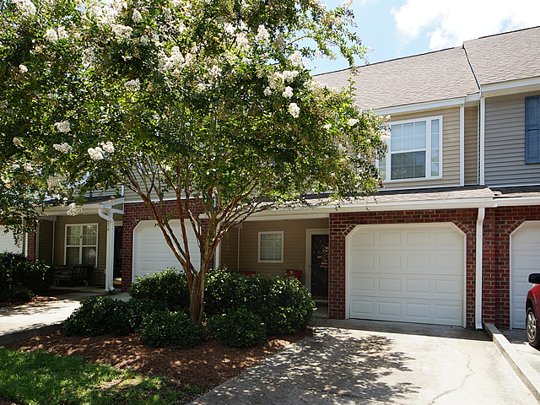
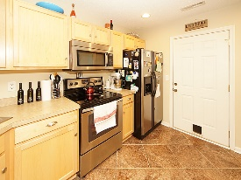
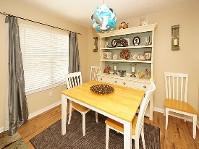
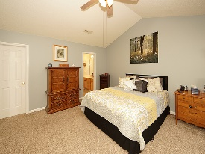
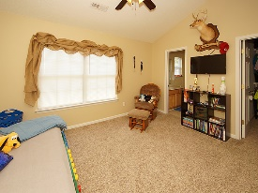
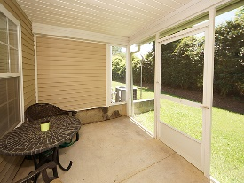
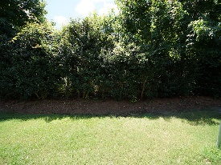

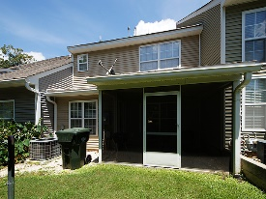

Enjoy Convenient Living At A Better Price
229 Darcy Avenue
Persimmon Hill Townhouses
Goose Creek, SC 29445
Open House Canceled!
Under Contract In 3 Days!
MLS# 17019847
$139,925
2 Bed / 2½ Bath
spacious 2 bedroom 2.5 bath townhome. Seller has professionally painted with chic colors, new carpet and this home is on a private lot situated on a cul-de-sac.
Screen porch, single car garage, neighborhood pool and convenient location to shopping make this home a must see and must buy!
Connie White, Broker
843-532-3356 · conniesyouragent@gmail.com
Charleston Homes · 597 Old Mt. Holly Road · Suite 301 · Goose Creek, SC 29445

