Slide 1
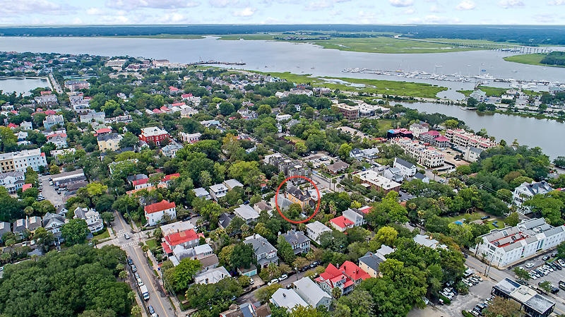
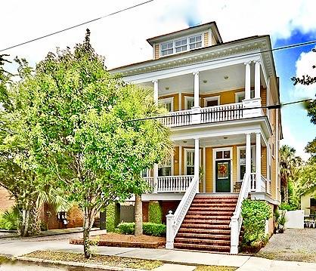
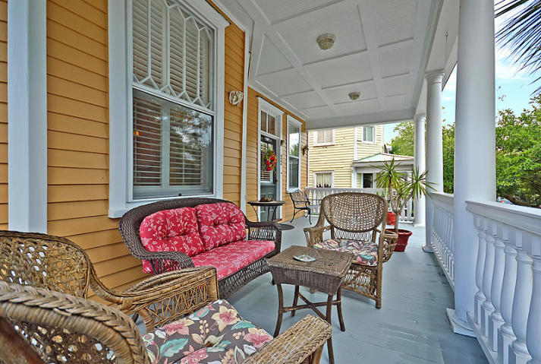
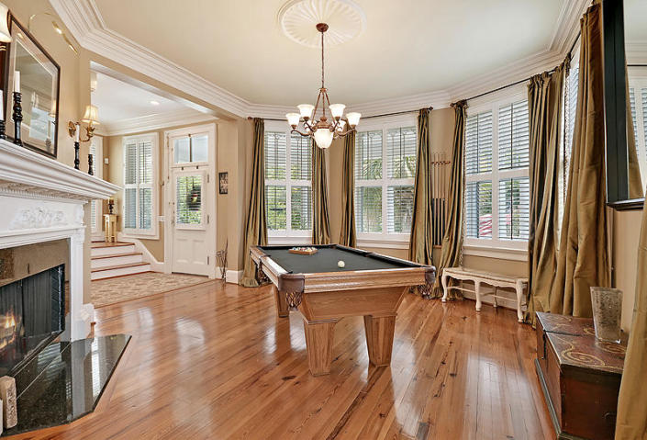
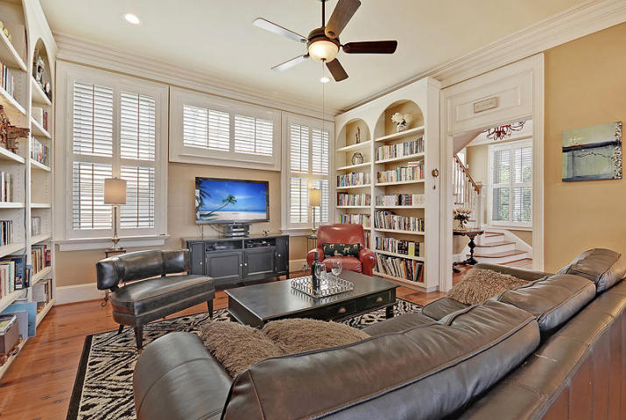
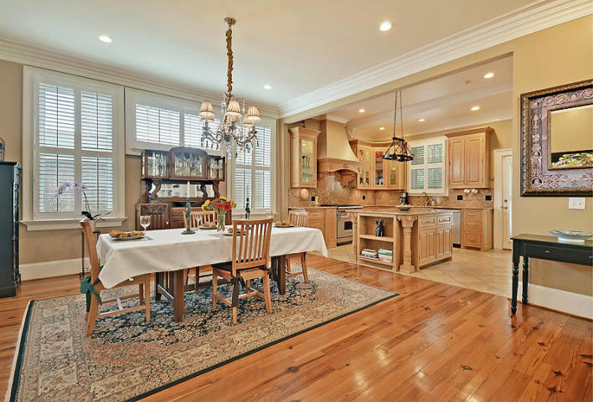
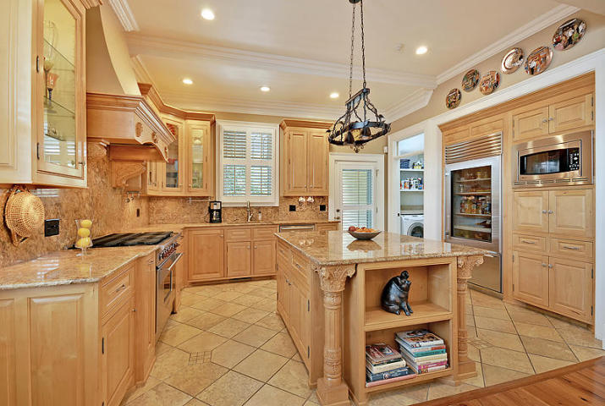
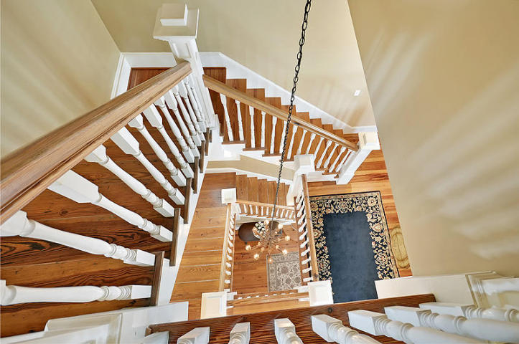
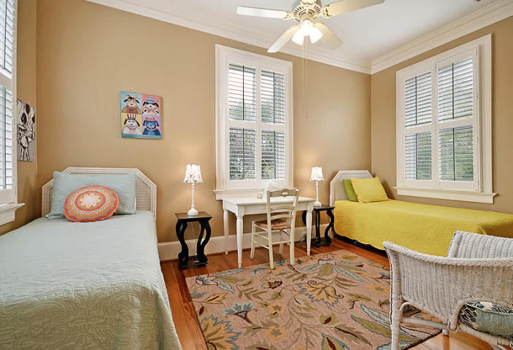
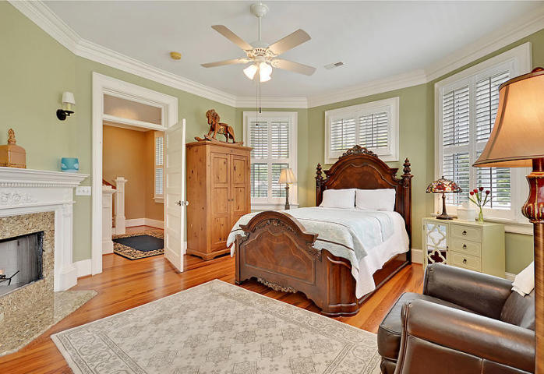
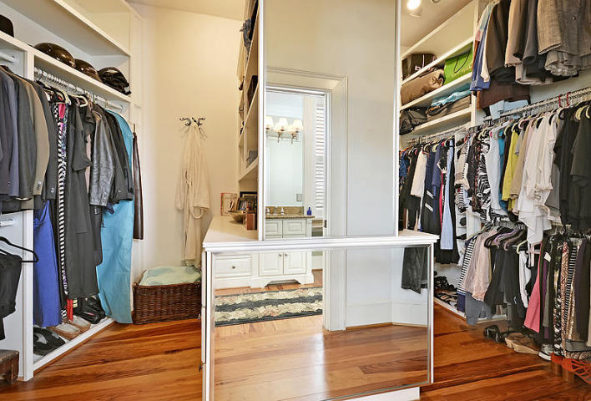
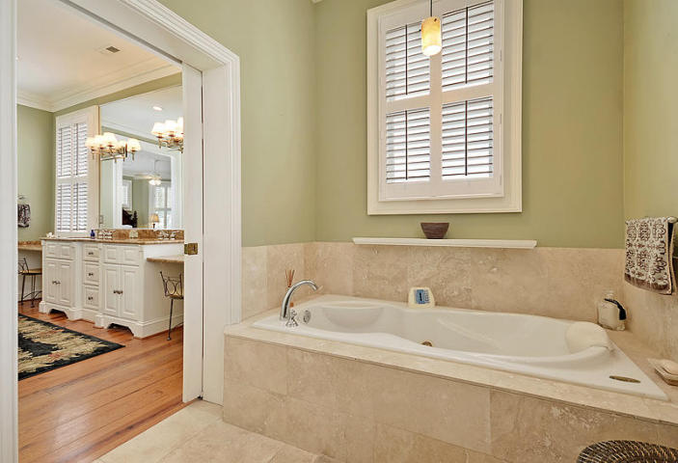
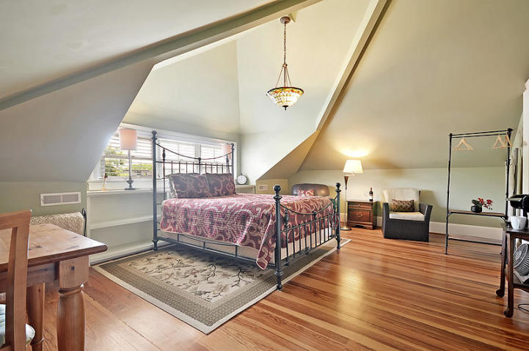
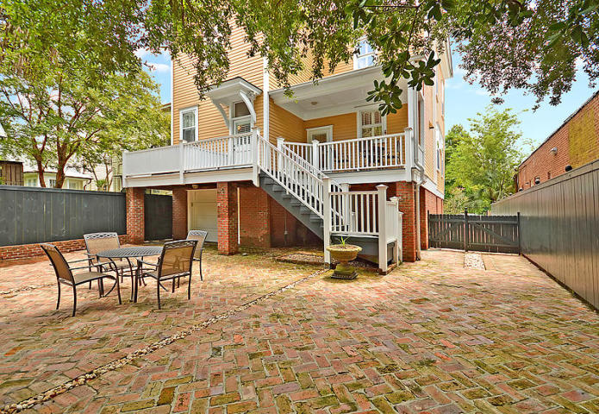
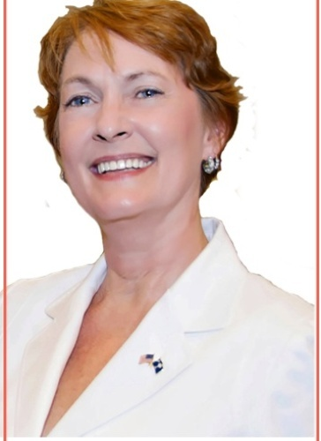

NEOCLASSICAL REVIVAL FOURSQUARE!
Buy.......Build.....Begin
22 Bennett Street
Harleston Village · Charleston, SC 29401 · MLS# 18017314 · $1,250,000
Early 20th. Century faithful restoration of the 1905 original design. Lovingly restored (back to the studs) and raised in 2004 to preserve restoration using top-grade materials and exacting standards. Elevation required substantial added pilings and replacement of all foundation walls and piers, while keeping original brick masonry design which includes expansive brick staircase and brick herringbone pattern courtyard and driveway (both with natural drainage system). All windows rebuilt with storm windows added throughout. Driveway gate replicates window design. Exterior completely painted in 8/17 to enhance trey porch ceilings, ornate cornice, balusters and columns. Upgraded, TRUE turnkey home! Open floorplan, Subzero, Wolf and Bosch appliances, granite hand-carved kitchen island. Sunny w/plantation shutters and gorgeous hardwoods, soaring ceilings, intricate crown mouldings, two gas fireplaces, and two oversized water heaters. Three HVAC systems, (one for each floor), and ensuite bath in each bedroom ensure comfort. Master suite has mantled gas fireplace, huge walk-in closets, dual sinks and vanities, jetted tub, oversized shower w/3 heads, toilet and bidet. Numerous built-ins throughout home, a powder room, a large 5th bedroom or game room, a home office w/outdoor access, wet bar, two huge verandas, large back porch, two-car garage, workshop and storage. Too much living space and storage to list! Flood insurance only $ 957. in 2018!! No ground level mechanicals or ductwork and no damage during recent storms! (Dining room chandelier does not convey.) Agent is owner.
Bobbie Rose
(843) 708-1535
bobbierose@kw.com
Keller Williams Realty Charleston | 496 Bramson Ct Ste 200 | Mt. Pleasant, SC 29464

