Slide 1
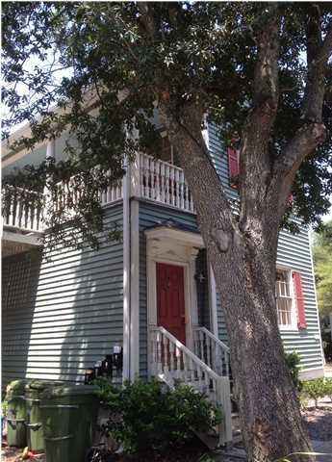
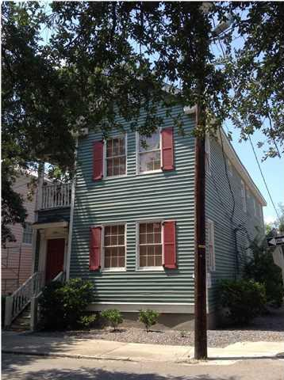
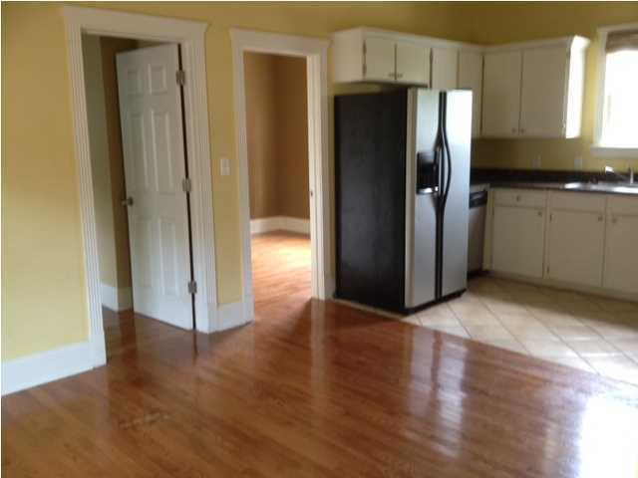
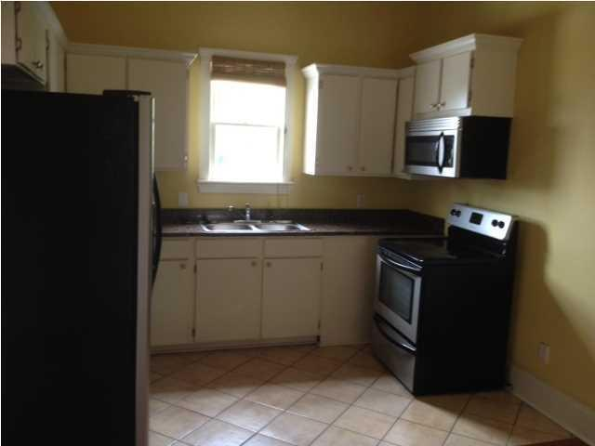
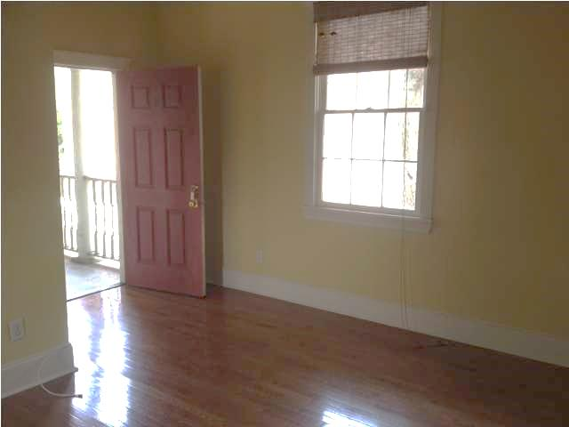
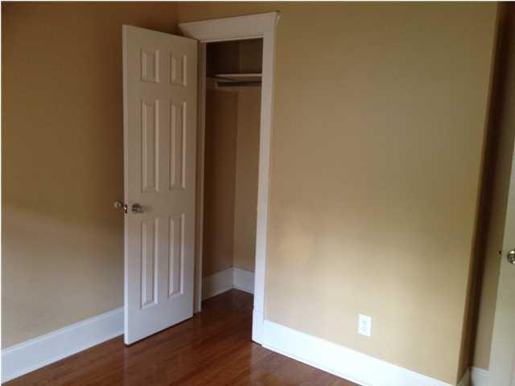
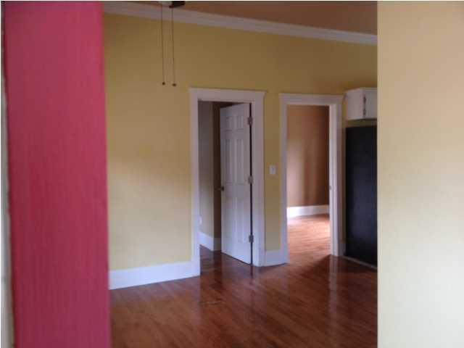
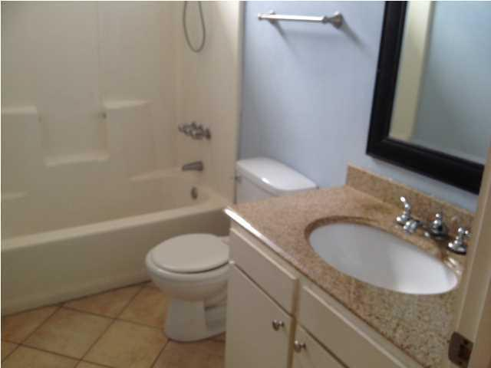

22 Cooper St Eastside Charleston, SC MLS# 1421141 $639,000 Unit 1: 1 Bed / 1 Bath Unit 2: 2 Bed / 1 Bath Unit 3: 1 Bed / 1 Bath Unit 4: 2 Bed / 1 Bath
Reduced $110,000!
Make An Offer! Call For Info Today!
Reduced $110,000!
Make An Offer! Call For Info Today!
This fabulous historical home built in 1900 and completely renovated in 2011 has all the modern conveniences. Hardwood floors, granite counters, new appliances, new heat and air conditioning just to name a few of the upgrades. A great view of the Cooper River and conveniently located to College of Charleston, MUSC, Roper, Trident Tech, restaurants, shopping, major highways, Charleston Airport and just near the foot of the Ravenel Bridge. Off street parking with 6 parking spaces available for tenants. Four rental units: $4400.00 a month. Just blocks from the Cigar Factory this property is a must see opportunity.
*If schools are important to you, please verify. Square footage was taken from the tax records.
Susan & Greg Day
843-900-0477 | 732-757-2904 charlestonbyday@gmail.com
www.charlestonbyday.com
AgentOwned Realty Co. Premier Group, Inc. | 824 Johnnie Dodds Blvd | Mt Pleasant, SC 29464

