Slide 1

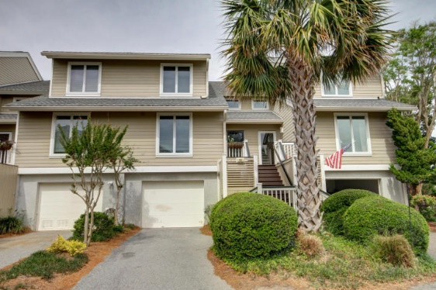
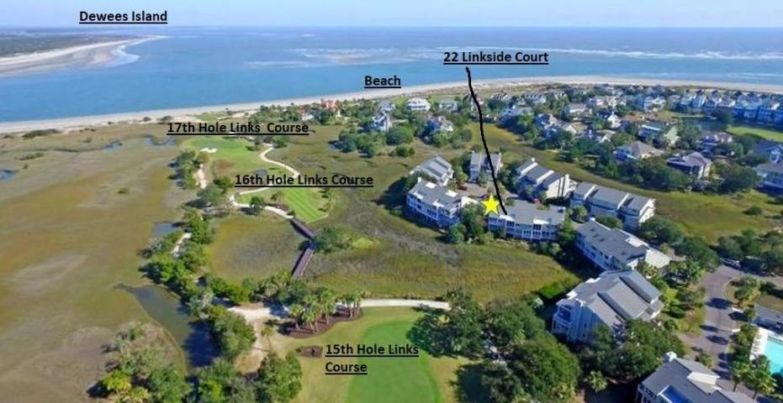
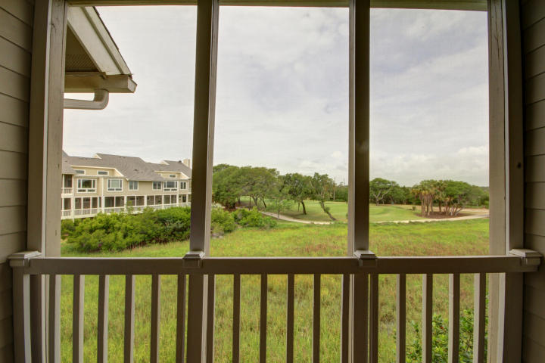
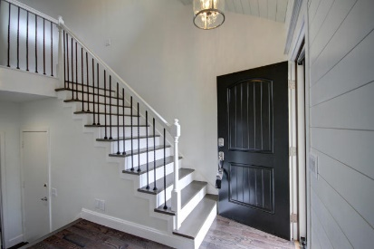
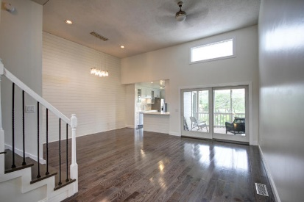
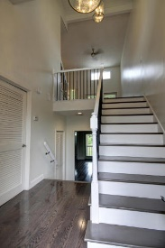
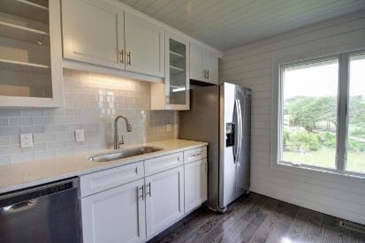
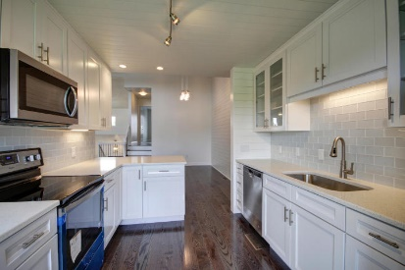
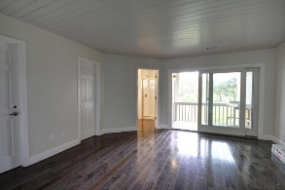
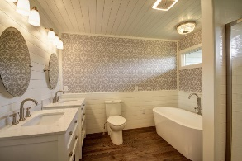
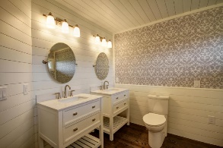
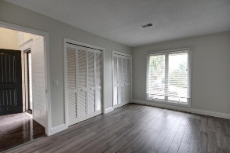
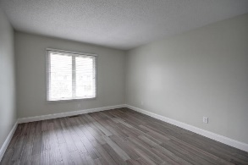
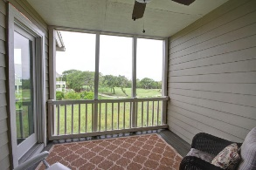
Like New 3Bd/3Ba Furnished Townhouse
On The 15th Hole of the Links Course
Liz Lyman
(843) 732-0017
liz.lyman@exprealty.com www.exprealty.com
22 Linkside Court | Wild Dunes | Isle of Palms | MLS# 18013389 | $659,000
Completely updated!! NEWLY FURNISHED!!
Amazing 3 bedroom 3 bathroom townhouse located in Linkside Villas in Wild Dunes Resort. This townhouse is a must see!! Too many upgrades to list. All new appliances, custom Craftmaid slow close cabinets, gorgeous quartz countertops. Bamboo and Oak flooring throughout.
All bedrooms have a private full bath. The Master Bedroom sports dual vanity, stand alone tub, and separate shower. Lots of storage and closet space. Incredible marsh views and the greens of the 15th hole.
With this location you are walking distance to golf, tennis, restaurants, and the BEACH!! Linkside also has their own private pool and 2 tennis courts! **All furniture included in sale price** Possibly one of the best deals in Wild Dunes!!!
eXp Realty Charleston · 711 Fairview St · Fountain Inn, SC 29644

