Slide 1
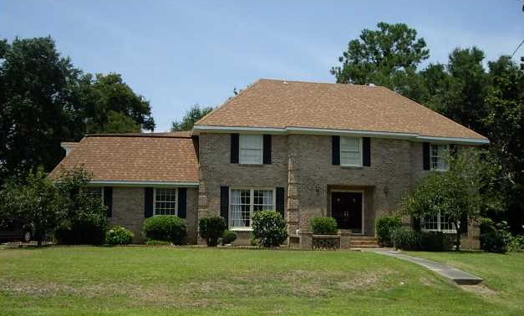
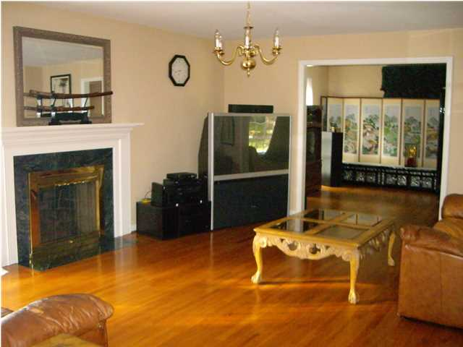
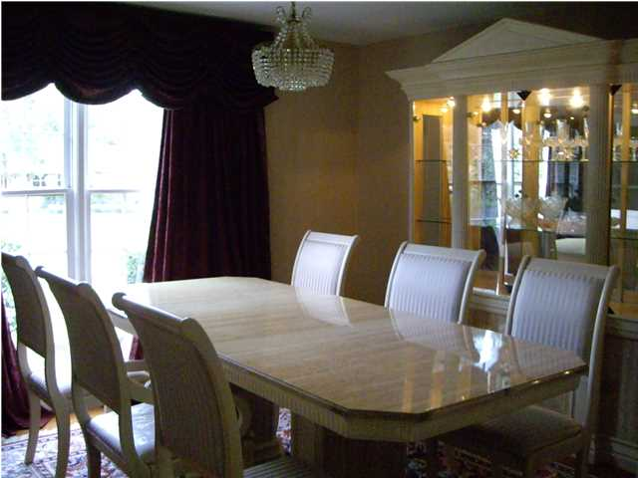
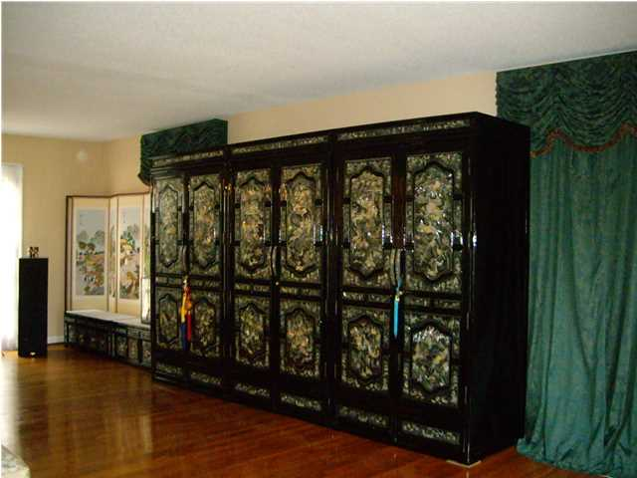
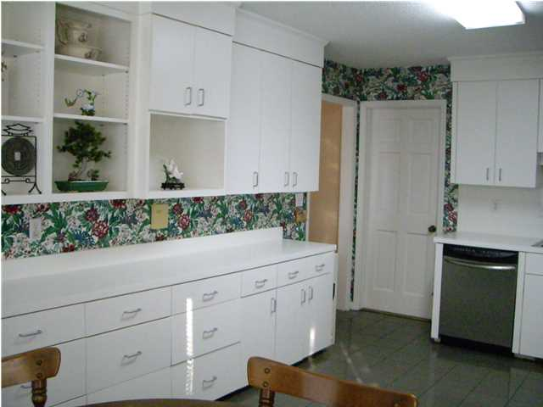
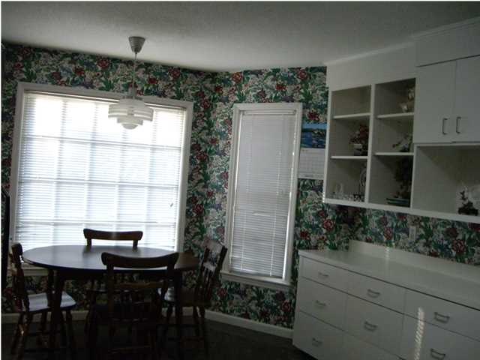
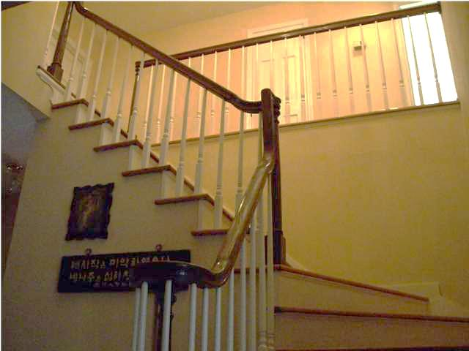
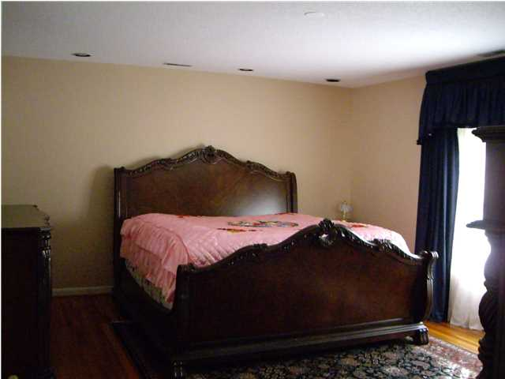
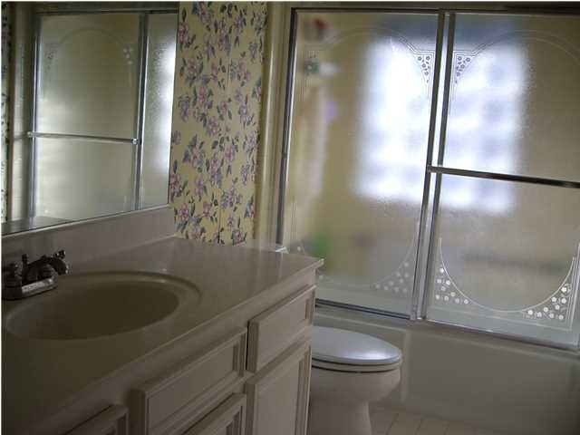
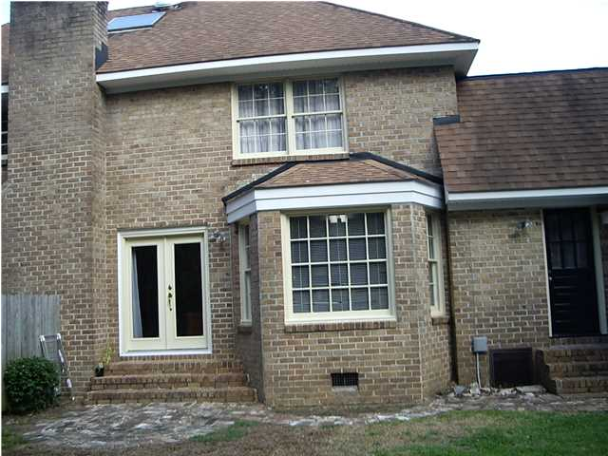


Open House Wednesday August 20th ~ 2-4 22 Old English Dr Wespanee Plantation Charleston, SC 29407 MLS# 1420249 ~ $450,000
Large two story brick home in Wespanee Plantation. Large Formal Living Room, Family room with fire place. Formal dining room and eat-in Kitchen with tile floors and custom made cabinets. All hardwood throughout the house except the frog. Upstairs has Large Master Bedroom with office or Sitting Room and bathroom with Jacuzzi Tub and Separate Shower, Walk in Closets. Two other large Bedrooms and a full bathroom upstairs. There is extra bedroom over the garage perfect for teenager. The garage was converted to Game Room. The house was Renovated in 1999 by previous owner. Wespanee Plantation is a great neighborhood, close to downtown Charleston, St. Francis Hospital, Airport, I-26 and Beaches. If you are looking for a large spacious home in a Convenient location with a great price this is it. Thank you for showing.
Cathy Rosenblum
843-817-7869
crosenblum@comcast.net

