Slide 1
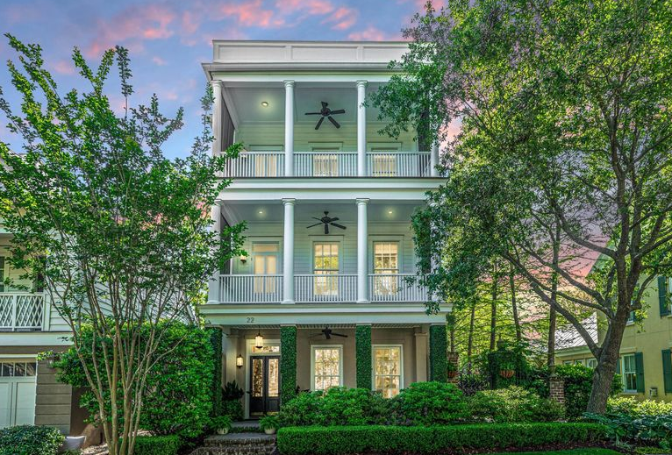
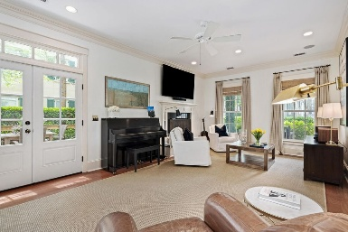
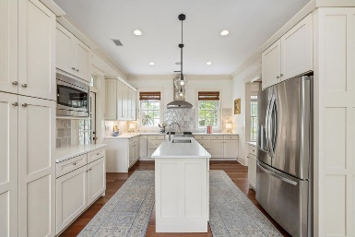
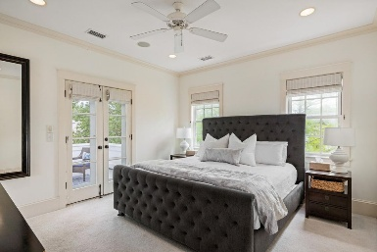
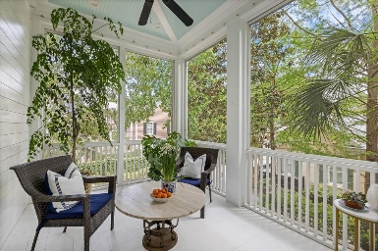
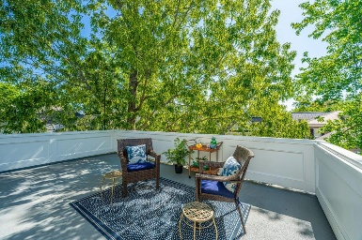

22 Fairhope Road Ion | Mount Pleasant, SC 29464 MLS# 25010856 | $1,945,000
OPEN HOUSE WEEKEND
Saturday, May 3 from 12-4 & Sunday, May 4 from 1-4
Welcome to 22 Fairhope, a Lowcountry gem in I'On, Mt. Pleasant, SC. This beautiful 3-bedroom, 5-bathroom home is perfect for entertaining and everyday living. Just steps from a marsh-front walking trail leading to the I'On boat docks and Creek Club, you'll have access to dog parks, playgrounds, and community lakes. The spacious entertainment room features French doors leading to a lovely courtyard with English boxwoods. The first floor includes a primary suite with a large walk-in closet and ensuite bathroom. The second floor boasts a chef's kitchen, formal dining room, bright living room, screened porch, and front porch with elevated views. The third floor features a second primary suite, an additional bedroom, and a versatile landing space, all offering stunning views. *Agent is owner.
Kathryn Martin 704-654-9730
kathryn.martin@carolinaone.com
Carolina One Real Estate
195 W Coleman Blvd
Mt Pleasant, SC 29464-3495

