Slide 1
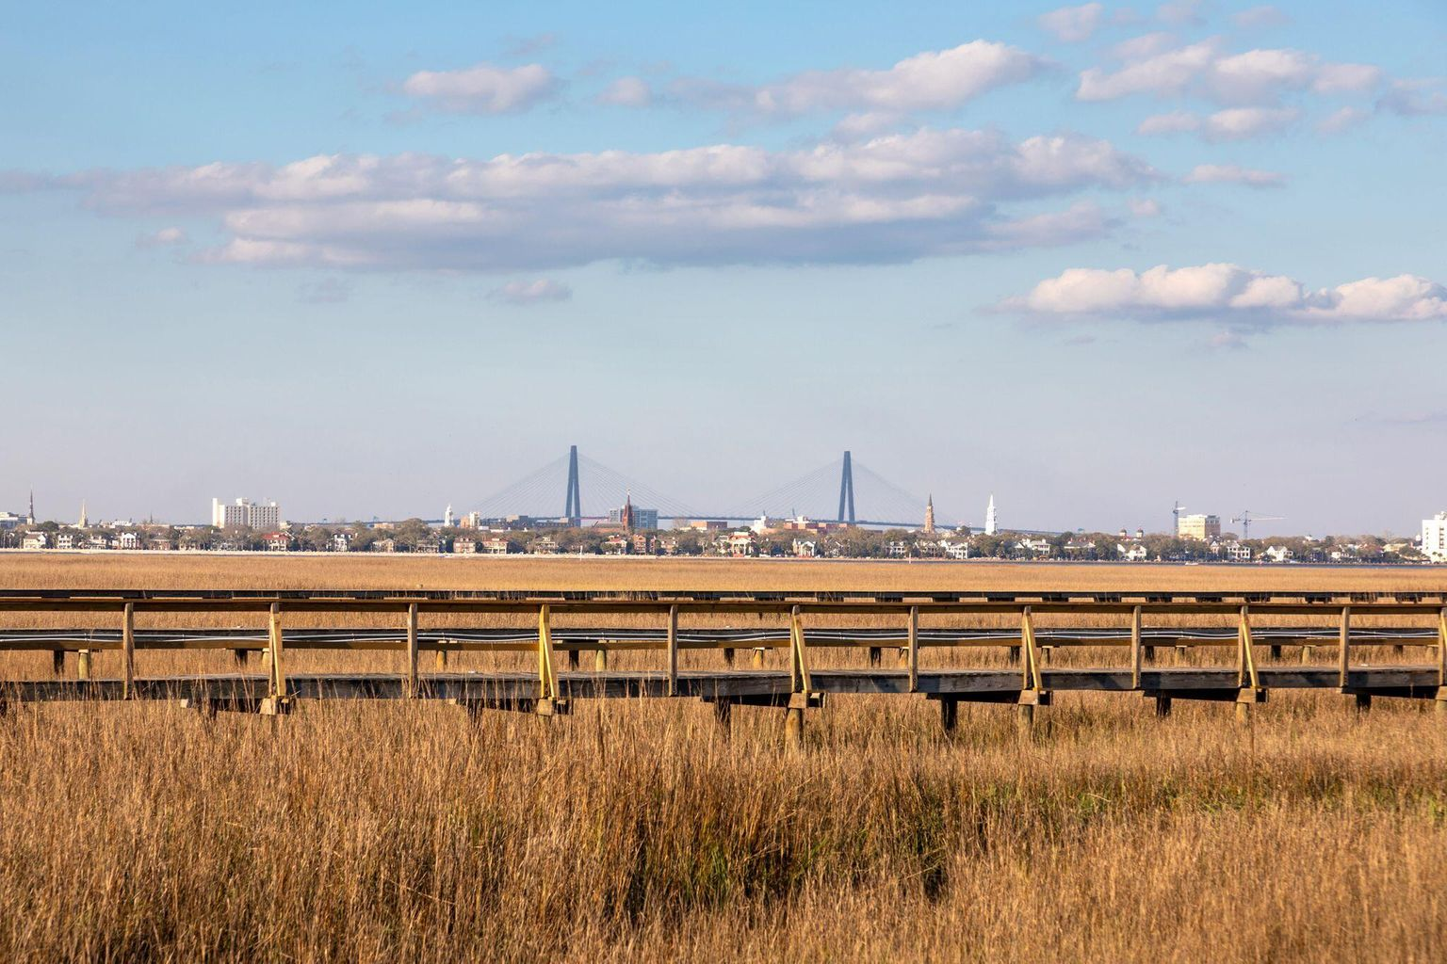
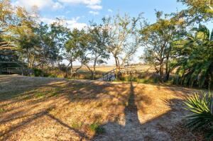
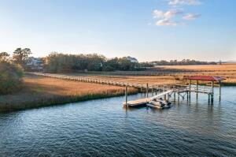
HUGE PRICE REDUCTION
Last Buildable Lot In This Exclusive Community
Breathtaking Views Of The Holy City
3 Minutes To Downtown
Dock In Place
22 Old Summer House Road
Point Verona
Charleston, SC 29412
MLS# 22006728
Now $1,369,000
Welcome Home to 22 Old Summer House Road, where the beauty of the Lowcountry is wrapped up in the most surreal setting. Surrounded by water all around and a private dock that is already completed, this is your opportunity to build your dream home on one of the most incredible lots, in a private, gated-community, 3 minutes from Downtown Charleston. This is the LAST buildable lot in this gated, exclusive neighborhood! Enjoy kayaking, boating, paddle boarding, fishing, and all things water while being so close to the city. The views of the churches and downtown city scape will take your breath away.
**Pre-approved House Plans in documents-convey with acceptable offer**
Kara Delpino
(843) 860-4166
kara@hbrtwn.com
www.karadelpino.com
Harbourtowne Real Estate
672 Marina Drive, Ste 110
Daniel Island, SC 29492

