Slide 1
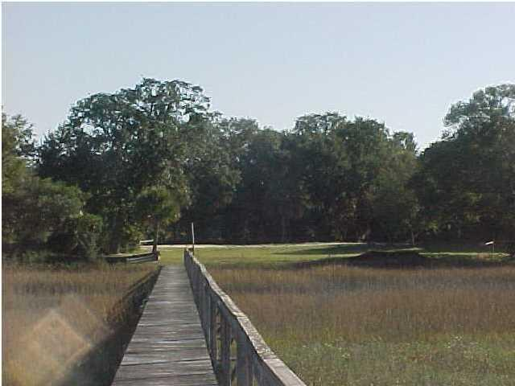
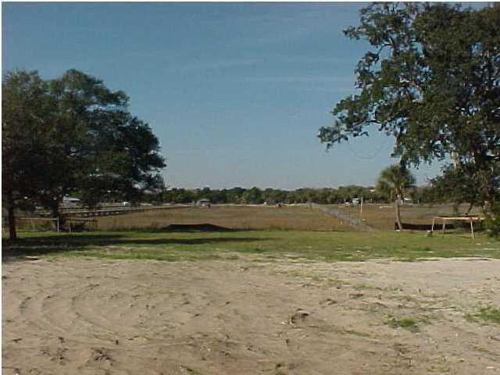
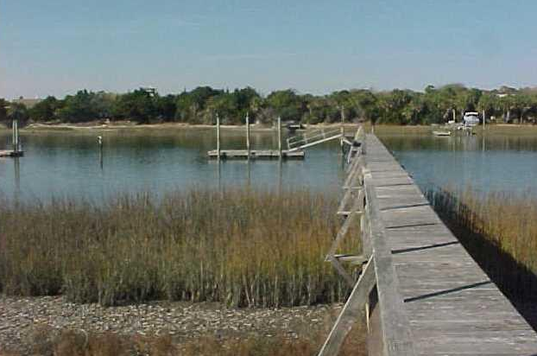

Large one acre lot on deepwater with private dock.
2301 Waterway Boulevard Isle of Palms, SC 29451 MLS# 1406814 ~ $2,200,000
Holly Covington
Office - 843-971-1312 Mobile - 843-442-4560
hcovington@thebeachcompany.com

