Slide 1
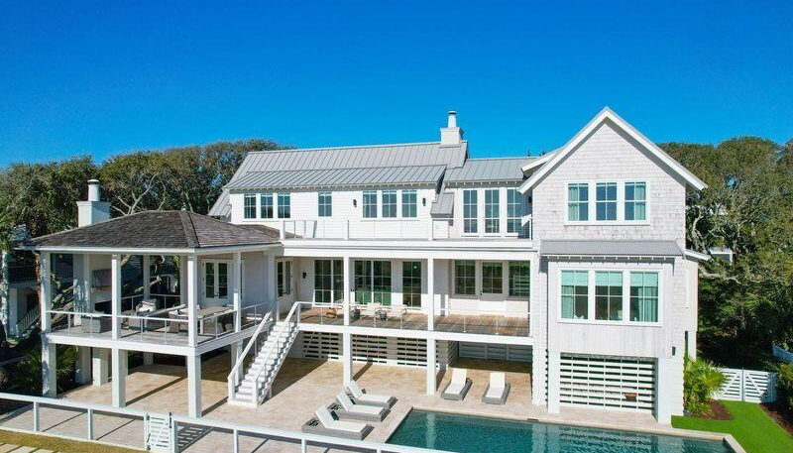
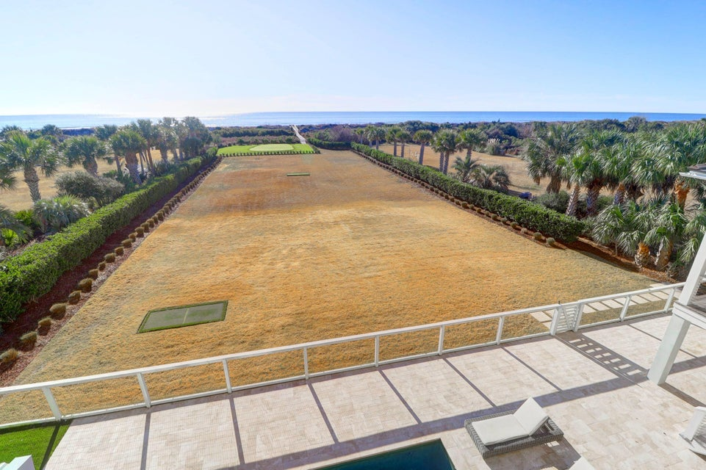
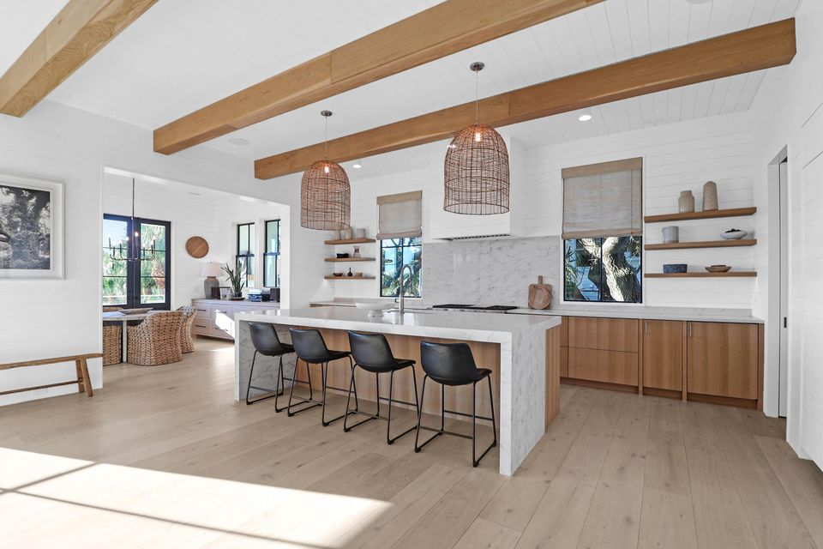
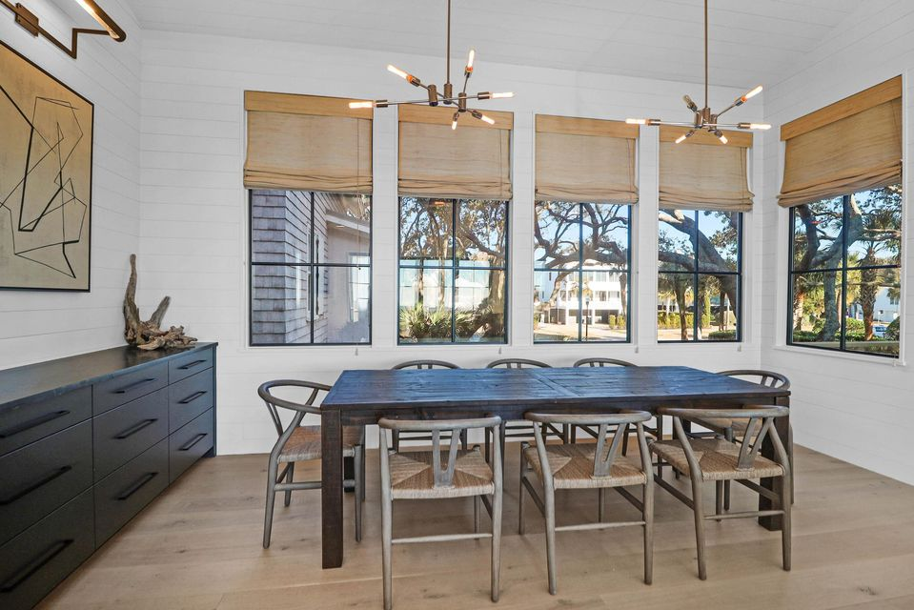
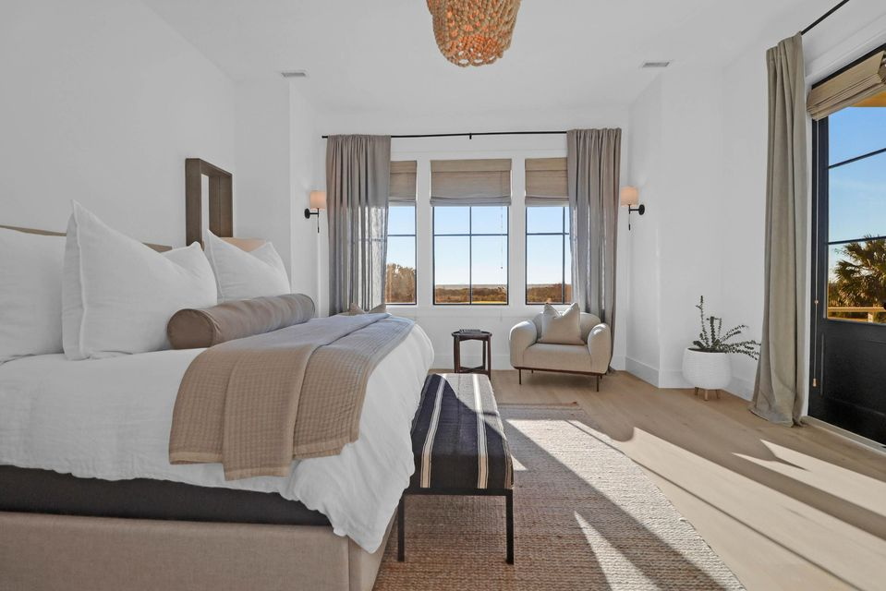
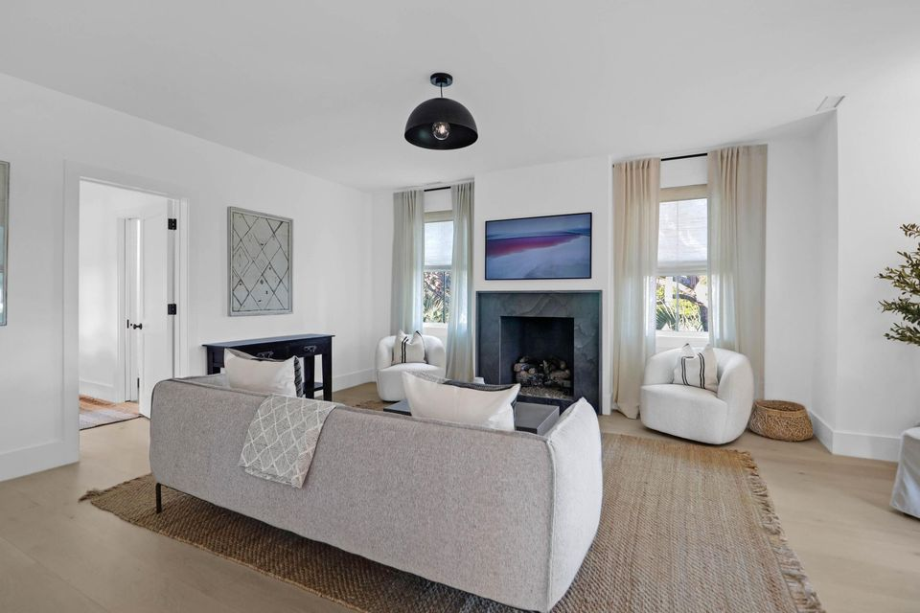
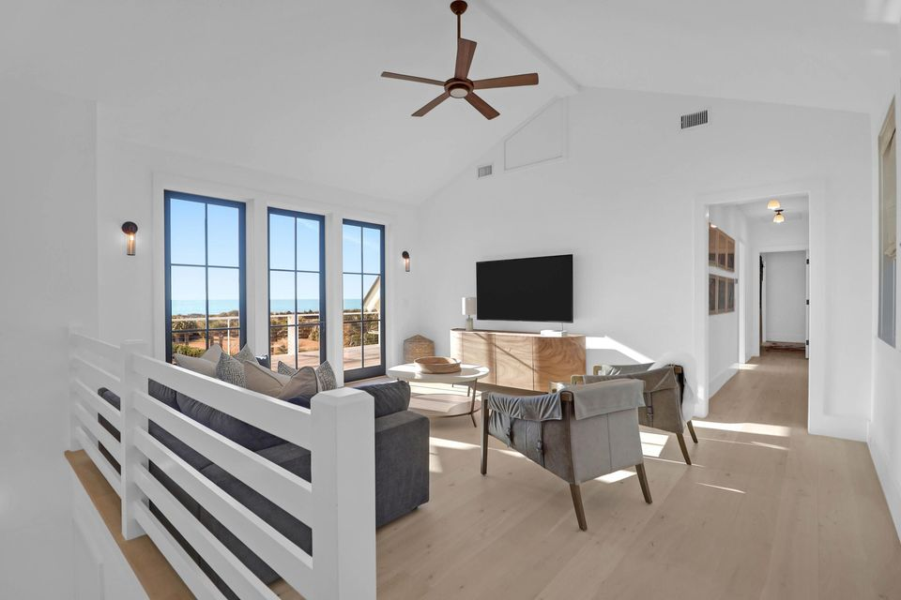
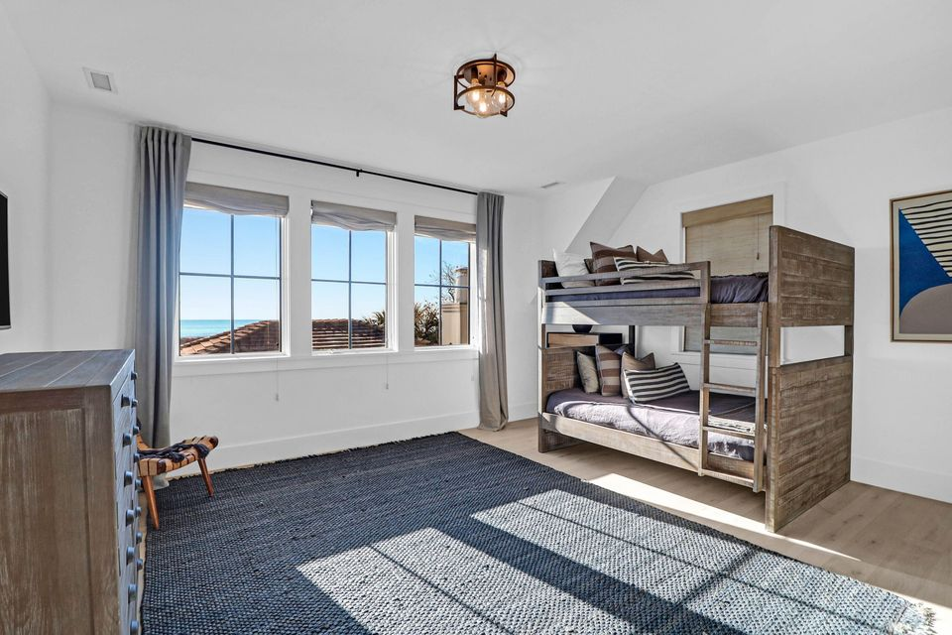
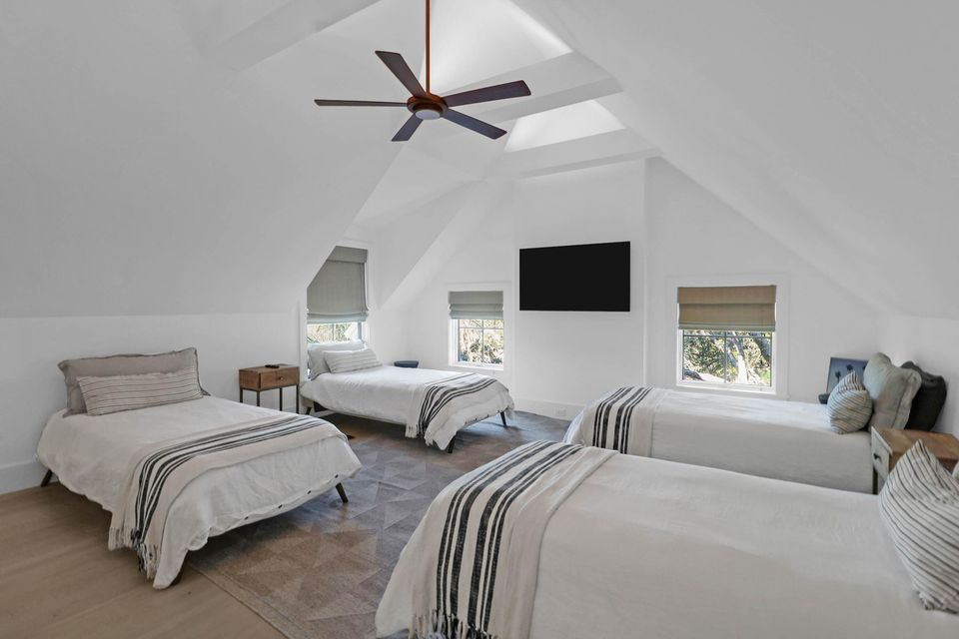
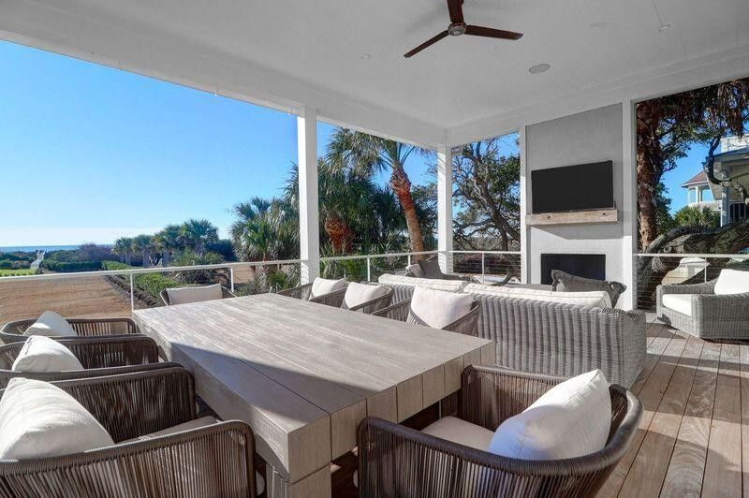
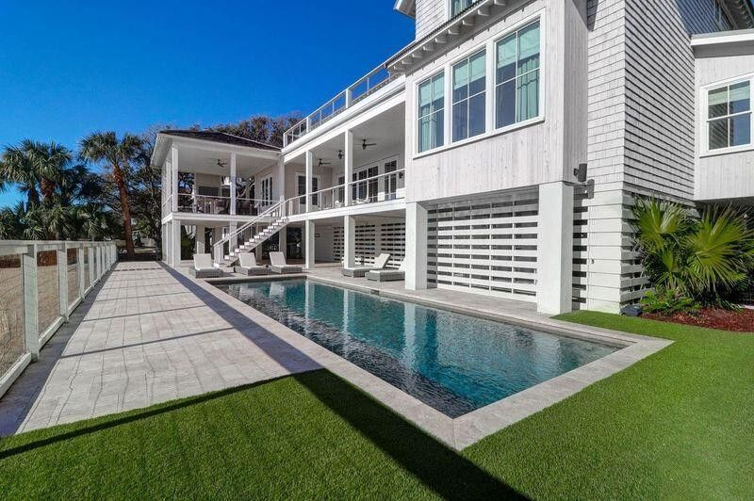
Custom Oceanfront Home on 1.97 acres
Price Reduced
2302 Palm Boulevard
Isle of Palms, SC 29451
MLS# 25003090 | $8,195,000
This incredible beachfront residence located OCEANFRONT on the Isle of Palms truly is the best of the best. Designed by the renowned architect Heather Wilson and custom built by Tiller Construction, this 6-bedroom, 6.5-bathroom home will wow your clients at every turn. Inside, the home is custom from head to toe, with an oversized great room featuring wide plank wood floors and a cozy fireplace that flows into the chef's kitchen, complete with subzero and wolf appliances and a center island ideal for entertaining. The luxurious master suite, located on the first floor, has amazing ocean views, custom built in cabinets, large walk-in closet and an amazing shower with full ocean views. Please don't compare this home to other/past IOP oceanfront homes. This lot is 112 feet wide and boasts 1.97 acres. Due to the rare lot width, the home was design for VIEWS. Which you will find from almost every room in the house. Upstairs features an open den with porch access, along with 3 additional guest bedrooms with ensuite bathrooms. The main floor also has an attached guest cottage with separate lock out entrance. The guest cottage features 2 BR and 2 BA, along with guest den and fireplace... and don't forget the wet bar. Where do we start with the amazing exterior of this home? The well-appointed landscaping, featuring the charm of live oak trees, in-ground pool, travertine patio, outdoor fireplace and amazing brick driveway, is well thought out in every direction. Last but not least, any golfers out there? Wait until you see the full sized green and chipping area, along with 2 tee boxes to work on your wedge game. Don't let your clients miss out!!
Jamie Hollingsworth
843-442-6492 | iopsold@aol.com
Salmonsen Realty | 864 Lowcountry Blvd Ste B | Mt Pleasant, SC 29464

