Slide 1

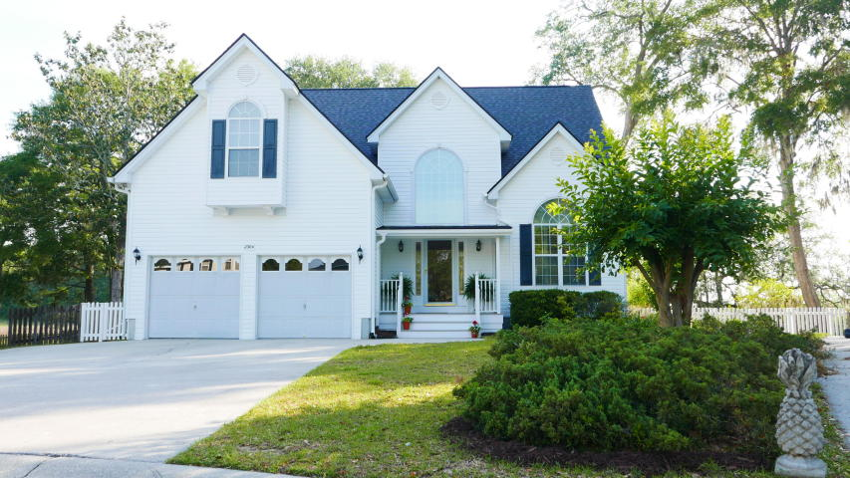
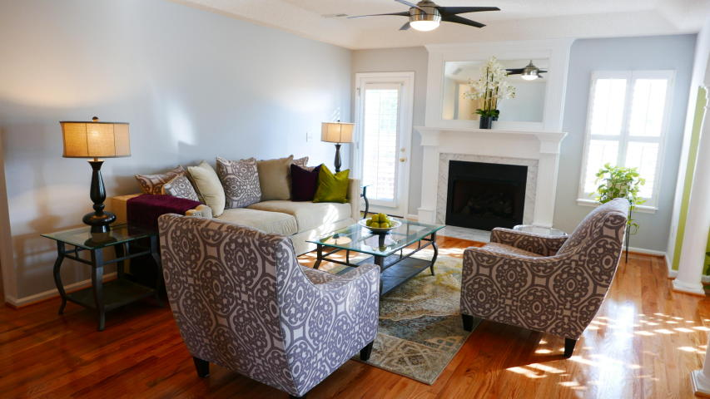
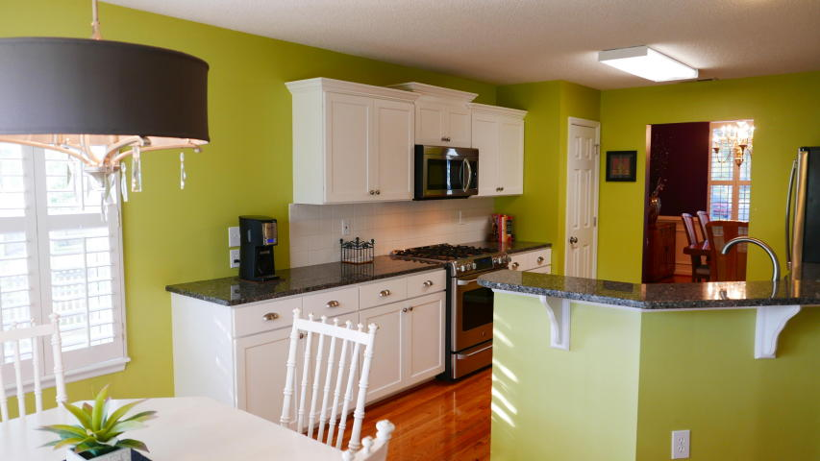
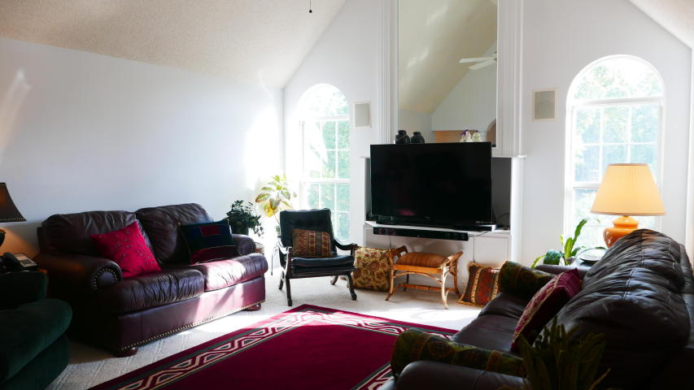
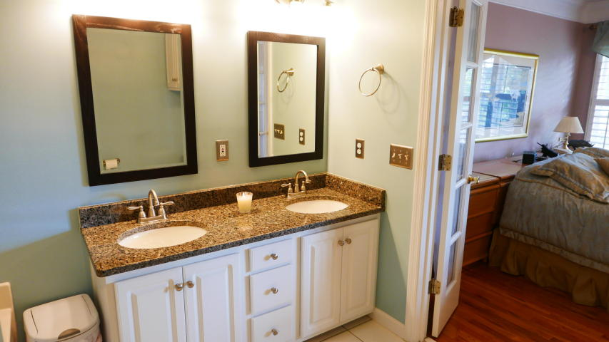
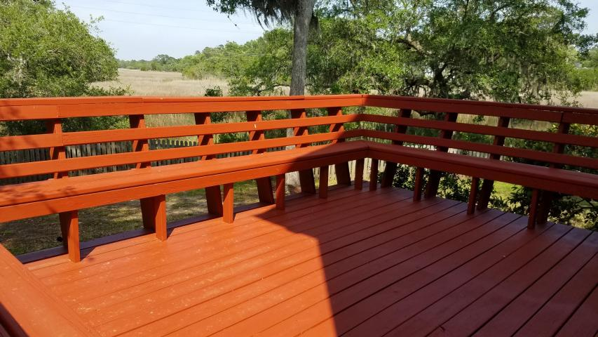
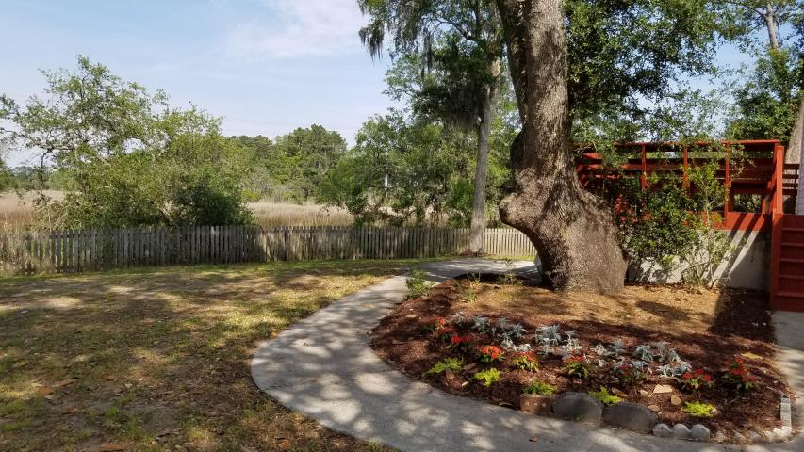
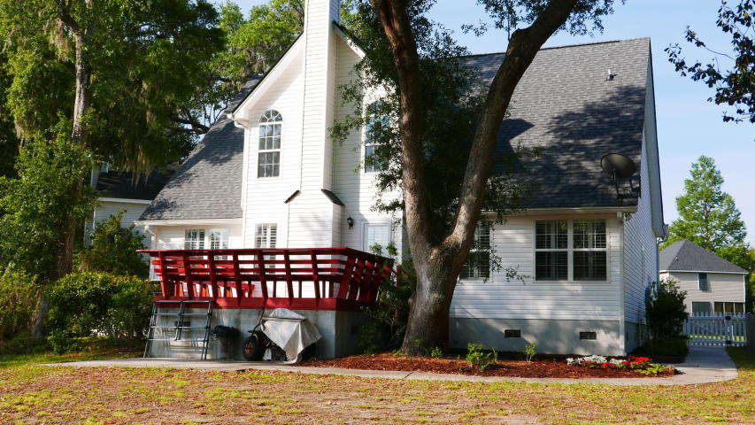
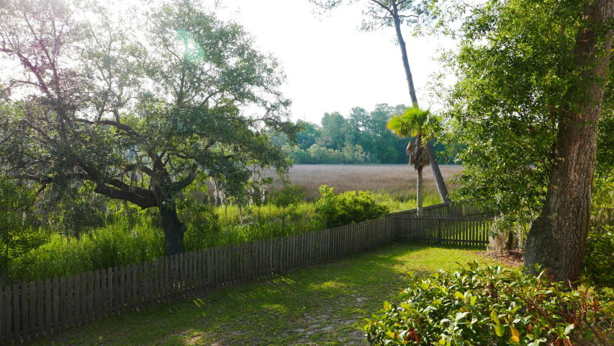


2304 Marsh Lake Court
Asheford Place at Canterbury Woods ~ Charleston, SC 29414 MLS# 17013372 ~ $355,000
BEAUTIFUL MARSHFRONT HOME in IMMACULATE move-in condition has so many UPGRADES!!! Views are amazing and on a high tide you may see kayaks floating by. 1 YEAR OLD ROOF! PLANTATION SHUTTERS on most windows! UPDATED KITCHEN has GRANITE countertops & STAINLESS appliances-love the GAS RANGE!!! This 4 Bedroom home has loads of closets as well as attic storage. HARDWOODS IN ALL OF DOWNSTAIRS look as if they're brand new. Downstairs Owners Suite includes walk-in closet, double sink vanity, separate shower & whirlpool tub!!! Upstairs are 3 more bedrooms and a super large family room. Great Room downstairs has a gas fireplace and is open to the kitchen and breakfast dining area. HUGE DECK is on a sturdy concrete foundation & has wonderful built-in seating. Fenced backyard, Crown Molding, Wainscoting in Dining Room, Remote-controlled shutter over tall foyer window, Flush-mounted speakers in some rooms, Concrete Patio and walkway, range/built-in microwave vent goes outside rather than back into kitchen, Etc..too much to list. You really must see this home in person to fully appreciate what it has to offer!!!
David Andrews
(843) 452-0113
charlestonda@gmail.com
AgentOwned Charleston Group • 902 Savannah Hwy. • Charleston, SC 29407
Real Estate • Mortgage • Insurance

