Slide 1
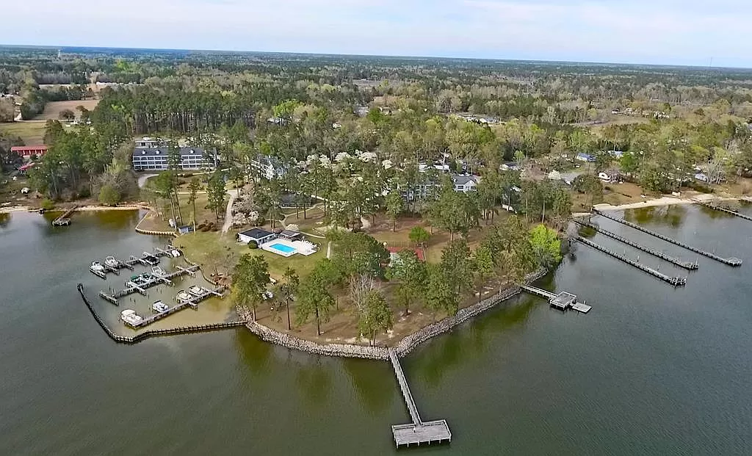
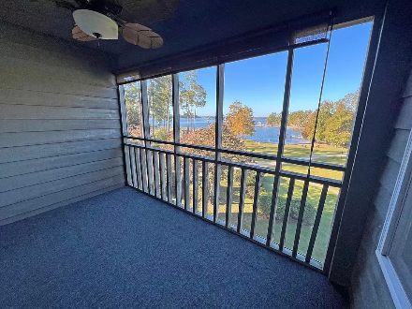
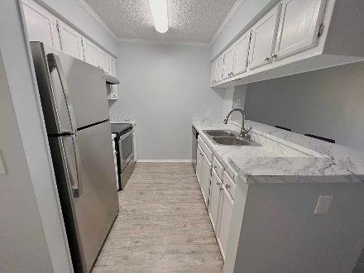
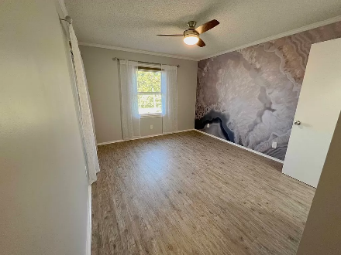
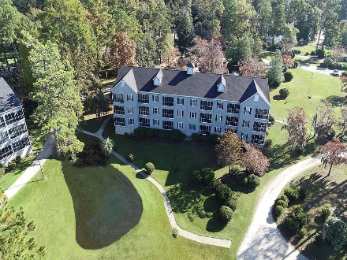

Lake Retreat
2304 Cypress Pointe #B304
Manning, SC 29102
MLS# 161612 | $198,000
Stunning Waterfront Condo on Tranquil Lake Marion. Nestled in the heart of the scenic Lake Marion community, this exquisite waterfront condo offers a rare opportunity to embrace the serene lakefront lifestyle you've always dreamed of. With breathtaking views of the shimmering Lake Marion, this property is a haven of relaxation and natural beauty. This gated condo complex host 2 day docks, fish cleaning station, pool, clubhouse, tennis courts and breath taking views. Lake Marion is a beautiful and diverse natural resource, offering a wide range of recreational opportunities and a picturesque setting for those who enjoy outdoor activities and lakeside living. Marina available with waiting list. HOA covers Water, Sewer, TV & internet along with grounds maintenance and building insurance.
Lake Homes Realty, LLC
Elloree, SC 29047
www.SCLakeLife.com
Kristie Anderson
(803) 387-9459
kristie@sclakelife.com

