Slide 1
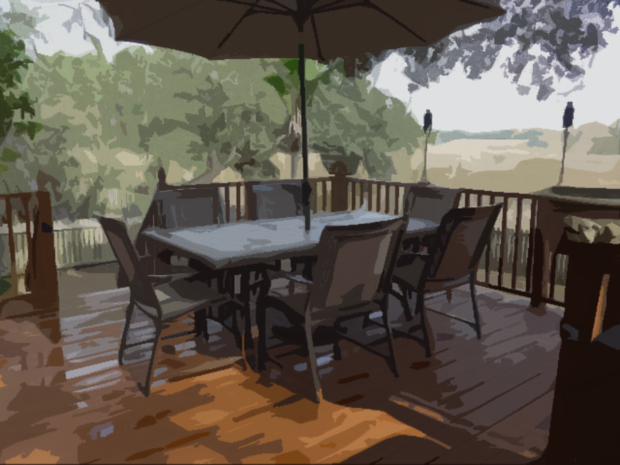
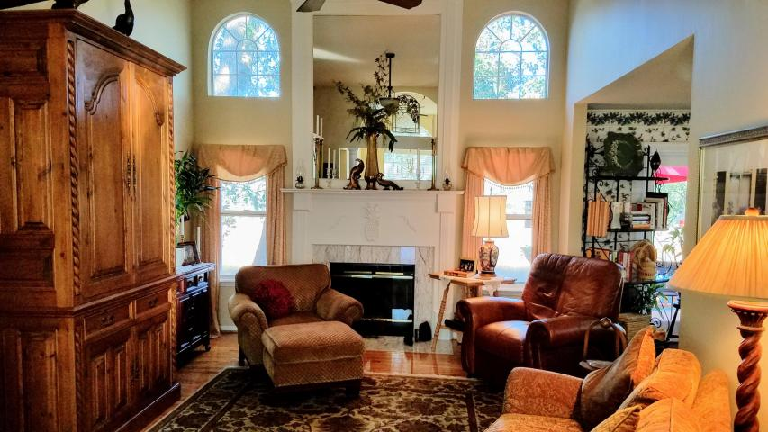
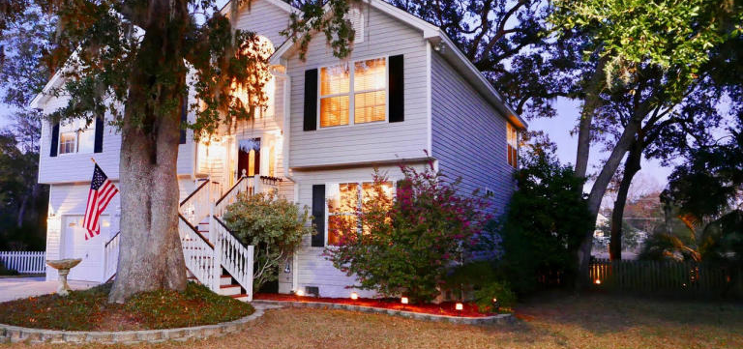
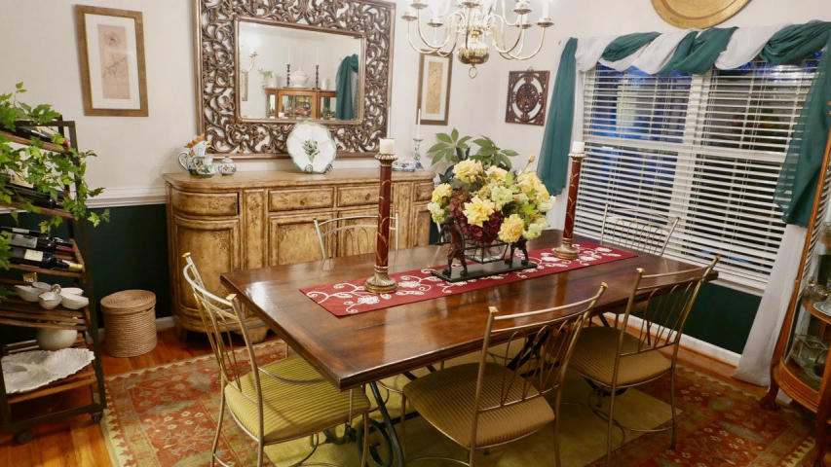
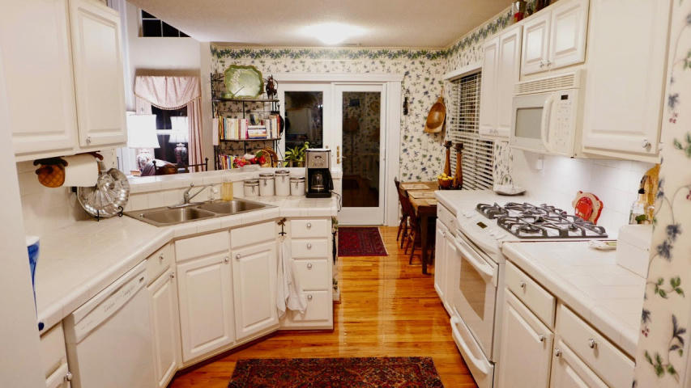
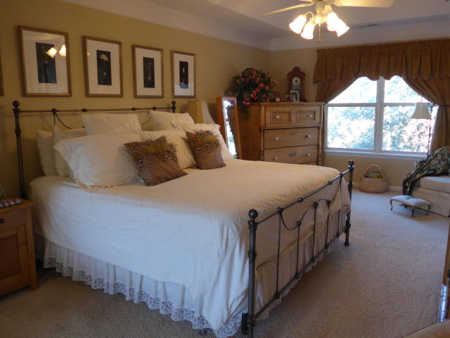
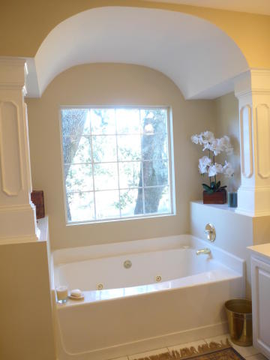
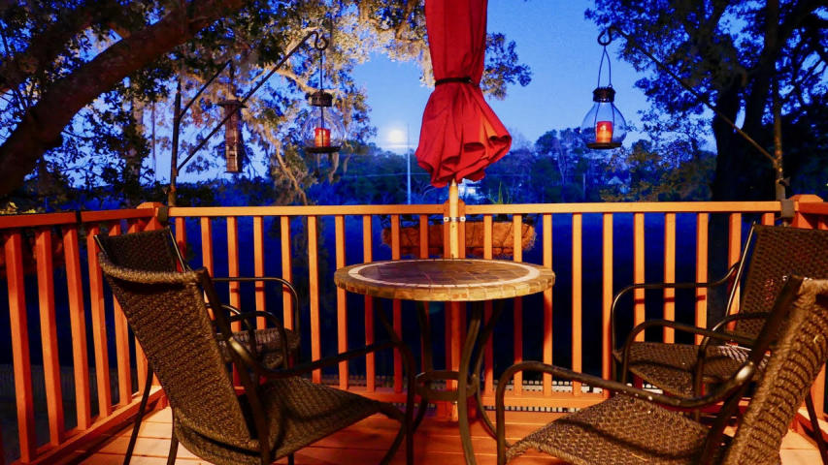
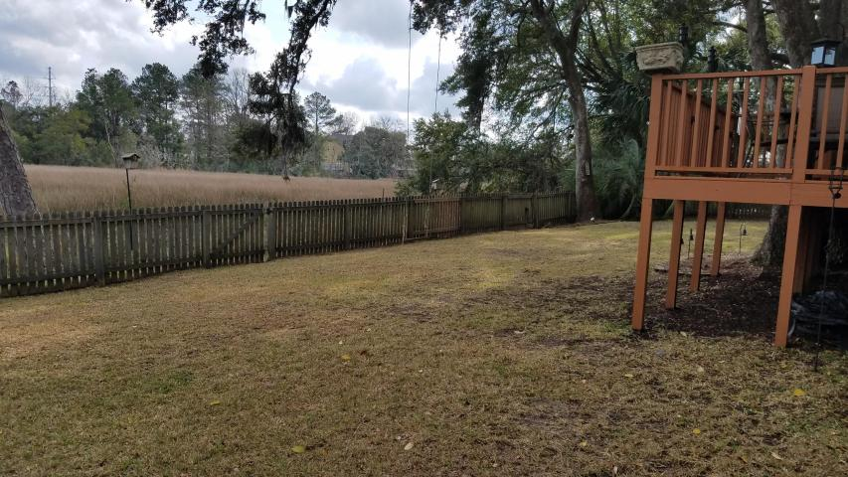


2306 Marsh Lake Court
Asheford Place at Canterbury Woods
Charleston, SC 29414 ~ MLS# 17003872 ~ $335,000
MARSHFRONT "Pineapple House"...lovingly named because of pineapple adornments. LONG-RANGE PEACEFUL MARSH VIEWS from almost every room! DECKS, DECKS & SCREENED PORCH for gathering family & friends ~ 4BR/3BA ~ HARDWOOD FLOORS lead into the home's grand foyer, great room, separate dining room, bright kitchen & breakfast area ~ super GAS RANGE, side-by-side refrigerator too! Great Room has a soaring ceiling & most majestic fireplace. GORGEOUS CHANDELIERS. Mother-in-law suite downstairs has 2 large bedrooms & a beautiful bath with awesome tiled shower!! Huge Master Suite upstairs has a sitting area, HIS & HERS CLOSETS. Spacious master bath has a whirlpool garden tub (with SPECTACULAR VIEWS), separate shower & double vanity. Fenced back yard is a bonus too! Quiet cul-de-sac. 2012 ROOF. NO HOA FEE. Loads of storage space throughout this home. HVAC under service contract...just serviced. NO HOA in this section of neighborhood but seller says you can choose to pay to join Canterbury Woods swimming pool. BRAND NEW SPRINGFIELD ELEMENTARY & MONTESSORI SCHOOLS RIGHT HERE IN THE NEIGHBORHOOD!!!
Barbara Harper
843-224-5759
Barbara.Harper@agentownedrealty.com www.ISellCharleston.com
AgentOwned Charleston Group • 902 Savannah Hwy. • Charleston, SC 29407
Real Estate • Mortgage • Insurance

