Slide 1
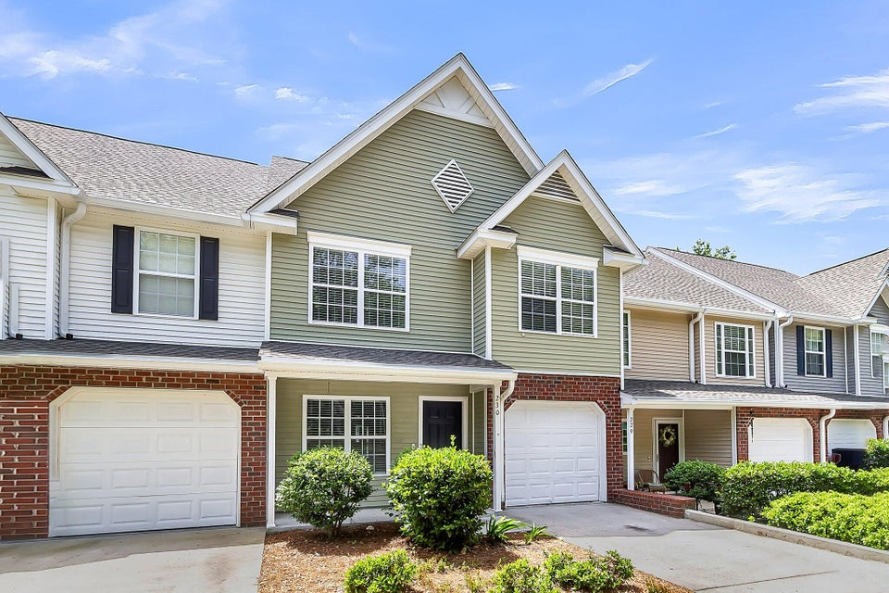
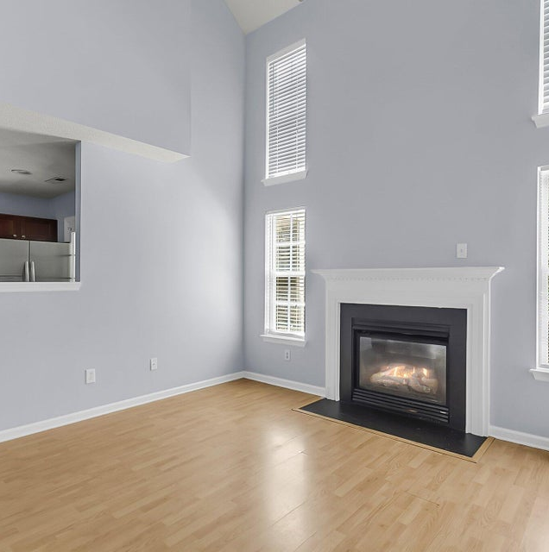
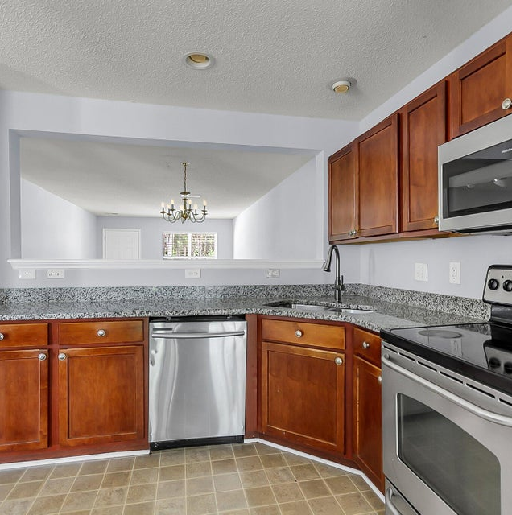

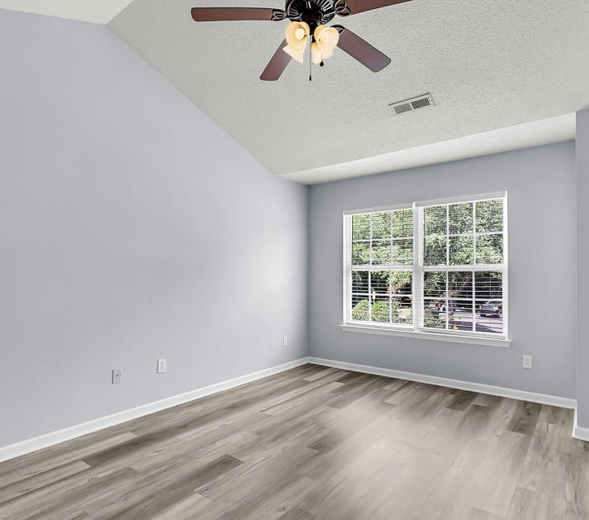
OFFERED AT AN EXCELLENT NEW PRICE!
$269,000
230 Darcy Avenue
Lakeview Commons
MLS# 25013957
Don't Miss This Fabulous Townhome In The Beautifully Designed Persimmon Hill Community.
®
PROPERTY FEATURES
listed exclusively by:
CHRISSY STRICKLAND
843-906-5553
chrissychsrealtor@gmail.com https://residerealestatellc.com/
3 Bedrooms
2.5 Bathrooms
1,542 Sq ft

