Slide 1
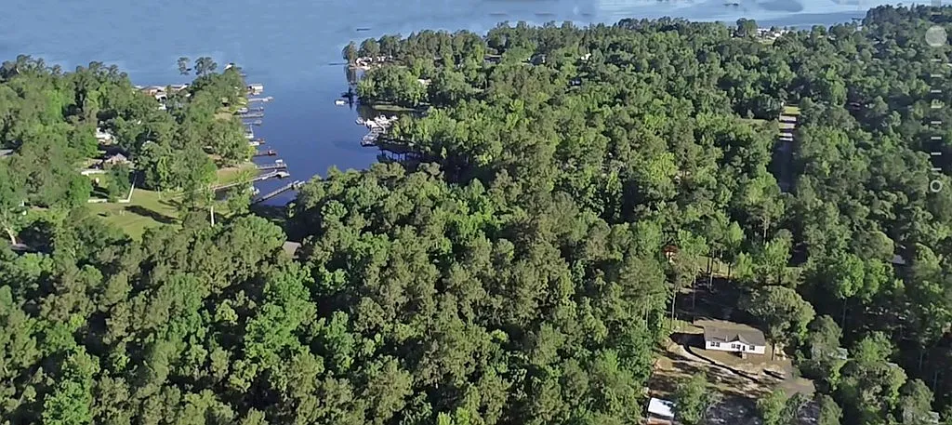
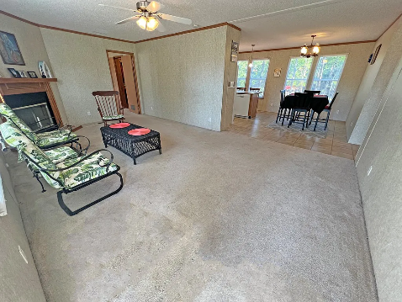
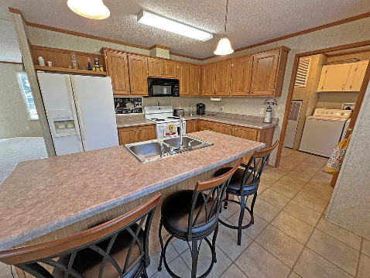
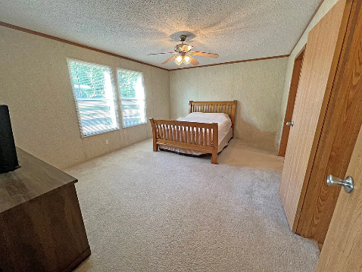
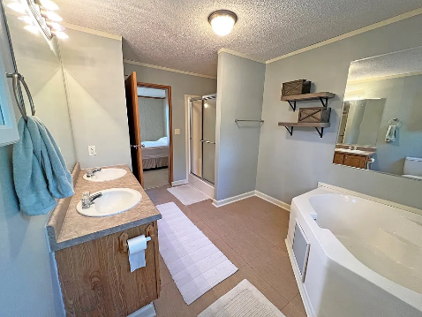
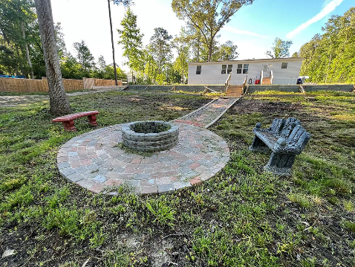
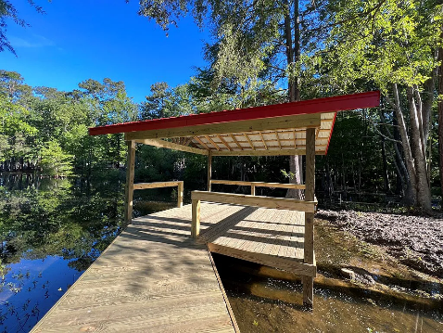
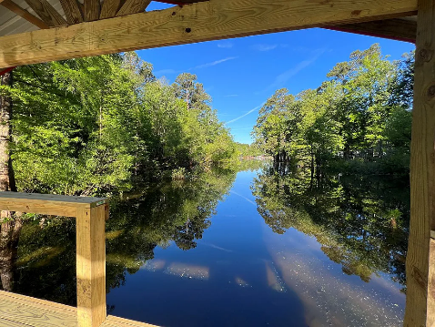
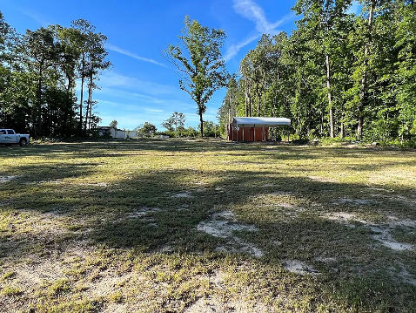

Waterfront Lake Marion
2310 Patriot Rd
Manning, SC 29102 ~ MLS# 156938 ~ $375,000
Over 1.5 Ac of waterfront property on Lake Marion. Newly built Dock, Firepit and seeded yard. Dock is 87ft long with a 16x16 pier head. The home sits on a deeded lot with a Santee Cooper Marginal (very common). Make this your full time home or just the weekend retreat.
Lake Homes Realty, LLC
Elloree, SC 29047
www.SCLakeLife.com
Kristie Anderson
(803) 387-9459
kristie@sclakelife.com

