Slide 1
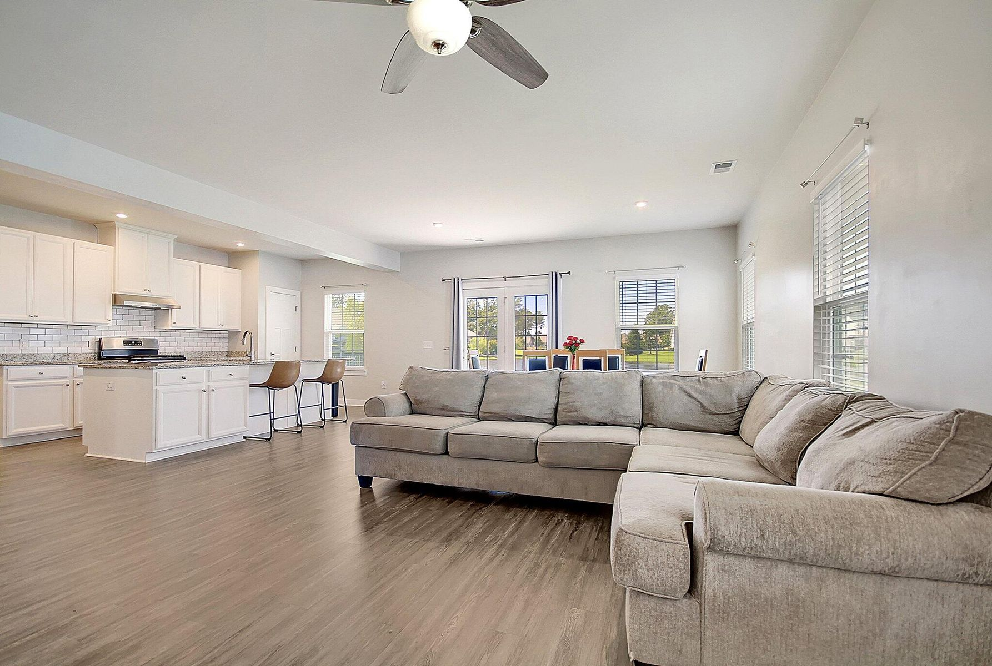
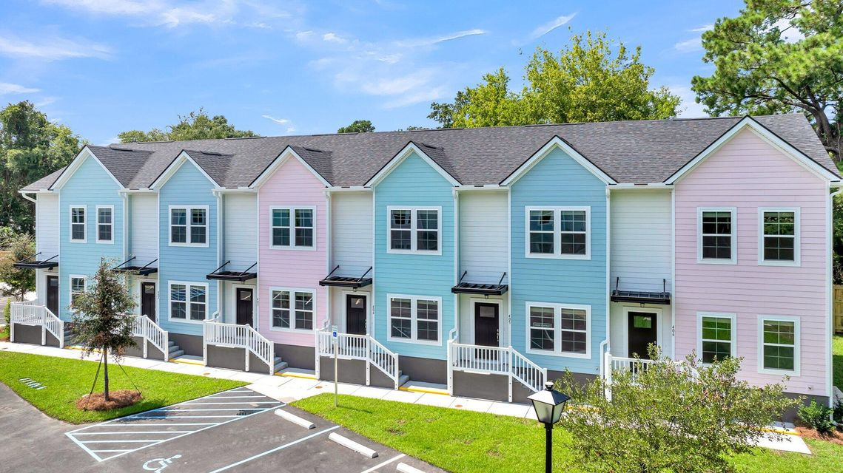
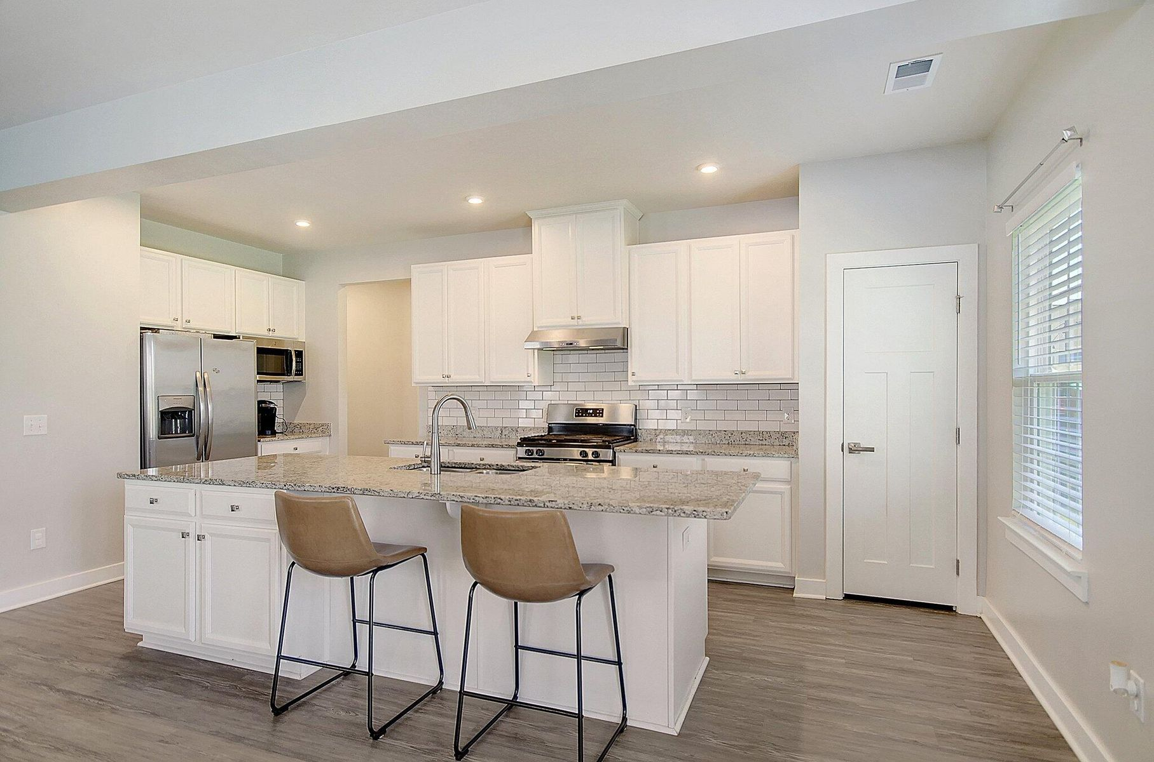
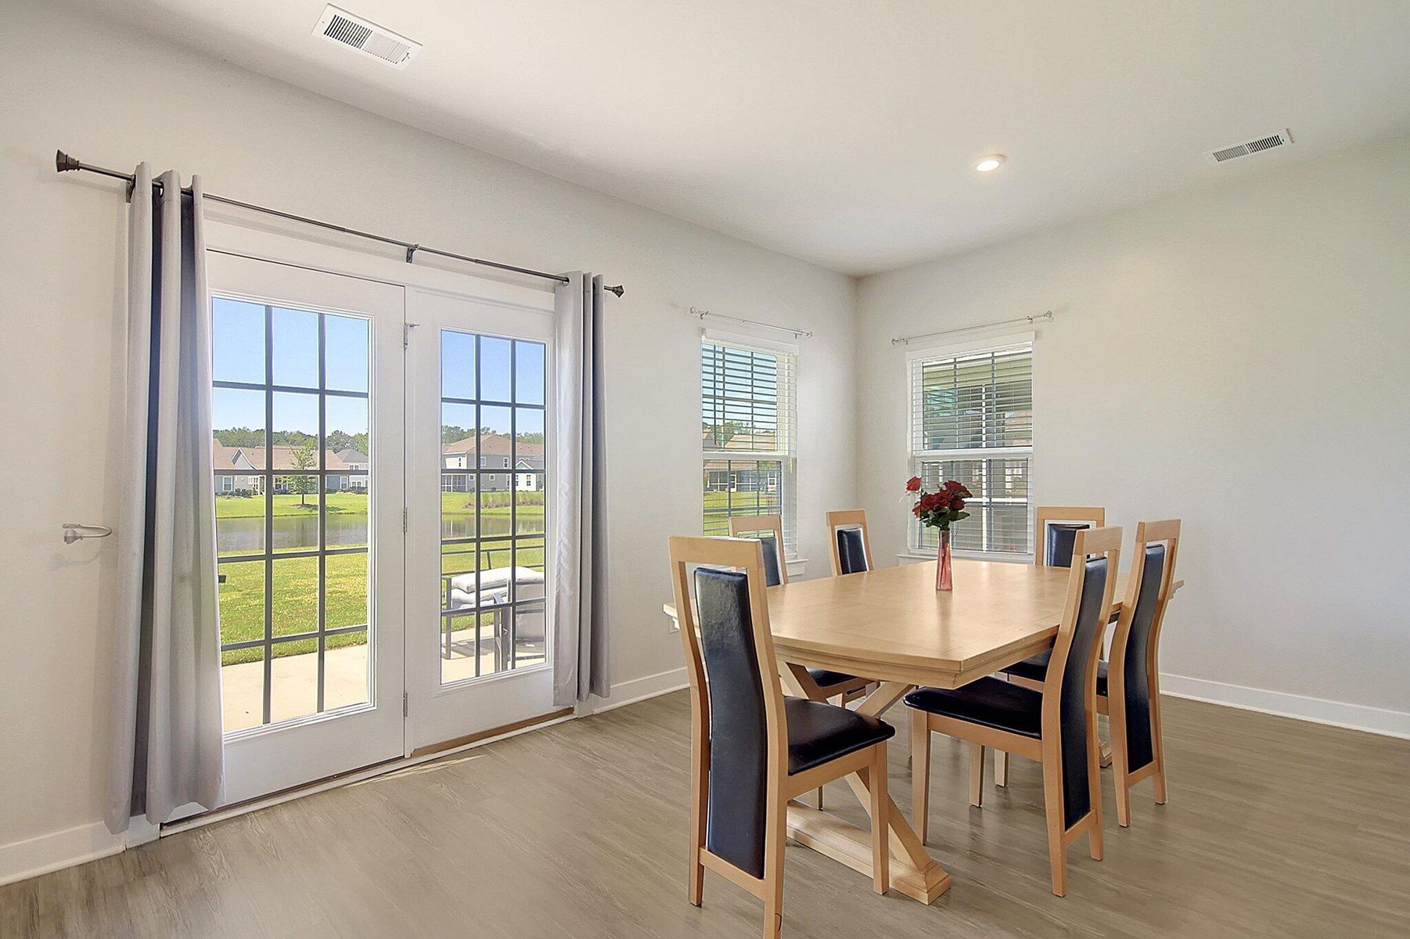
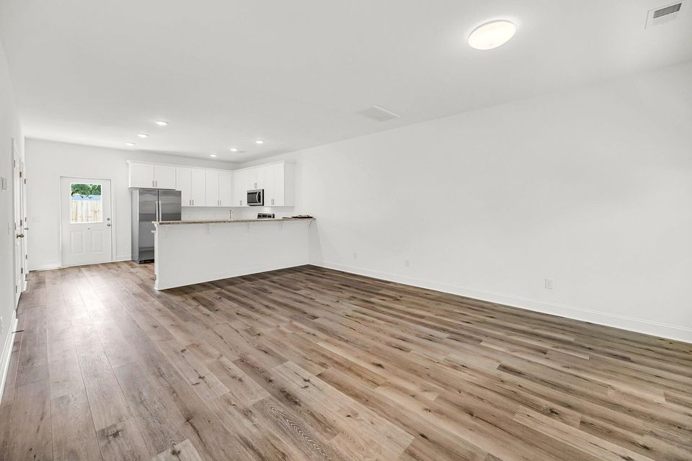
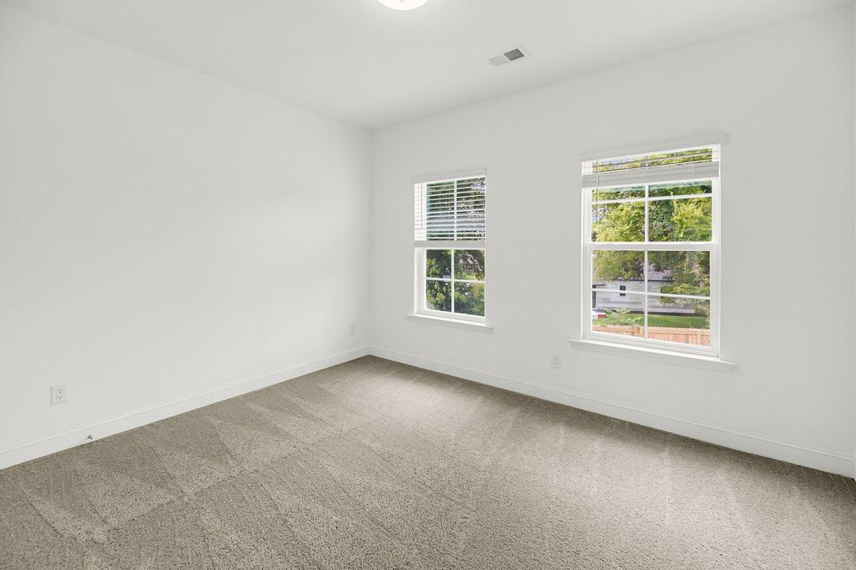
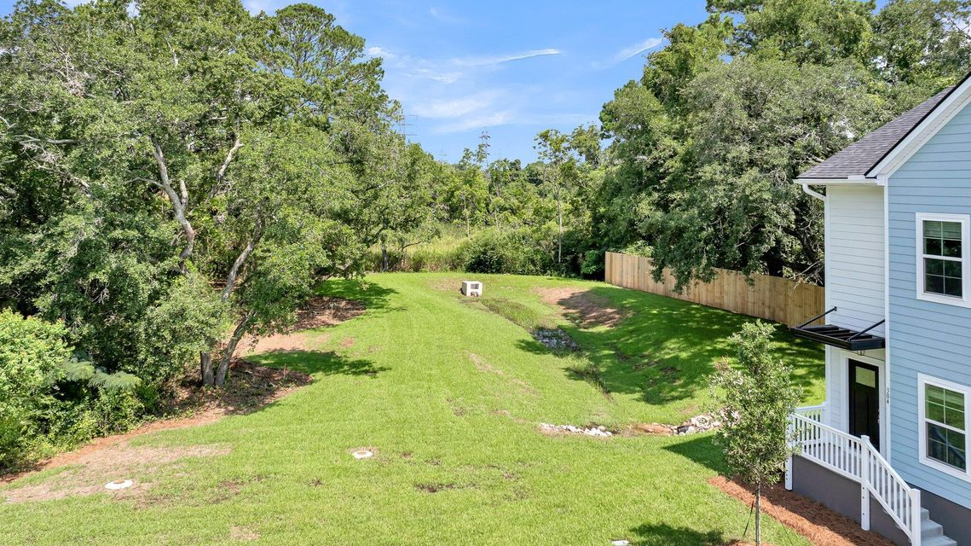


Open House Wednesday, April 2nd from 12-2
Light Refreshments will be served
2312 Meridian Road #2300
North Bridge Towns | North Charleston, SC 29405 | MLS# 24019638 | $279,900
Last home left!!! $5000 towards buyers closing costs for contract closing by April 15! Welcome to where opportunity and affordability meet, North Bridge Towns. This immaculate 3 bedroom room end unit home is ready for you. Featuring vinyl plank flooring, granite countertops, 42in upper cabinets with crown moulding, high ceilings, and all appliances including washer and dryer. You won't have to bring anything but your furniture and clothes. Truly low maintenance living. Buyers must meet income guidelines as well as other criteria to purchase. These include that buyers must owner occupy and cannot own another home. Buyers may qualify for additional down payment or other assistance to aid in their purchase. Please ask your agent for details.
Kashonna Wine
843-801-1874
kwine@exitlowcountry.com
www.exitlowcountry.com
Exit Realty Lowcountry Group | 3294 Ashley Phosphate Rd, 1-E | North Charleston SC 29418

