Slide 1
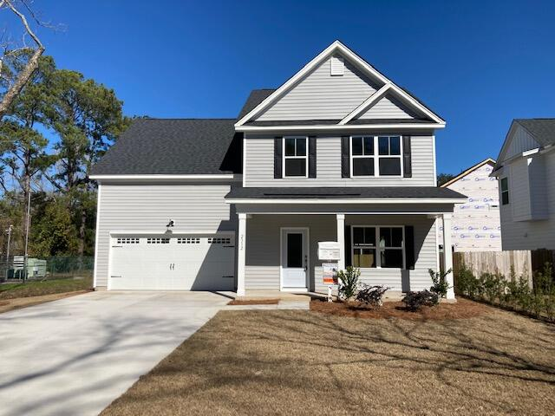
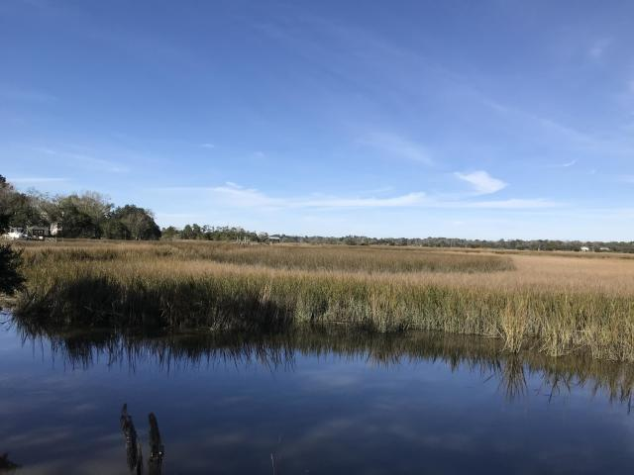
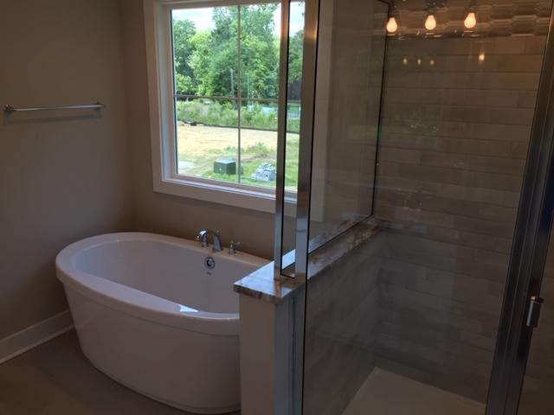
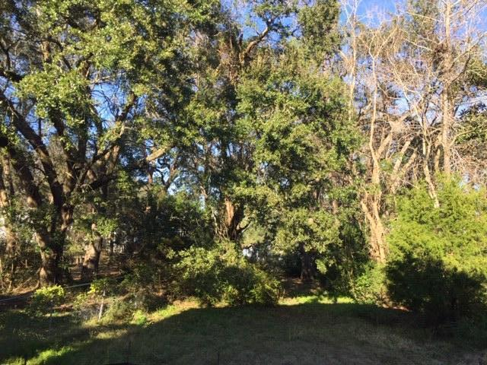
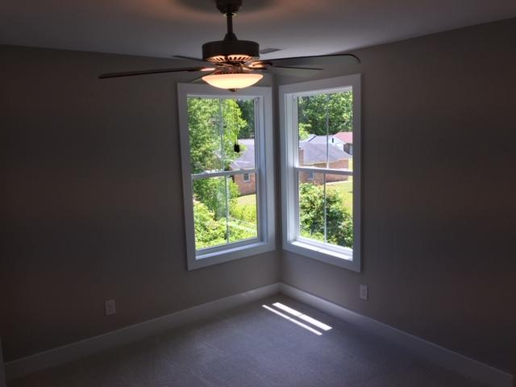
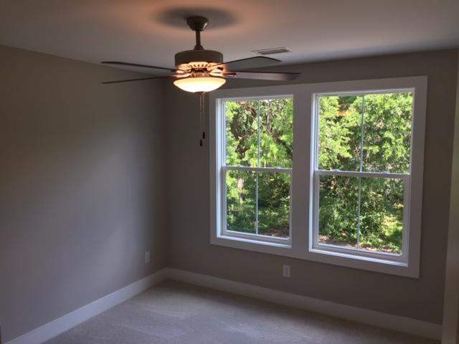
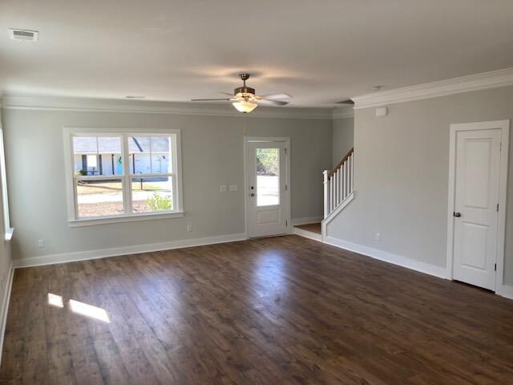
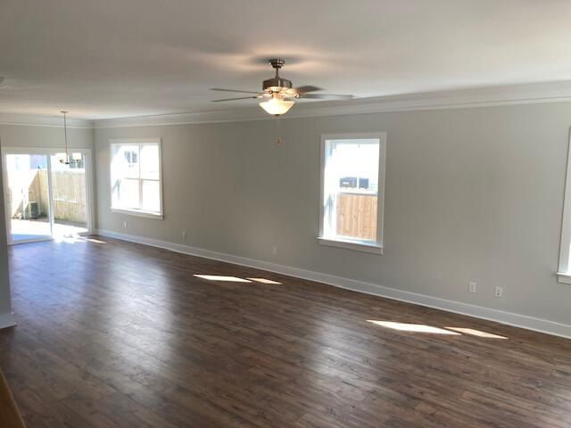
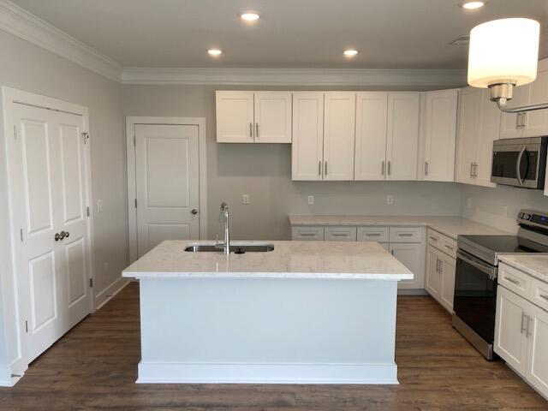
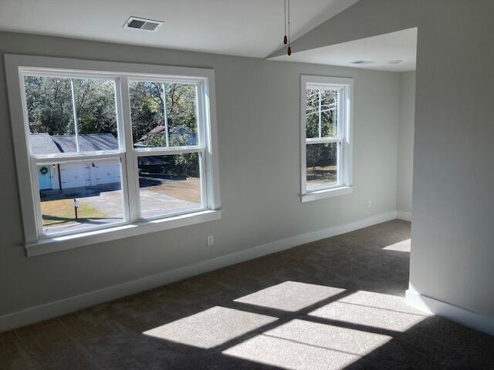
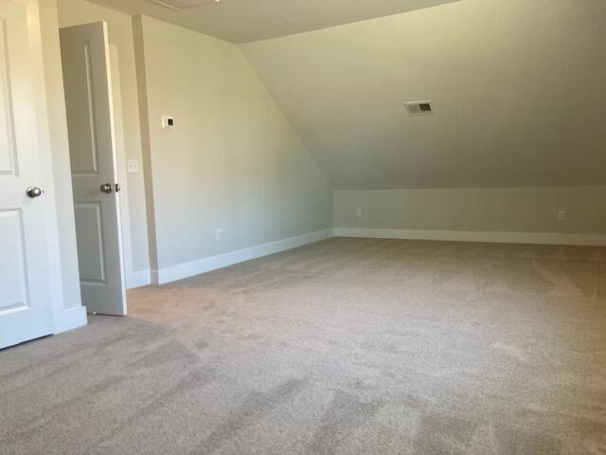




WEST ASHLEY NEW CONSTRUCTION
Open House this Saturday from 12-2 PM
2312 Oakland Road
Charleston, SC 29414
MLS# 23000509
$489,900
4 Bedrooms :: 2½ Baths :: 1,990 sf
BRIGHT & OPEN NEW CONSTRUCTION in the heart of West Ashley!
Situated on a quiet street, this 4 bedroom & 2.5 bathroom home is convenient to shopping, dining, Downtown and I-526!
The Large open concept with 9' ceilings and tall windows invites you right into this home. Beautiful crown molding downstairs and wainscoting in the dining area give a very nice touch! The kitchen is nicely appointed with quartz counter tops, upgraded shaker cabinets and stainless steel appliances. The stairs have beautiful Oak Treads with an LVP landing leading down the hall. 4 bedrooms allow room for family and/or guests! The master bathroom has a large & elegant tiled shower and dual vanities! Walk in closet!
This home is a stone's throw from the public boat ramp, which is very quick access to the Ashley River!
Eric Draper
(843) 442-7118
eric.draper@gmail.com
Jon Moore
(843) 732-3365
jon@charlestonrealestategroup.com
www.charlestonrealestategroup.com
Charleston Real Estate Group | 443 Folly Road | Charleston, SC 29412

