Slide 1
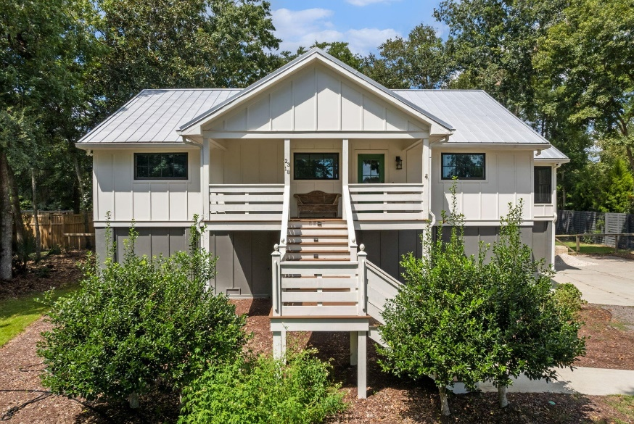
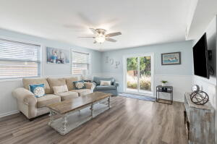
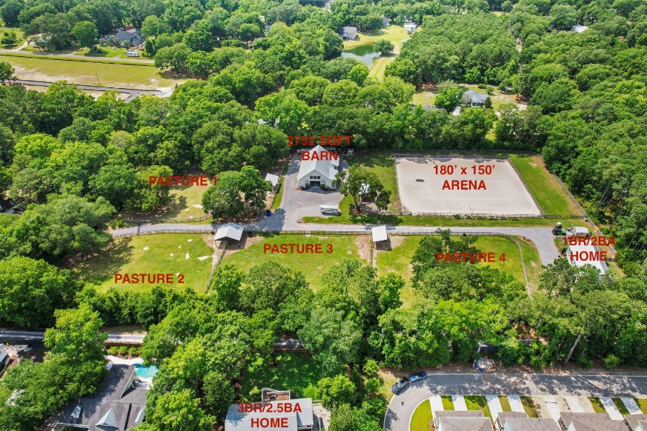
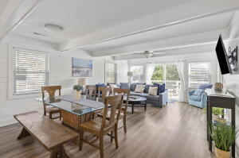
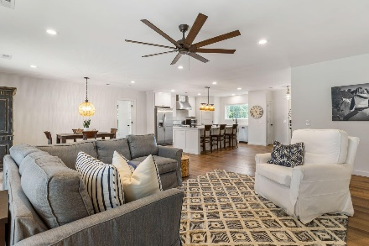
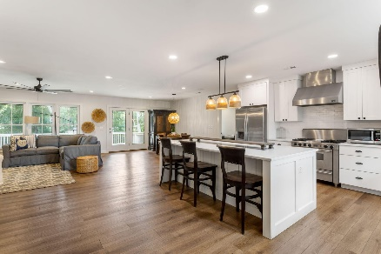
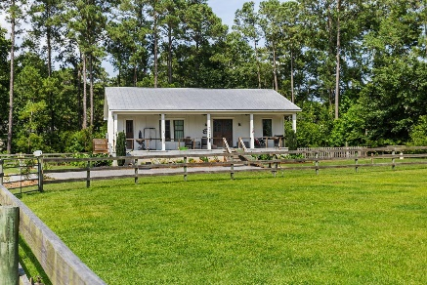
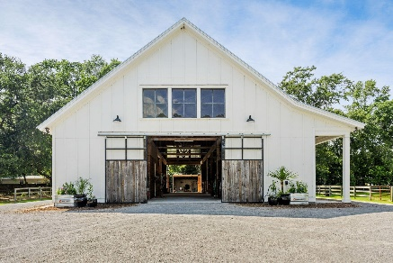
2318 N Palmetto Fort Drive
Palmetto Fort | Mount Pleasant, SC 29466
MLS# 23021150
New Price! $5,395,000
Darrell Creek Elevated Home With Elevator & Salt Pool
Horse Farm In The Heart of Mt Pleasant
UPDATED: This listing now includes a 0.43 acre parcel (Tax IDs 577-14-00-031 and 577-00-00-002) with a beautifully renovated 3 bed, 2.5 bath elevated home (1960 sqft). This additional parcel is adjacent to the one-of-a-kind, 5-acre farm in the middle of Mt Pleasant! The thoughtfully designed, custom-built horse farm sits between Oyster Point and Liberty Hill Farm off Rifle Range Rd. There is nothing like this in Mount Pleasant! The farm features a beautiful 1 bedroom/2 full bath, 1000 sqft caretaker's cottage; 2752 sqft custom barn with five 12' x 14' stalls; 180' X 150' riding arena with professional-grade GGT (German Geo Textile) laser-leveled footing and drainage system installed by East-West Arena Construction; five impeccably maintained, rotated pastures with large run-ins; and two chicken coops. The house sits on a 0.43 acre lot and has 3 bed, 2.5 baths. The home accesses the farm through a gate on the side of the farm. This 1960 sqft home matches the coastal farmhouse style of the buildings on the farm, including board and batten siding and metal roof. From the front porch, enter the home through the foyer and note the hardwood floors, custom lighting and fans, and spacious open floor plan. Large windows and full light French doors in the rear, bringing the outdoors in. The kitchen includes a large island with an abundance of storage; custom Shaker-style white cabinets; quartz countertops; white subway tile counter-to-ceiling backsplash; and stainless steel appliances including gas stove and vent hood. Beyond the kitchen is the dining area to the right and the family room to the left. Between them are French doors leading to the large back deck where you can watch your horses graze through the trees over morning coffee or evening drinks! All bedrooms feature hardwood floors; custom lighting, fans, and shades; and beautifully finished en suite bathrooms. The elevated home has 2 garage bays that would hold 3+ cars and has an enclosed area for an office or workshop (not included in the sq footage).
Check out the listing for more details and photos!
Andrea Rogers
(843) 532-3010 | andrearogers1@gmail.com | www.andrearogersrealtor.com
AgentOwned Preferred Group | 1400-G Palm Blvd | Isle Of Palms, SC 29451

