Slide 1
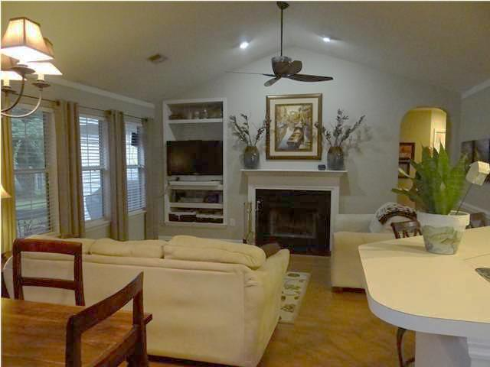
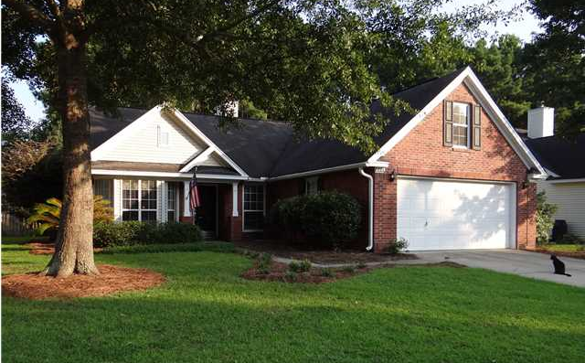
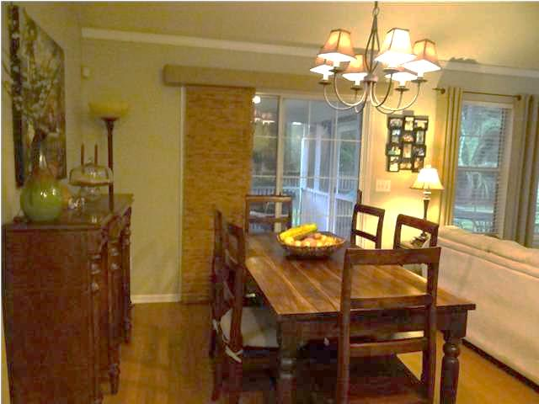
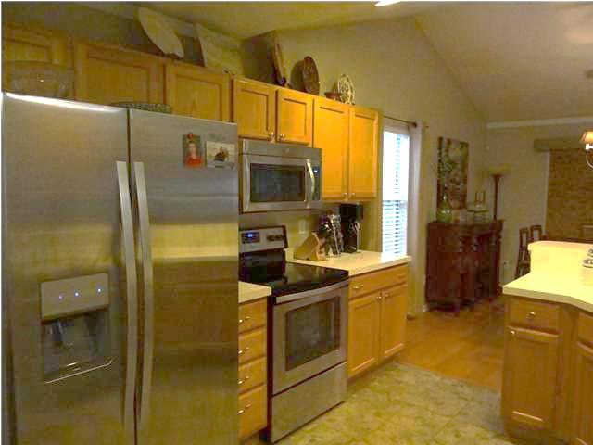
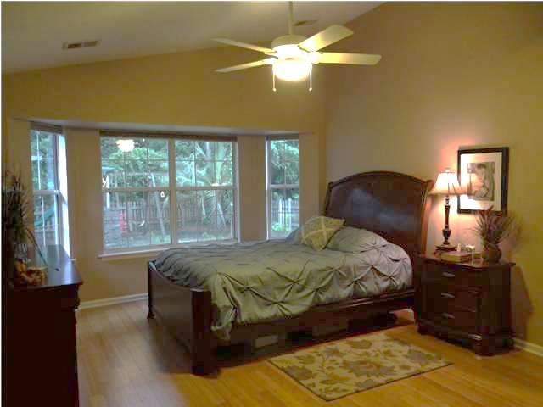
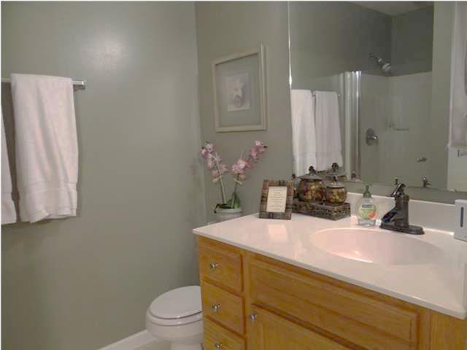
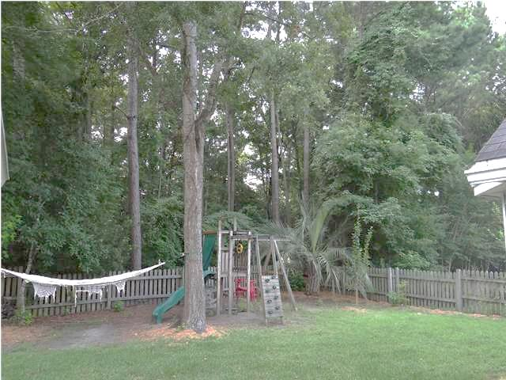
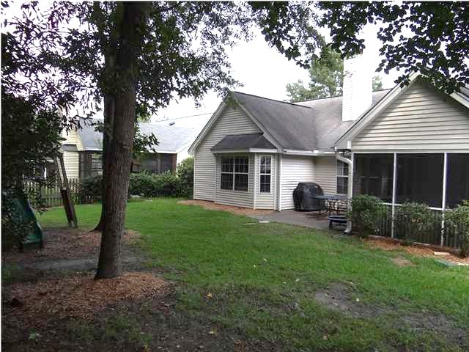
Move-in Ready Home on a Private Lot
231 Historic Dr
Rice Bay @ Belle Hall
Mt Pleasant, SC 29464
MLS# 1421512 ~ $320,000
Enjoy living close to everything that Mt. Pleasant and Charleston has to offer in beautiful Belle Hall Plantation! This single-story, open floor plan is move-in ready, offering 3 bedrooms and 2 baths, with hardwood and tile flooring throughout (no carpet except in the master closet!) The spacious Bright Open kitchen boasts plenty of room for entertaining, including a dining area, breakfast area and new stainless appliances. Privacy is a plus as the Fenced back yard overlooks Neighborhood Green Space with lots of trees! In a couple of years you will enjoy the fruit of the nicely landscaped yard, which includes a young Pear and a young Plum Tree, two Blueberry Plants and two Grape Vines. Cozy up to the Wood-burning Fireplace in the den with Vaulted ceilings. The master bedroom is large with a Generously sized walk-in Closet. Master bath has a Stand Alone Shower, Garden Tub with His and Hers sinks. Enjoy drinking your morning coffee on the Screened in Porch as you watch many of the Bird species Charleston has to offer! Grill out with friends on the Brick Patio. The two additional bedrooms are spacious as well and share a hall bath. The Laundry room is adjacent to the 2-car garage with a lot of shelving, and allows for a "mud room" space. This home has been newly painted throughout and has smooth ceilings. The tidy 2-car garage has a full wall of wire Shelving and additional wood shelving. Belle Hall Plantation offers 2 community pools, tennis courts, walking trails, and basketball courts. The Veranda section also has its own smaller Pool and Playground. This home is conveniently less than 10 houses down from the Veranda pool. This home does not currently require flood insurance. Agent is owner.
Meg Prokopenko
megpro@me.com
843-324-2813 O
843-693-9774 C
Giese and Associates, LLC | 669 Marina Drive | Ste A5 | Charleston, SC 29492

