Slide 1
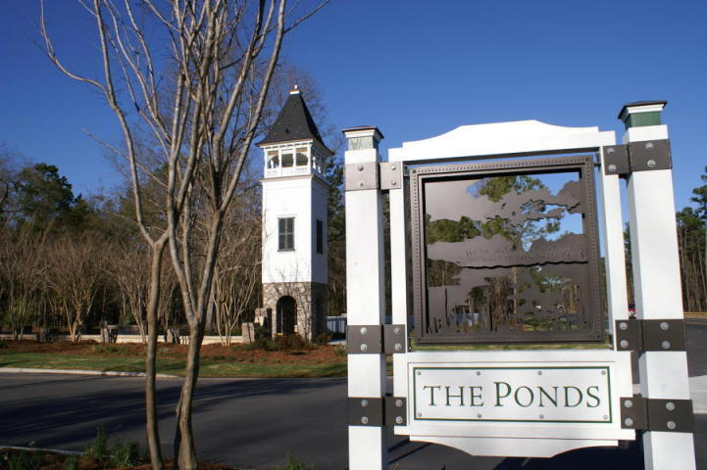
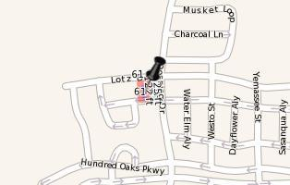
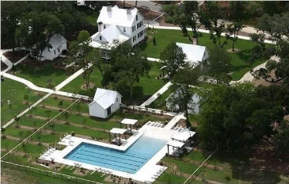
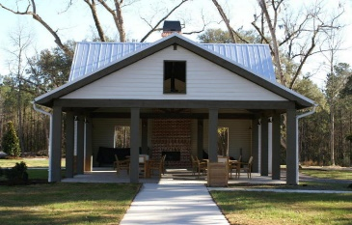
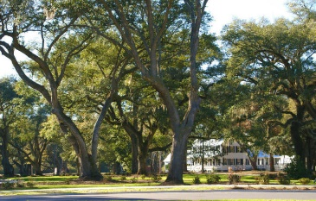
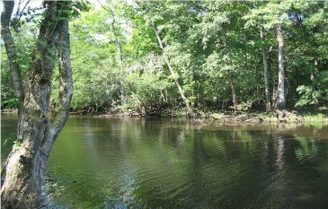


OPPORTUNITY KNOCKS!
231 Lotz Drive
The Ponds
Summerville, SC 29483
MLS# 15027797
$66,900
DO YOU RECOGNIZE A GOOD BUY WHEN YOU SEE ONE!
Discover Lotz Drive. Located in the popular “The Ponds” neighborhood and is a beautiful, large lot within walking distance of all amenities.
The Ponds is an Exclusive neighborhood, carefully planned as a Natural Retreat.
Build your dream home with your selected builder or use our Builder. You want be disappointed.
The current owner has a home plan that may transfer with the lot sale at closing.
Dorchester II School District. Priced for a quick sale!
Acreage, schools, taxes and HOA fees are approx. Buyer to verify.
Bill Everett, Jr
Broker
843-693-8539
Bill@TheEverettGroup.net
RE/MAX Pro Realty, 9209 University Blvd, Charleston, SC 29406

