Slide 1
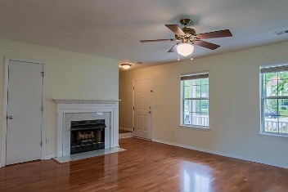
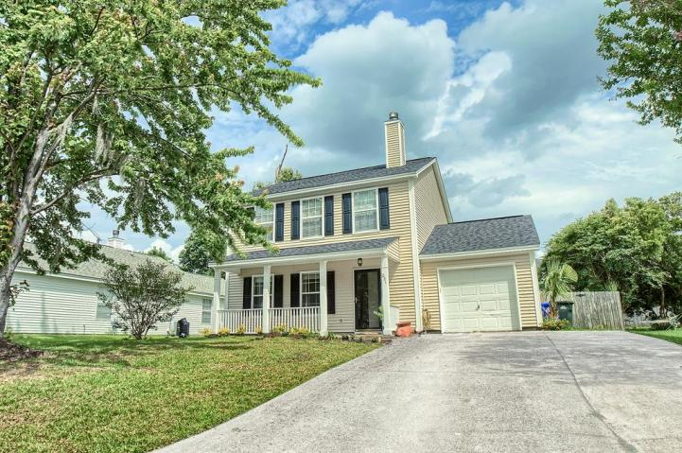
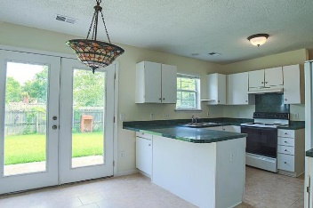
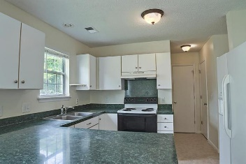
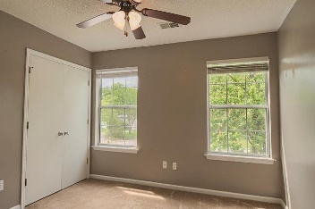
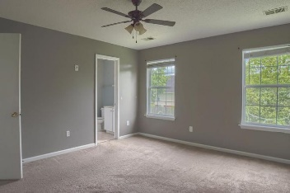
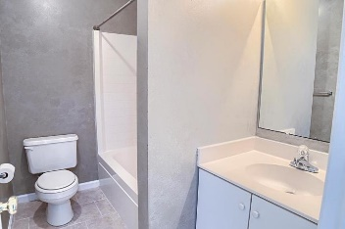
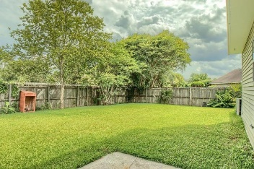
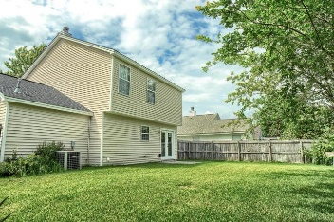

231 Lytham Court Charleston, SC 29414 | MLS# 17015399 | $230,000
Just Listed in Shadowmoss Plantation
Gorgeous 3BR Home | Cul-De-Sac
Well kept colonial home nestled a quite cul de sac with large fenced backyard perfect for outdoor living. This 3 bedroom and 2 1/2 baths home features tile and hardwood floors, gas fireplace in living and beautiful arch way. Also boast natural light from French doors and front porch idea for rocking chairs for wining down. New roof replaced last year, master bedroom has walk in closet and addition storage/linen closet. Shadowmoss Plantation is a gorgeous golf course community located minutes away from historical Plantations, great schools, shopping mall, an array of restaurants and close to downtown.
Chris Bing
(843) 608-9432
chris.bing@cbcarolinas.com
www.buywithbingrealestate.com
Coldwell Banker Residential Brokerage
4969 Centre Pointe Dr
Suite 203
Charleston, SC 29418

