Slide 1
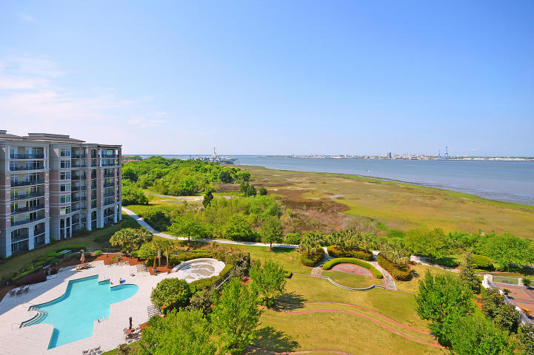
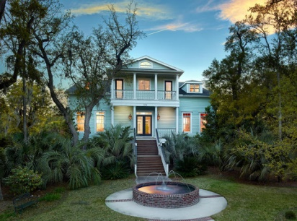
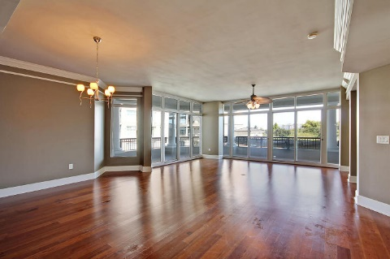
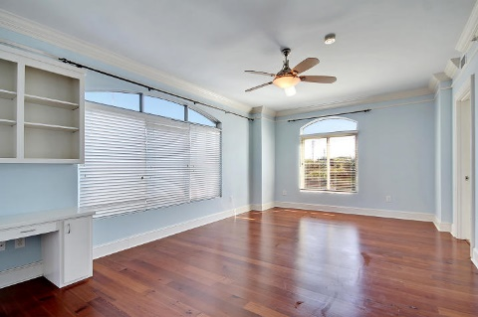
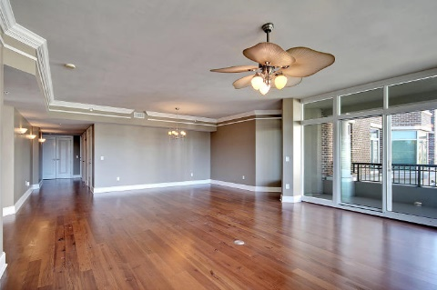
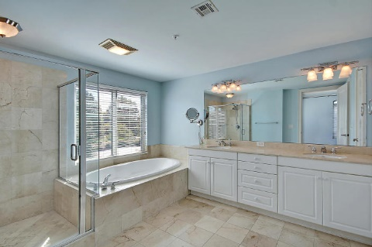
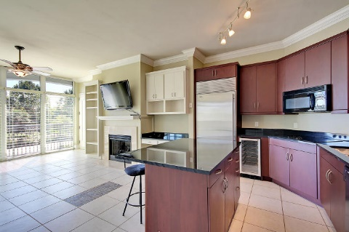
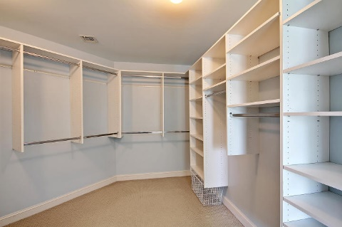
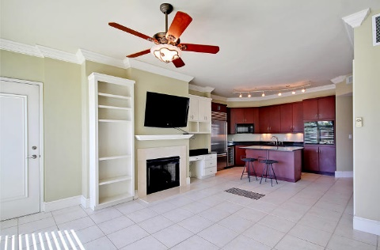
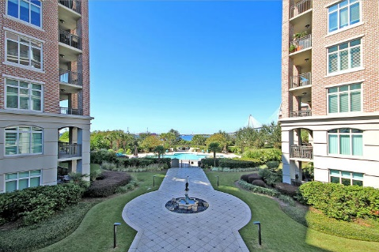
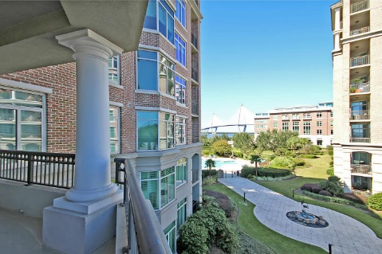
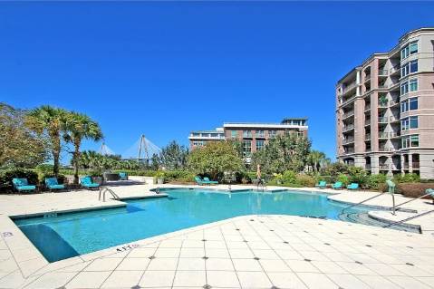

Reduced by $50k
231 S Plaza Court
Renaissance On Charleston Harbor ~ Mt Pleasant ~ MLS# 15026202 ~ $895,000
Incredible Condo! With world class amenities, lovely views and over two thousand square feet of living space, this two bedroom, two and half bath condo at The Renaissance on Charleston Harbor leaves nothing to the imagination.
This great condo features tiled and hardwood floors, state-of-the-art kitchen appliances including a wine cooler, roomy bedrooms, lots of natural light, and a deck with a gorgeous view. Once outside, the Cooper river and the Arthur Ravenel Bridge will take your breath away.
This great condo also has a new air conditioner, disposal, dryer, and water heater. Not only will you come to appreciate maintenance-free living at The Renaissance on Charleston Harbor, but you'll get to indulge in the incredible amenities. A state of the art fitness room, a sparkling pool and elegant clubroom are all at your disposal.
When it comes to entertaining and having visitors, you can even reserve guest suites on the plaza level for nights at a time at a very reasonable cost. Located walking distance to waterfront park and downtown, you can enjoy all that Charleston has to offer without getting into a car. If you've been searching for the best of the best when it comes to luxurious living, lifestyle and views, this is it!
Nate Gainey nate@mattoneillteam.com 843-513-2038

