Slide 1
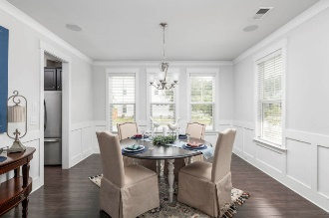
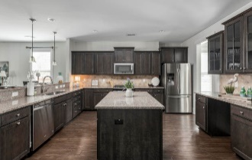
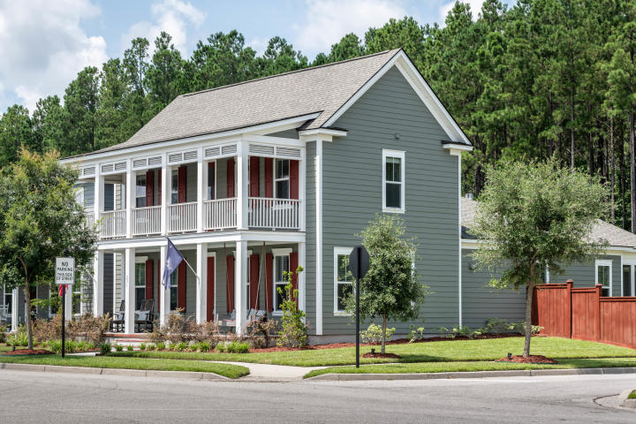
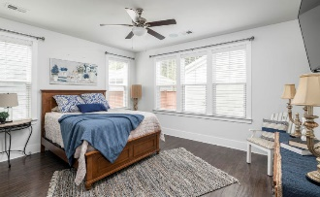
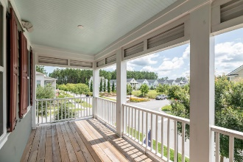
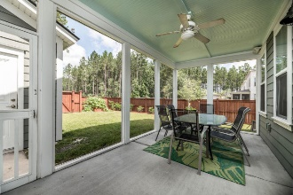
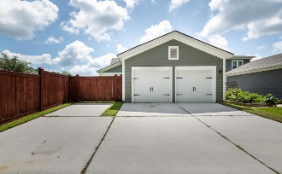


231 Scholar Way
Nexton · Summerville
MLS# 20018384 · $423,900
OPEN HOUSE
Saturday. September 19th 1 -4
The double front porches of this Nexton home are so inviting! This home on Scholar shows like a model home from the time you walk in the door. First, you will notice that the seller spared no expense on the upgrades in this home. There are hardwood floors throughout the house except for the spare bedrooms. This home is set up for entertaining with a surround system in the living room and outdoor speakers on front and back porch. There is a huge office and dining room in the front of the house. The kitchen has so many upgrades, including the kitchen cabinets and doors, kitchen drawers, glass cabinets and backsplash. There is an oversized 2 car garage with extra driveway for parking and a privacy fence enclosing the backyard. Also, there are ceiling fans throughout. The primary bedroom is on the main floor with upgraded countertops and mirrors. The laundry room also has upgraded cabinets and countertops and is on the main floor as well with the two secondary bedrooms on the 2nd floor.
Rodney Hancock
(843) 437-1347
rodneyhancock08@gmail.com mortgageprofessionalsonline.com
AgentOwned Charleston Group
902 Savannah Hwy
Charleston, SC 29407
Real Estate ● Mortgage Insurance ● Business Brokerage

