Slide 1
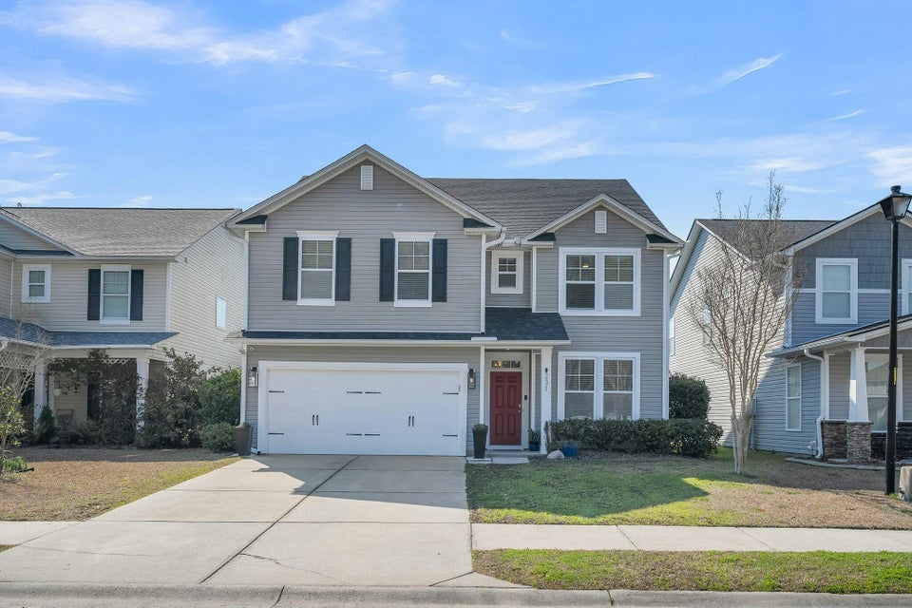
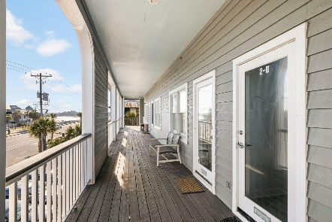
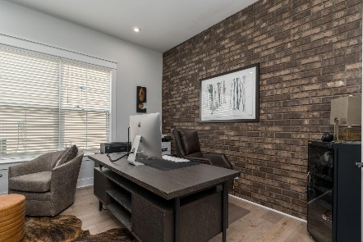
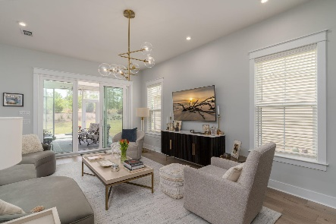

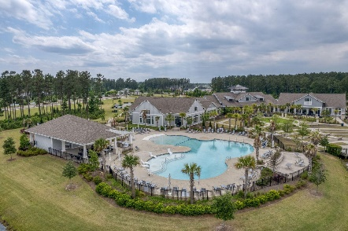
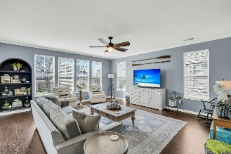
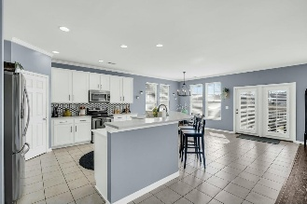
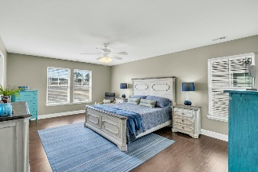
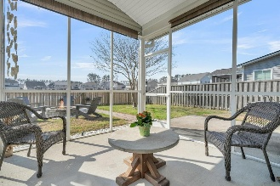
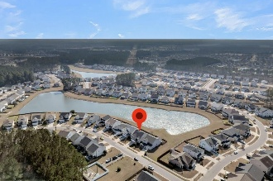
231 Laurel Crest Way
Cane Bay Plantation | Summerville, SC 29486 | MLS# 25005708 | $429,000
Darrell Creek Elevated Home With Elevator & Salt Pool
Cane Bay Waterfront Masterpiece
Co-sponsored by
Offering $3000
Lender Credit
Why Wait for New Construction?! 231 Laurel Crest Way is a big & beautiful four bedroom (plus loft and flex space), two and a half bath home on a premium pond lot! Located in Cane Bay Plantation's Sanctuary Cove, this beautiful two-story home has an abundance of upgrades, including huge quartz island, stainless steel appliances, wood floors throughout (yep, NO CARPET!!!), crown molding, fully screened porch, fenced yard and much more! As you enter the home you are met with French doors on a flex space- perfect for a home office/ work area, homeschooling or formal dining space. Plenty of cabinet space with private pantry and a huge open floor plan overlooking the eat-in kitchen and living room. New architectural shingle roof last year and new HVAC coil this year.
Upstairs there is a huge loft, oversized laundry room, a full hall bathroom, and 4 bedrooms. The massive master bedroom overlooks the water, has double vanities, double walk-in closets, garden tub and stand up shower and a private water closet. The other three bedrooms are also spacious and have double door closets for easy access. Tankless water heater, ceiling fans in every room and additional patio space for grilling, a whole wall of shelving in the garage and enjoying everything The Lowcountry has to offer. Pond is stocked and you will see people out fishing on the banks many days. Close to all Cane Bay Schools, amenities, dining, and shopping. Commute to the Naval Weapons Station, Joint Base Charleston, Volvo, Boeing, Bosch, Google and the gorgeous beaches of Historic Charleston.
Rochelle Rennert
843-847-9694 | rochellesellscharleston@gmail.com | www.RochelleSellsCharleston.com
AgentOwned Premiere Group, Inc. | 219 N Highway 52 Ste A | Moncks Corner, SC 29461-3926

