Slide 1
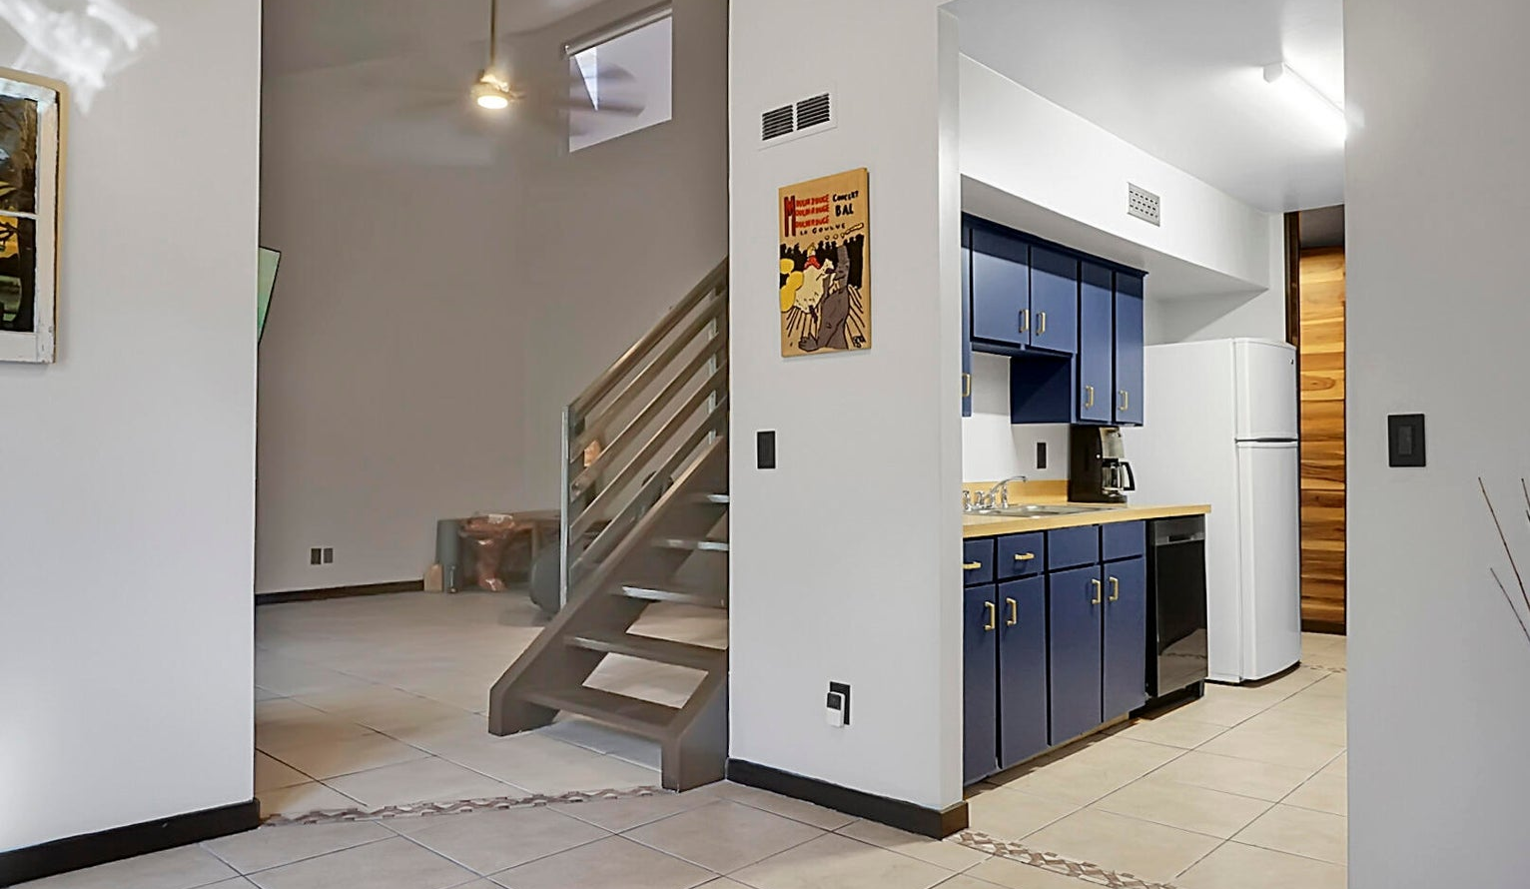
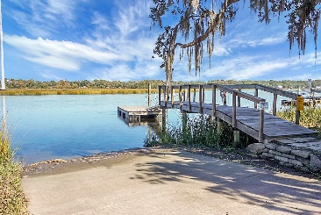
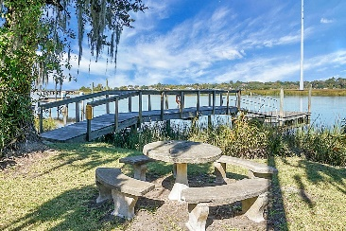
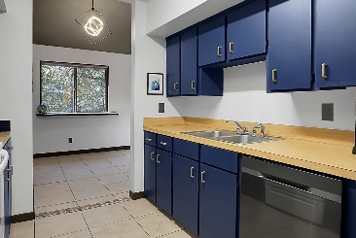
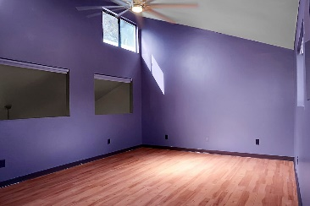
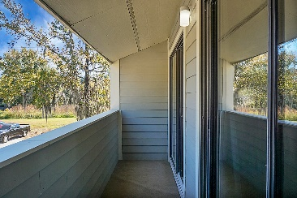
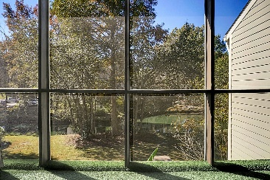

2321 Treescape Drive #1706 Ashleytowne Village Charleston, SC 29414 MLS# 23025382 | $313,500
Bring Your Boat
Reduced $32,000
This rare find in West Ashley boasts 3 bedrooms, 3 full baths, and an open-concept 2-story layout. Enjoy exclusive access to a community boat ramp and dock with breathtaking Ashley River views. Additional amenities include a walking trail, pool, and tennis courts.
The screened back porch offers serene pond and wildlife views, with both lower bedrooms sharing a balcony. Inside, cathedral ceilings and a wood-burning fireplace with a custom stone surround create an inviting atmosphere.
Conveniently located near shopping, the hospital, and just 20 minutes from downtown and the beaches. Don't miss this unique opportunity! Neighborhood boat Storage subject to availability. Seller offering $2000 toward closing or rate buy-down. Regime fee covers exterior maint hazard insurance, termite bond.
Gerri Sandford
(843) 817-8762
gsandford29455@gmail.com
Anchor Line Realty LLC
1619 Samuel Rd
Charleston, SC 29412

