Slide 1
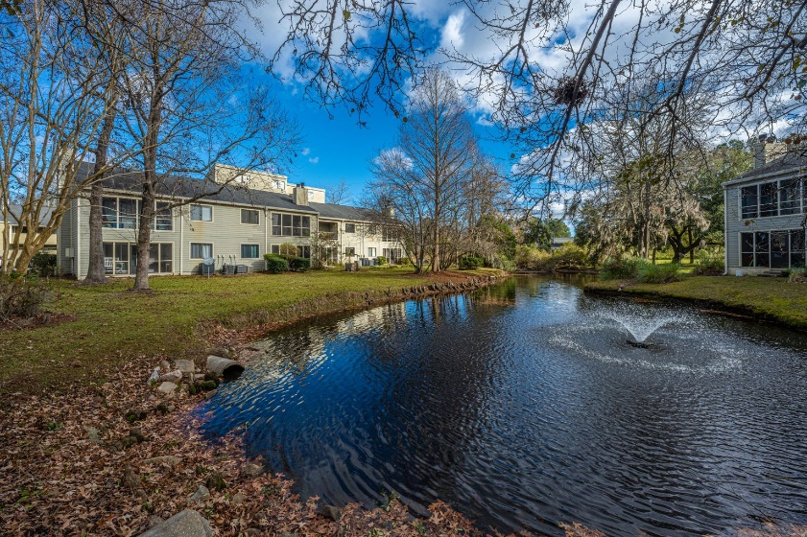
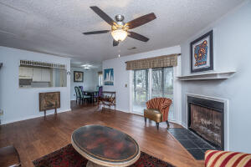
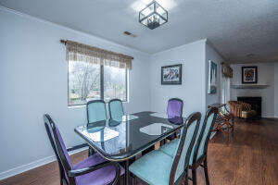
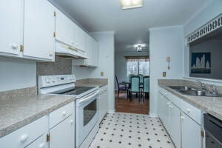
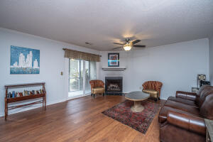
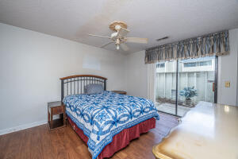
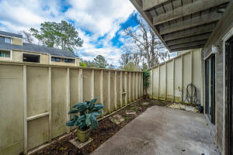
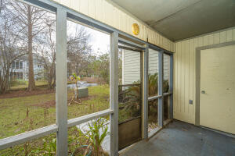



Why wait for new construction?
This Park Circle area home is LESS THAN 2 YEARS!
West Ashley - $175,000
2321 Treescape Drive 2
Ashleytowne Village · Charleston, SC 29414 · MLS# 22000305
Welcome to 2321 Treescape Drive, Apt. 2. This is a lovely first floor condo with no stairs and a view of the pond out the back. There are two bedrooms, two bathrooms, a front patio and a back porch. It boasts some very nice LVT flooring, a galley kitchen and a large den with a wood burning fireplace. Just nearby with only a 4 minute drive is Lowe's Foods, Charleston Coffee Exchange, Yoshi Poke & Kitchen and Ladles Soups on Bees Ferry Road.
Del Shaffer
843.408.6821
dshaffer@carolinaoneplus.com
2713 Highway 17 North
Mt. Pleasant, SC 29466

