Slide 1


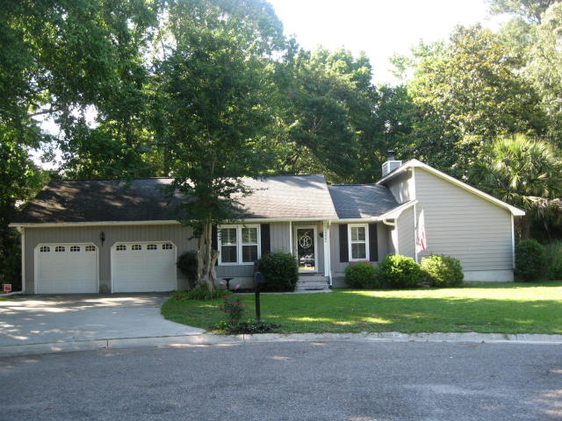
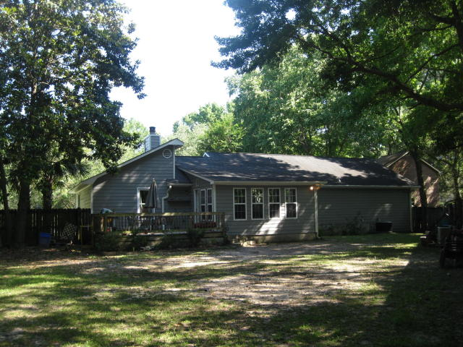
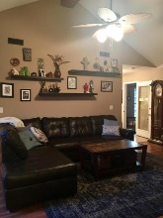
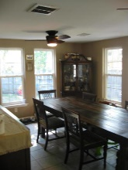
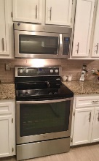
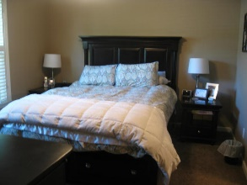
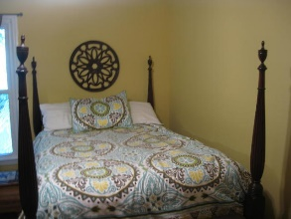
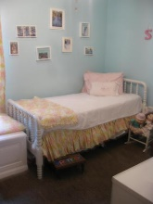
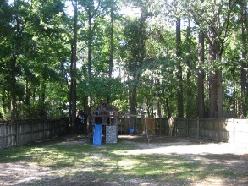
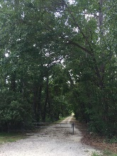


Wonderful Home on the Greenway...Minutes from Downtown
2322 Mckee Court
Sylvan Shores – Charleston ~ MLS# 17013942 – Just Reduced to $289,000
Wonderful, cozy home located on a cul-de-sac in West Ashley, off of the Greenway (walk or bike path goes through West Ashley) Access is from a gate in the back yard!
Three bedrooms and Bonus Room. Vaulted ceiling in the great room with fireplace and a large Sunroom currently used for Dining Room, overlooking a large back yard, opens to the relaxing deck under a huge Magnolia tree.
A nice flow for entertaining. The room over the garage offers privacy for guest, older child or a great office. Kitchen boast beautiful granite counter tops, tile and backsplash and many cabinets. Room for an eat in kitchen table or breakfast nook with bar space as well. Very well kept and this owner replaced all windows & HVAC.
This is a must see and only minutes to downtown.
Jan M. Miller, Broker Associate
jan.miller@goldenbearrealty.com
www.GoldenBearRealty.com
Golden Bear Realty | 654 Coleman Blvd, Suite 100 | Mt Pleasant , SC 29464
Cell (843) 345-9719 | Office (855) 352-9088 | Fax (561) 721-3311

