Slide 1
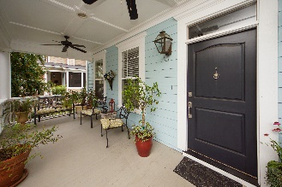
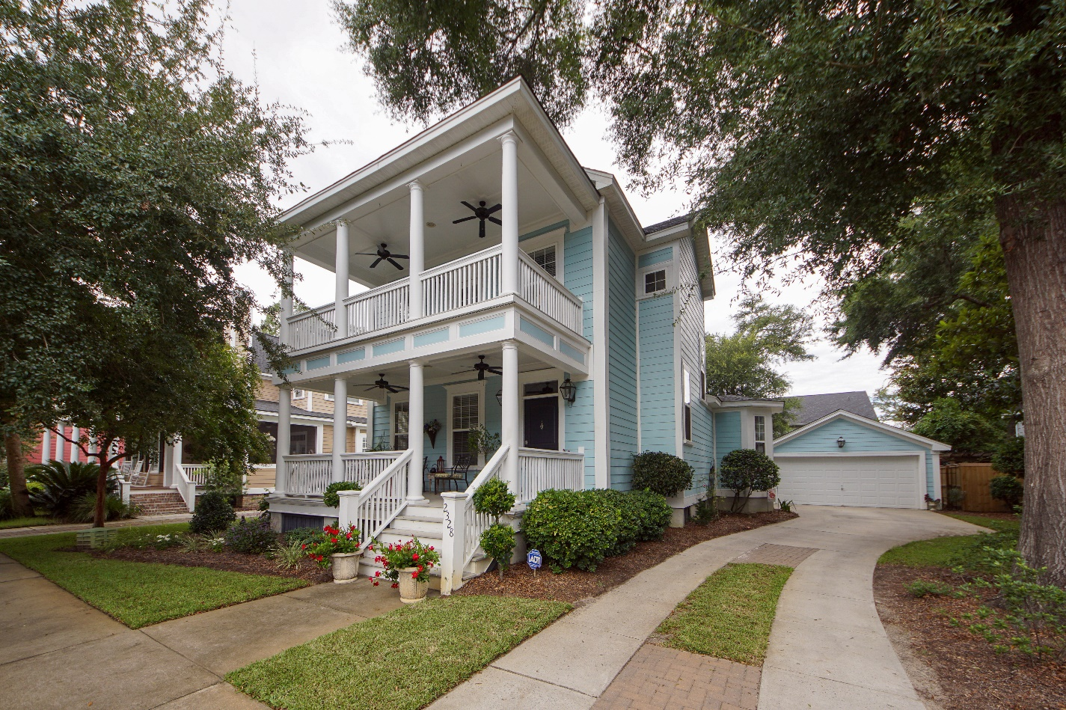
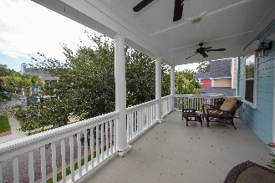
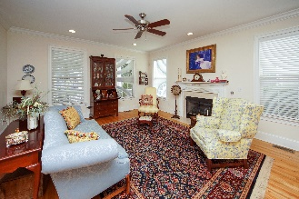
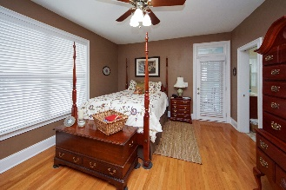
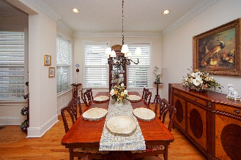
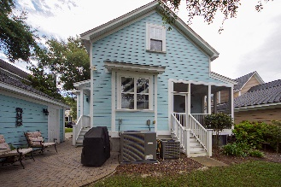
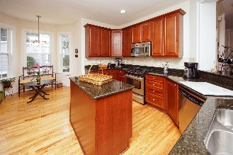
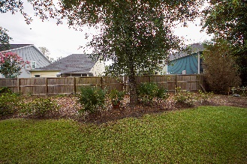
ULTRA-RARE OPPORTUNITY TO BUY IN MCLAURA BLUFF
2328 High Tide Drive
Charleston, SC 29414 | MLS# 21023168 | $499,000
This is everything historic Charleston has to offer! This is a RARE opportunity to own a home in McLaura Bluff. Beautiful massive balconies overlooking great oak lined streets. McLaura Bluff was built to encompass it's residents with the architecture and style our beautiful city is famous for. Breathtaking inside and out with top quality finishes including cement plank exterior. Relax on the terrace overlooking a tastefully landscaped back yard. No neighbors in front of the home allow peaceful and private enjoyment of the 2 oversized balconies. Minutes from Charleston's most beautiful historic plantations and not far from downtown Charleston and our spectacular beaches. NEW roof 2020, NEW downstairs HVAC 2020, NEW upstairs HVAC 2018.
Johnny Crosby
jcrosby@propertyadvisorsinc.com | 843-270-9407 | www.charlestonhomeproviders.com
Brand Name Real Estate | 4 Carriage Lane, Suite 106 | Charleston, SC 29407

