Slide 1
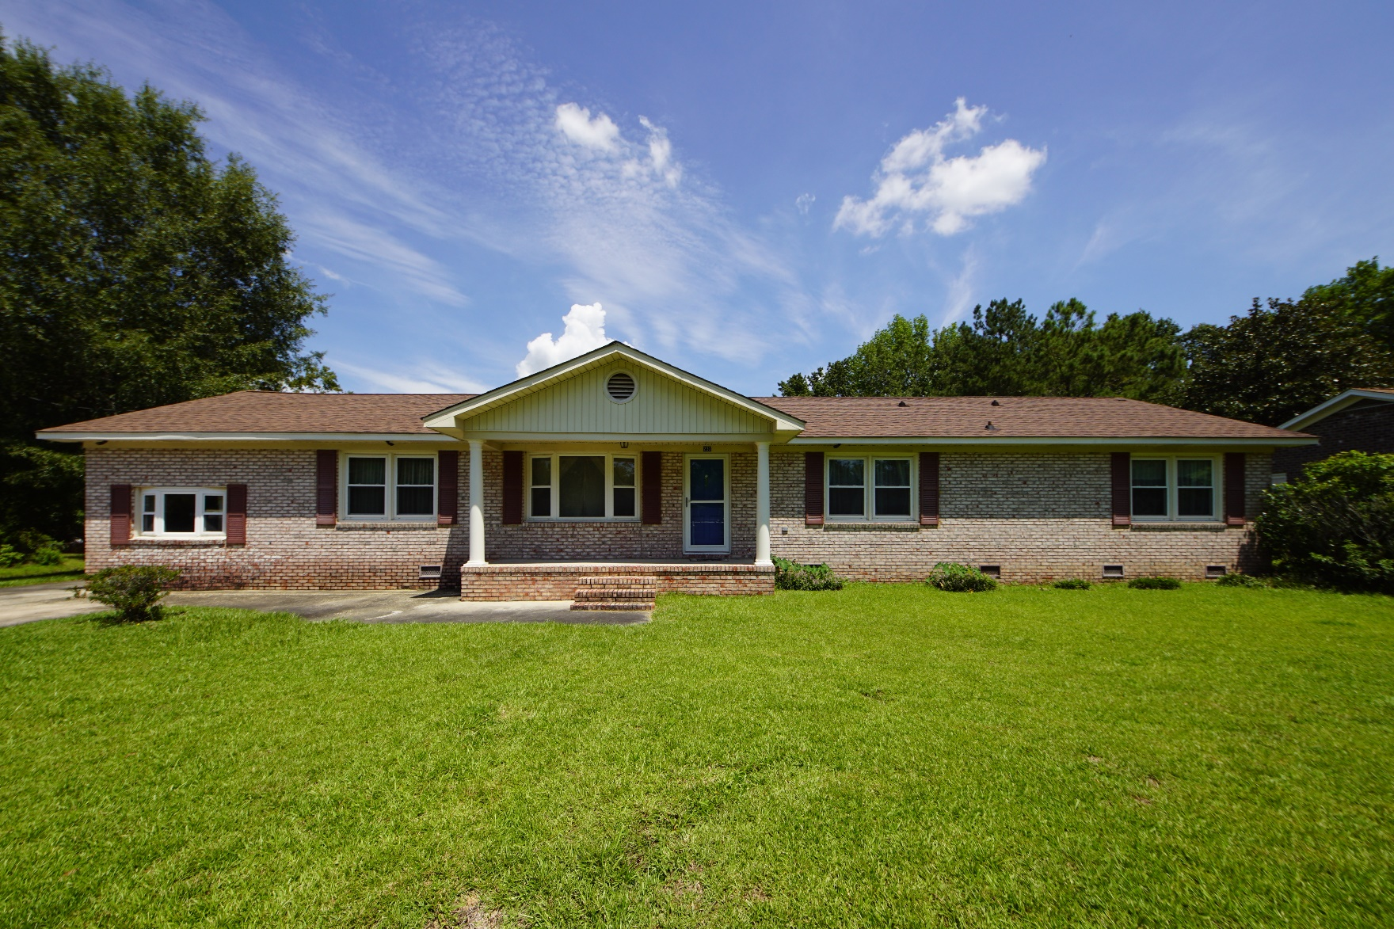
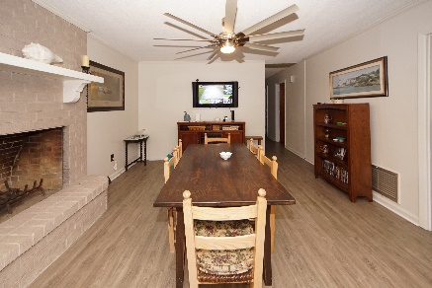
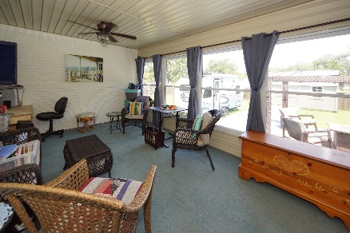
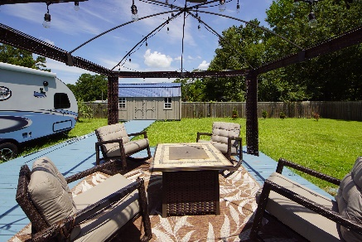


232 Janice Street
Goose Creek, SC 29445
MLS# 19020742 :: $248,000
5 Bed / 3 Bath
Just Reduced in Pineview Acres
Price Drop!
Own a true 5 bedroom 3 bath ranch home and no HOA in Pineview. Sellers have remodeled the kitchen with new cabinets, granite counter tops and flooring. Plenty of space for the chef in the family! Traditional in style this home has a formal living, formal dining and den. Sellers currently use the den as the dining room using the fireplace as a focal point. Plenty of space for a blended family or teenagers with a full apartment off of the kitchen and additional bonus storage or living space at the top of the stairs. Master bedroom has full bath and the hall bathroom is newly remodeled. Oversized sun room and 20x20 deck add to the grand features and space of the house. **original hardwood flooring is under carpet in hallway and bedrooms**
Connie White, Broker
843-532-3356
connie@chrepros.com · conniewhiterealestate.com
Charleston Homes · 597 Old Mt. Holly Road · Suite 301 · Goose Creek, SC 29445

