Slide 1

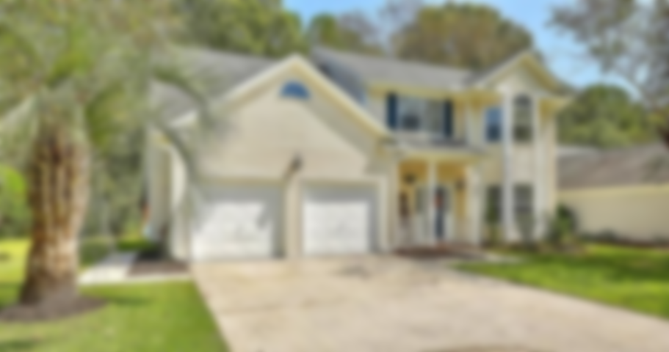
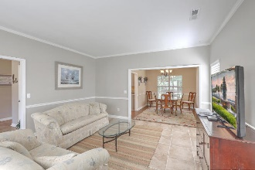
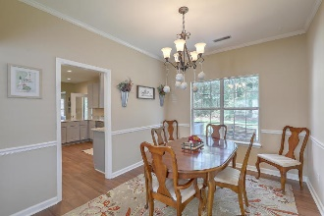
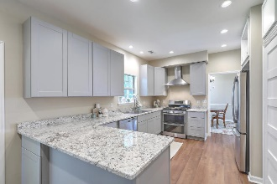
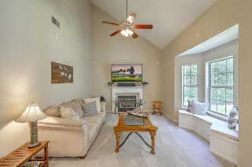
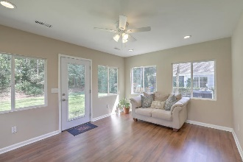
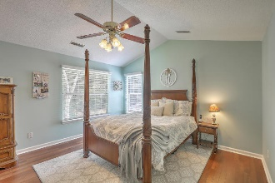
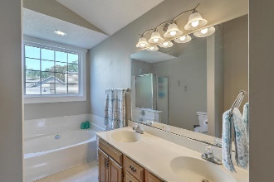
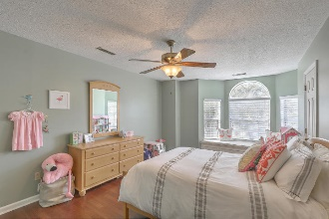
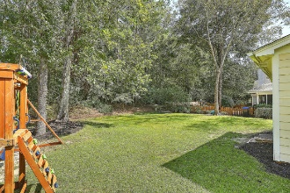
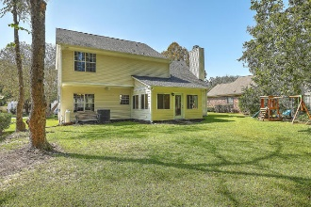

Pam Bass
Realtor
M 843-259-4926 | O 843-277-6677
pam@pambassproperties.com
www.pambassproperties.com
Brandymill Agent Open House
Lite lunch from Hamby’s catering
Chance to win up to $100
Thursday, October 10th ~ 12-2
232 Smithfield Avenue | Summerville, SC 29485 | MLS# 19024125 | $274,900
OPEN HOUSE CANCELED
HOUSE JUST WENT
UNDER CONTRACT!
Beautiful 4 Bedroom 2 1/2 Bath move-in ready family home with lots of upgrades. This owner added a 12 x 16 Sunporch, new roof, re-plumbed the home, installed new cabinets, new granite countertops, installed solid hardwood flooring, a gas stove and painted the interior of the home. This home has lots of space for a large family with a formal living room, formal dining room, eat in breakfast area and spacious family room with vaulted ceilings and gas fireplace. The private backyard is perfect for grilling out and watching the kids play. Conveniently located to shopping and restaurants and in desirable Dorchester 2 school district.
Coldwell Banker Residential Brokerage | 4969 Centre Pointe Dr. Ste 203 | Charleston, SC 29418

