Slide 1

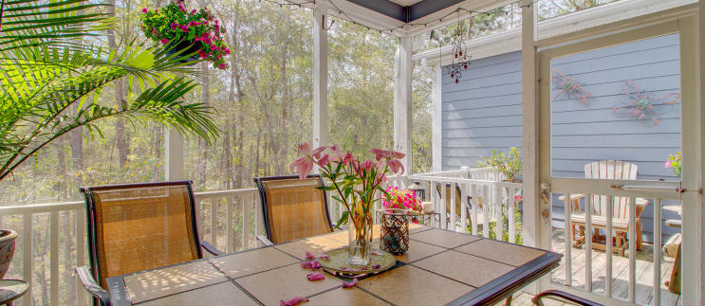
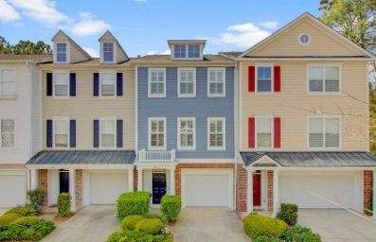
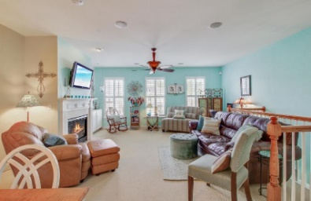
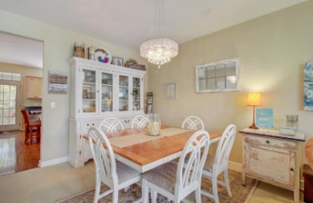
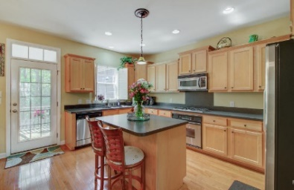
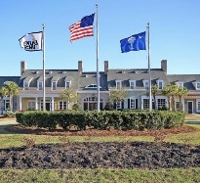
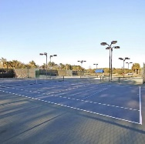
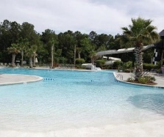
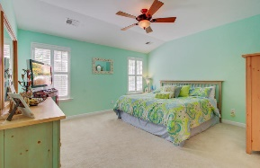
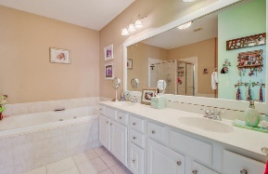
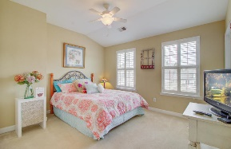

Tee it Up - Dunes West
Jason Barton
(843) 936-1421
jbartonsc@gmail.com
bhomecharleston.com
232 Fair Sailing Road #34 | Mount Pleasant | MLS# 19008737 | $279,900
Welcome - Your Dunes West Home Awaits. From the moment you enter the gates of Dunes West you won't want to leave. This beautiful 2 bedroom / 2.5 bathroom condo/townhome stands quietly in Egrets Walk. As you park your car in the garage and enter into the foyer, hang your coat, take off your shoes and head upstairs to relax. The living room's spacious open floor plan is complete with a gas fireplace and plenty of wall space for decorating. Plantation shutters throughout are perfect for privacy or letting in the warm sunlight. The wood floors proudly cover the kitchen/dining area with plenty of cabinets and a center island for even more counter space while you enjoy cooking on the gas range.
The porch offers both a screened in and open area with a quiet wooded view to sit and enjoy all of the sounds of nature Dunes West holds. The large master bedroom offers a walk in closet and a master bath that is spa worthy. The giant jetted garden tub is perfect after a full day on the course and the ground floor has an additional multipurpose room used for a place to exercise or office space. Dunes West offers full amenities including a Championship golf course (which is repeatedly recognized as a world-class golf experience and has been named among the Top Ten Resort Courses and America's Fifty Best Courses), running/walking trails, boat ramp and boat storage, 2 club houses with community pools, tennis courts, athletic club and restaurant. If you do decide to go out, you will find yourself close to Mt Pleasant's great shopping, dining and area beaches.
Call and schedule your personal tour now!
eXp Realty Charleston · 711 Fairview St · Fountain Inn, SC 29644

