Slide 1
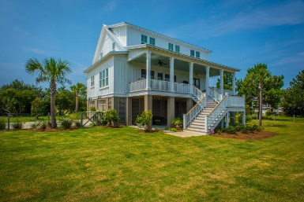
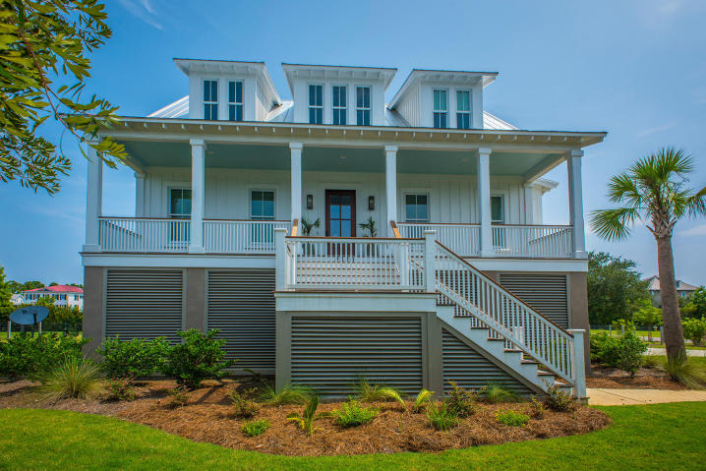
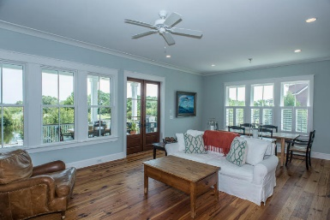
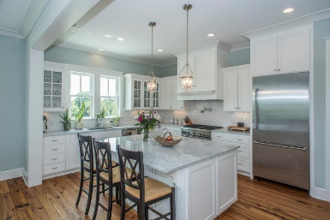
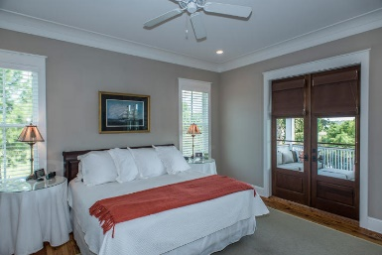
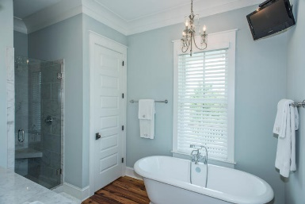
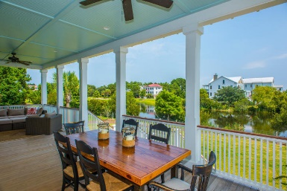
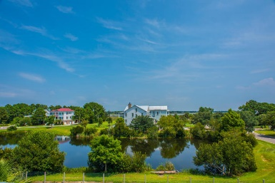

Custom Home with Sweeping Views of the Stono
$715,000
4 Bedroom
3½ Bath
2,933 Sq Ft
2330 Rushland Landing Road
Rushland
Johns Island, SC 29455
MLS# 15022671
Custom home, built to be the builders personal residence. This home features many upgrades including a metal roof, cement plank siding, top of the line impact resistant windows, and spray foam insulation throughout.
The interior features a custom built kitchen with marble counters and Thermador appliances. The interior also features antique heart pine floors, 10'ceilings downstairs and 9' upstairs. Upstairs has 3 bedrooms with jack and jill baths, a media room that could be converted to a 5th bedroom, and a nook that serves as a office.
The rear of the home boast a large porch, fenced yard and views of the pond. Under the home has a garage for 3 cars. In addition to the community club house, pool, and dock the homes on Gregorie Commons also have a private dock with access to the Stono River.
Frank Thornhill, Realtor®
(843) 224-7997
fthornhill@hanlandevelopment.com
Melanie Thornhill, Realtor®
(843) 270-8997
melaniethornhill1@gmail.com
Hanlan Consulting and Development
241-243 East Bay St · Charleston, SC 29401
www.hanlangroup.com

