Slide 1
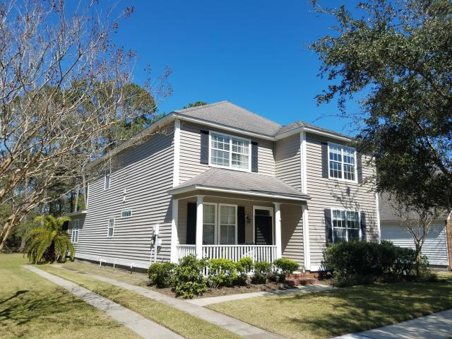
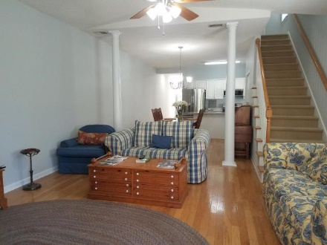
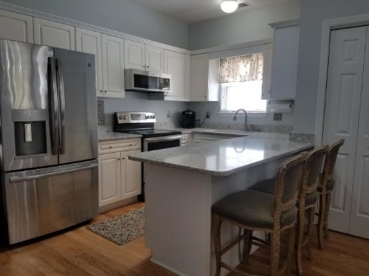
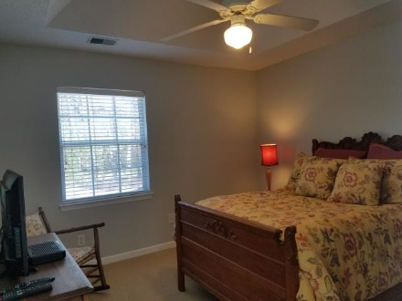
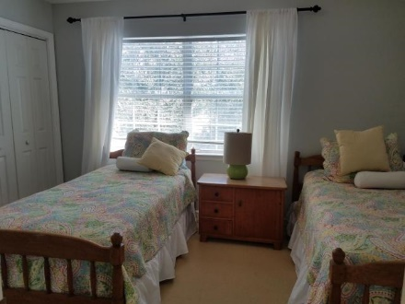
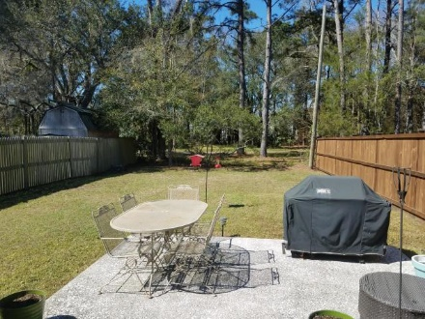
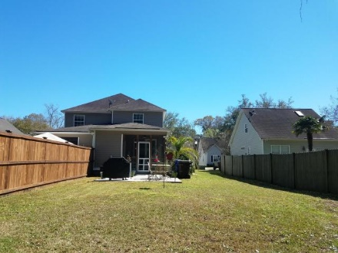
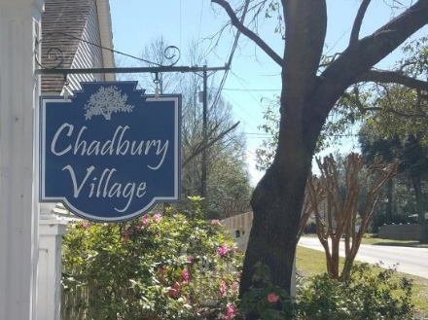
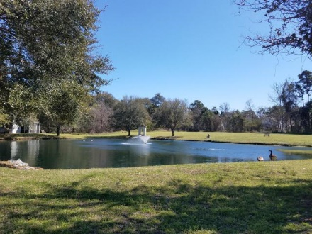



Home for Sale w/ No Regime Fee 2333 Chadbury Lane Chadbury Village Mount Pleasant, SC 29466 MLS# 19006593 $315,000
$24 HOA per Month in Mt. Pleasant!
HOA does allow short term rentals!! Hardwood in most downstairs living areas. Open floor plan with columns and a kitchen that overlooks living areas. BRAND NEW ROOF BEING INSTALLED 3/9/19, BRAND NEW GRANITE AND TOP OF THE LINE APPLIANCES INSTALLED IN KITCHEN 2/18/19, brand new interior paint job throughout whole home. Screened in porch out back with an extra concrete patio, also a porch in the front. One of the least expensive HOA's in Mt, Pleasant but they are very stable. 5 minute drive to Isle of Palms beach, 15 min. to downtown, 2 min. to Mt.pleasant Towne Center with shopping and restaurants. This is the only Townhouse set in the neighborhood aka your chance to get in at the best price in the neighborhood! Take a look at this well kept home with an amazing location!
Taxes paid at investor rate, would be cheaper if primary home. This home backs to woods. French doors lead to screened in porch. Extra storage attached to screened porch.
Stephen Kugelman
(843) 330-0403
steve@agentowned.com
www.kugelmanrealestate.com
Robert Brandon Judy
(843) 330-2689
robert.judy@agentownedrealty.com
AgentOwned Preferred Group | 1400-G Palm Blvd | Isle Of Palms, SC 29451

