Slide 1
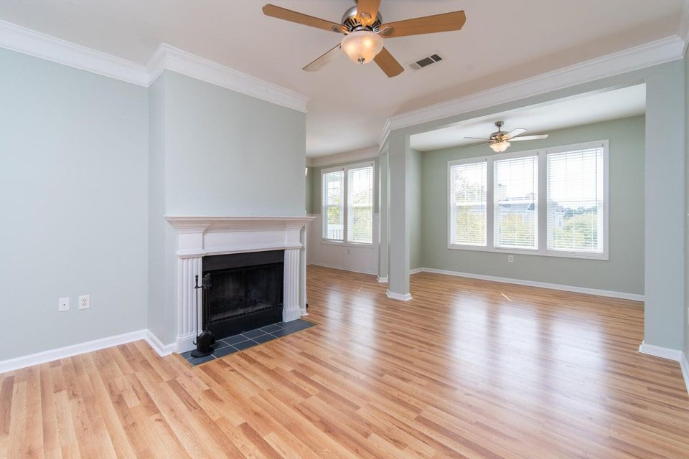
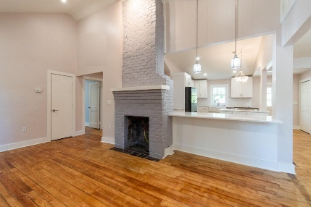
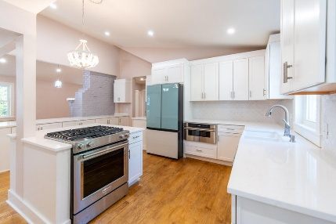
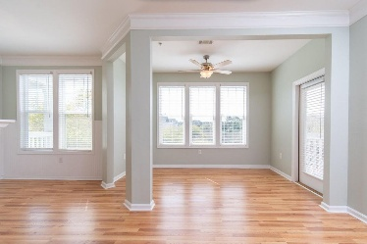
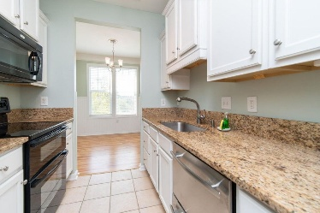
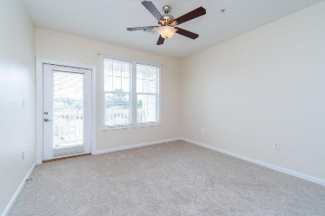
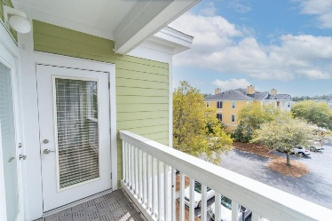
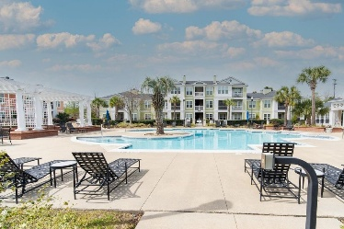


Southampton Pointe Condo For Sale
2333 Chatelain Way Mount Pleasant, SC 29464 | MLS# 25000733 | $324,900
Beautiful top-floor one bedroom condo in Southampton Pointe (gated) with a close proximity to the clubhouse, pool and gym. It is just minutes to the beach and Towne Center shopping. Owners' suite with ceiling fan and walk-in closet. Kitchen with granite counter-tops, newer stainless appliances, updated flooring on main areas & bathroom. The community has a resort style pool, clubhouse, mail station, tennis court(s) and media room. Additional Features.- nine-foot ceilings, newer HVAC system & hot water heater, fresh interior painting, wood burning fireplace, sunset views from balcony. Quick Settlement Available! Come see this magnificent condo today! Call your Realtor and reserve your showing appointment.
Gil Aviles
843-697-5535
gil@aviles-realestate.com
www.Aviles-RealEstate.com
Aviles Real Estate Brokerage
Charleston, SC / Miami, FL

