Slide 1
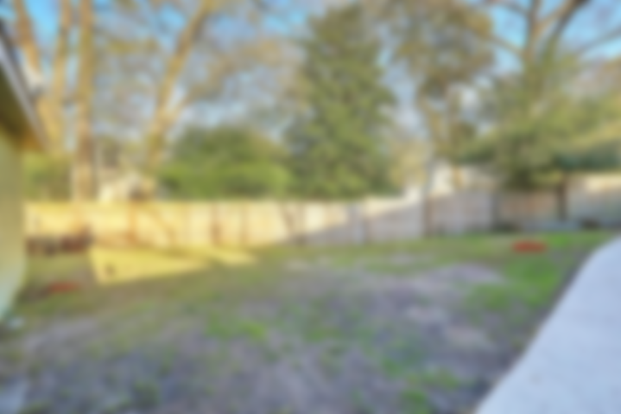
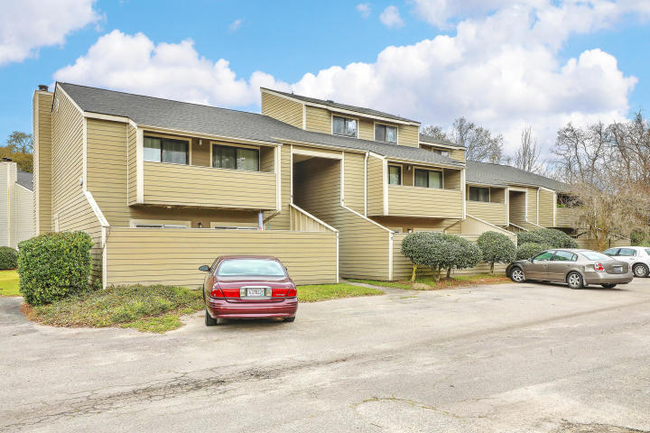
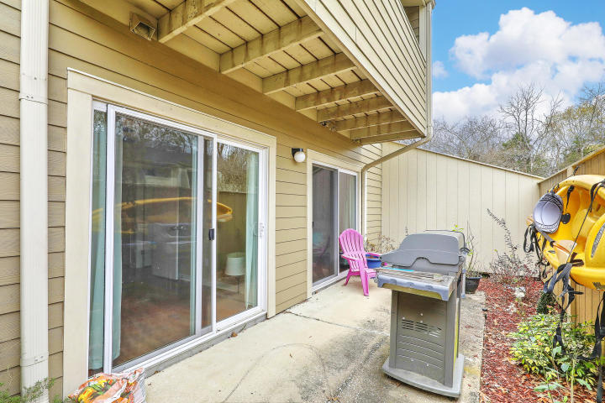
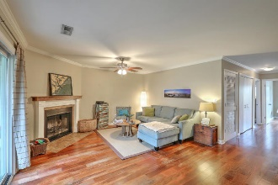
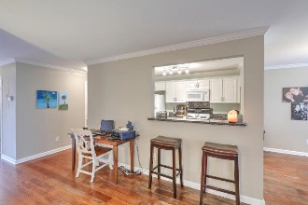
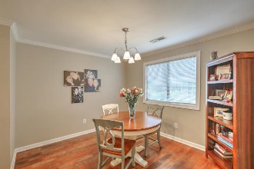
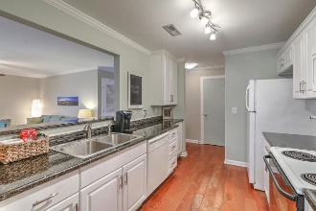
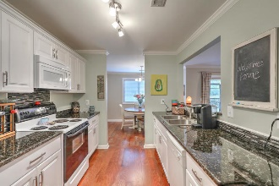
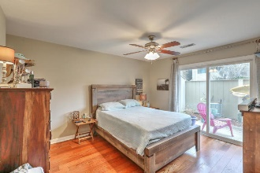
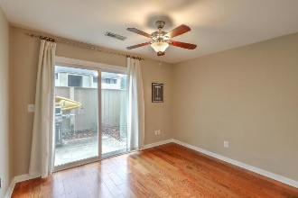
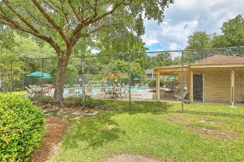
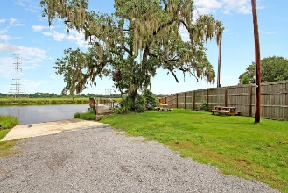
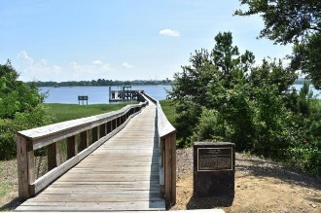


Ashleytowne Village | Just Listed!
Open House Sat 12-2
2334 Treescape Drive Unit 2
Charleston, SC 29414 | MLS# 19007380 | $131,775
Charming updated 1st floor condo that will please even the most discerning buyer. Features include:**Updated kitchen w/granite counters**Hardwood floors throughout**Both bedrooms lead out on to the patio to enjoy the lowcountry breezes, gardening or an evening BBQ**For those rare winter moments, the coastal inspired fireplace in the living room will keep you toasty.**Unwind after long day on your screened porch leading out to a lovely park-like green space to enjoy those nice summer nights. Ashleytowne Village is a quiet Community that offers a neighborhood swimming pool, dog park, gazebo, boat storage, as well as a boat dock & ramp on the Ashley River! And, of course, you will love being close to shopping, dining, entertainment along with easy access to Bees Ferry and I-526. Welcome home!
Desiree Maurer
Office - (843) 416-2000
Mobile - (843) 327-9010
desiree.maurer1@gmail.com
www.yourcharlestonhousesearch.com
Keller Williams Realty
496 Bramson Ct Ste 200
Mt. Pleasant, SC 29464

