Slide 1
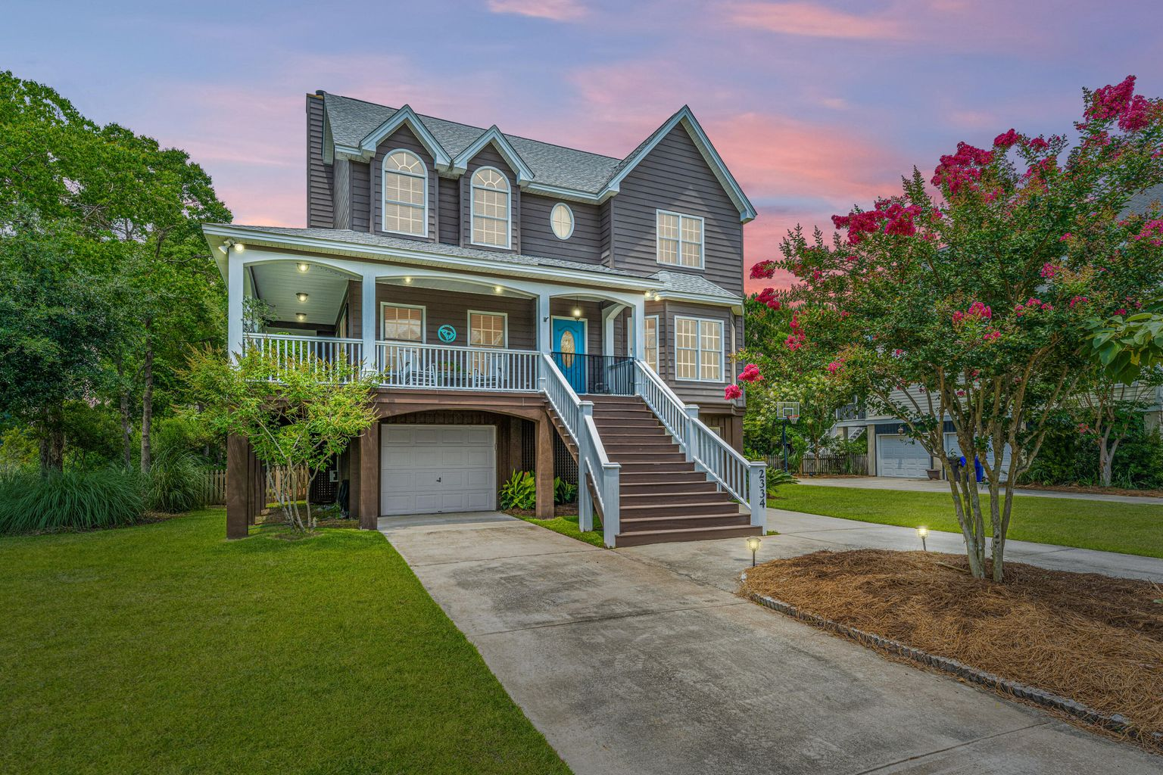
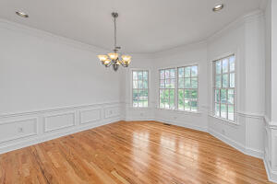
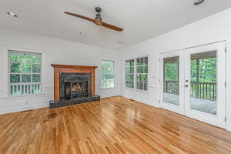
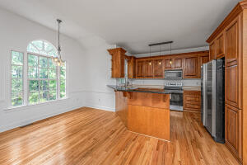
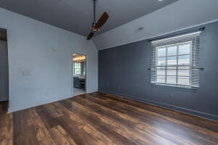
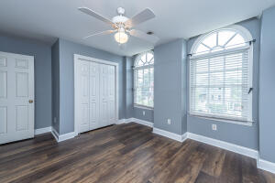
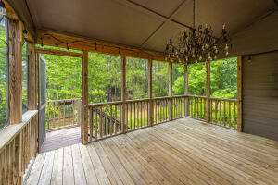
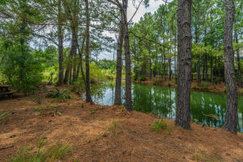


2334 N Creek Drive
Rivertowne Country Club | Mount Pleasant | MLS# 22017258 | $775,000
OPEN HOUSE SUNDAY
OPEN HOUSE
SUNDAY, JULY 10TH FROM 1 TO 2:30
Stunning elevated Lowcountry home with wraparound front porch and two screened porches off of the back to enjoy one of the most picturesque lots in the North Creek section of Rivertowne Country Club. With a pond on one side and a pond behind you are afforded both privacy and a nature lovers dream. This 4 bedroom 2.5 bath home has freshly painted walls, and newly refinished wood floors on the first floor and new LVP on second floor. Two car garage with plenty of storage and a workroom under the home. This home is turn-key ready for you. New roof in 2018 with a 10 year transferrable warranty. Neighborhood dock with golf and tennis at the Country Club.
A wonderful place to call home.
Cindy Elenberger
O 843-884-1622 | M 843-696-6701
cindy.elenberger@carolinaone.com
Carolina One Real Estate | 628 Long Point Rd | Mt Pleasant, SC 29464-3032

