Slide 1
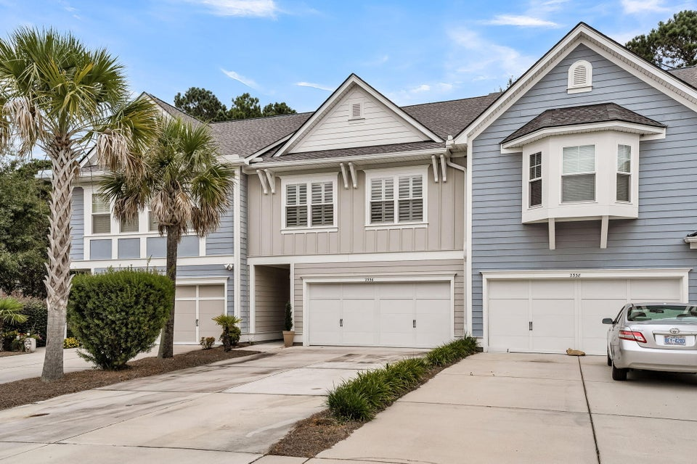
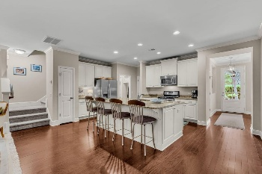
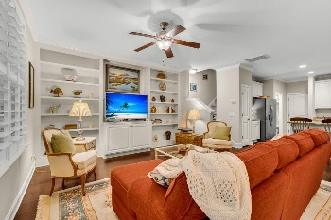
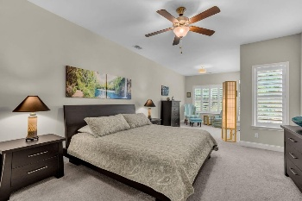
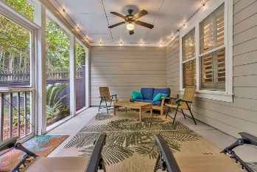
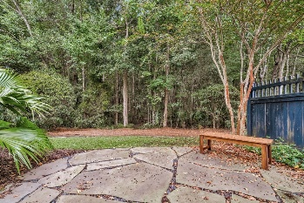

2336 Kings Gate Lane Dunes West · Mount Pleasant, SC 29466 · MLS# 25024956 · $649,000
Just Listed-Mount Pleasant
New Roof 2025! Discover extraordinary, low-maintenance luxury living in this impeccably designed, 3-bedroom, 2.5-bath condo ideally positioned to overlook a picturesque park in front and tranquil woods behind—offering breathtaking views from every window. Inside, you're welcomed by gleaming hardwood floors, soaring natural light, and a flowing, open-concept layout. The inviting foyer leads into a chef-inspired gourmet kitchen featuring a grand center island with seating for four, a deep sink, dazzling granite countertops, stainless steel appliances, ample cabinet storage, a gas range, a pantry, and an elegant dining area. The kitchen opens seamlessly to a sun-drenched family room accented by a wall of windows, and custom built-in cabinets, creating a warm yet sophisticated space for relaxing or entertaining. A stylish powder room and well-appointed drop zone by the two-car garage complete the first floor. Upstairs, a spacious loft offers endless possibilities: a second living area, home office, media room, or playroom. The lavish primary suite boasts a serene sitting area with woodland views, space for a king-sized bed and furnishings, and a spa-quality ensuite bath with indulgent soaking tub, separate tiled shower, dual vanities, and an expansive walk-in closet. Two additional generously sized bedrooms share a beautifully finished full bath, while a conveniently located laundry room makes chores a breeze. Step out to the peaceful screened porch, the perfect retreat for morning coffee or unforgettable Lowcountry evenings overlooking the private backyard. Located in The Heritage at Dunes West, this coveted community provides full lawn maintenance and offers optional memberships to the clubhouse, pool, and golf course. Residents enjoy lushly landscaped grounds, meandering walking and running trails, and a premier location just minutes from pristine beaches, the airport, and downtown Charleston with upscale shopping, and dining. This exceptional, move-in-ready home is a rare opportunity and won't last. Schedule your private showing today!
Stan Huff
843-670-2835 stan.huff@agentowned.com
Jill Marcacci
843-297-5590 jill@agentowned.com
www.agentownedrealty.com
AgentOwned Realty Co. Preferred Group, Inc. | 824 Johnnie Dodds Blvd | Mt Pleasant, SC 29464

