Slide 1

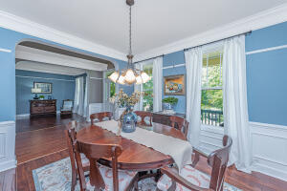
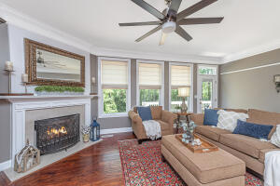
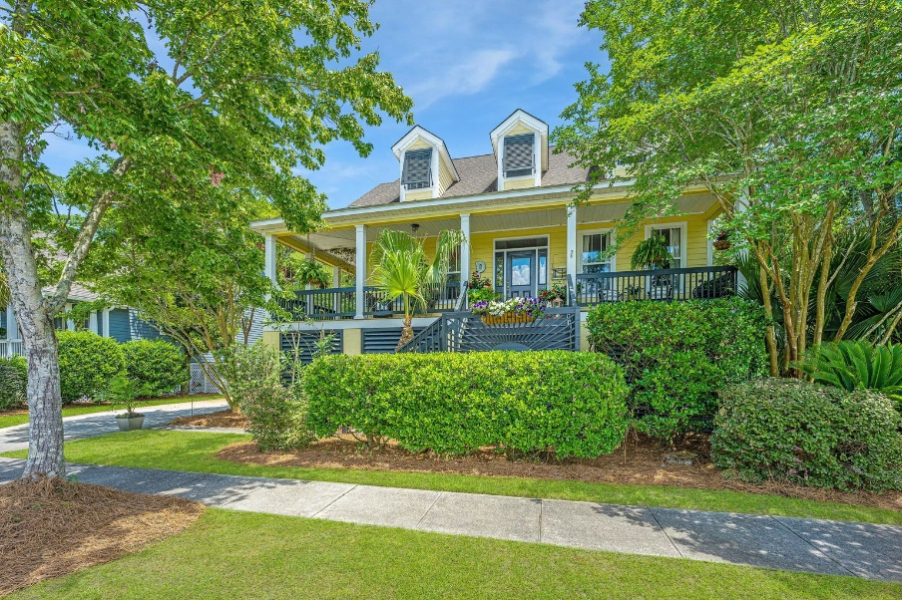
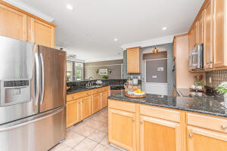

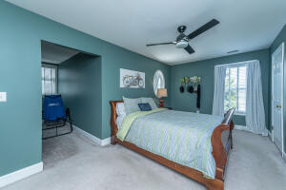
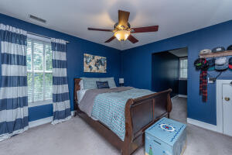
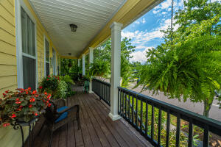
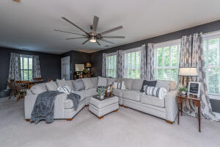
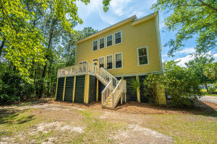
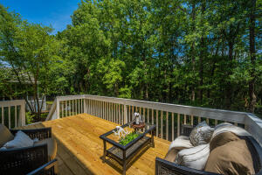
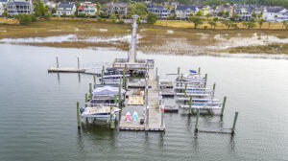



2338 Sandy Point Lane
Rivertowne On The Wando
Mount Pleasant, SC 29466
MLS# 22015241 | $865,000
Lowcountry Charm
Charming Lowcountry style home located on a private lot with wooded buffer in highly sought-after Rivertowne on the Wando. Enjoy the classic southern sitting porch before stepping into the welcoming foyer where you're greeted by gorgeous hardwood floors and custom details such as multi-piece crown moulding, picture moulding, and arched case openings. The well appointed kitchen features plenty of cabinet space, granite countertops, a large peninsula, large pantry, and a casual dining nook flooded with natural light. Access to the wrap around porch makes this an ideal space for serving up happy hour cocktails or enjoying a quiet cup of morning coffee! A much desired first floor owners' suite provides a generously sized retreat with an en-suite luxury bath. The bathroom offers a dual sink vanity, a separate shower, large soaking tub, private water closet, linen closet, and a walk-in closet. Upstairs you'll find two secondary bedrooms, both offering generous closets (one with a walk-in!) and attic eave storage spaces! You're sure to enjoy outdoor living in this home's notable spaces. In addition to the wrap-around front porch, there is an ample sized deck just off the family room that offers plenty of space for lounge furniture as well as a place to grill! The marsh/wooded buffer behind the home provides plenty of privacy but the lot extends beyond what is currently visible so you can enjoy the lower maintenance of a smaller yard or extend to give a larger space for kids, pets, or possibly a pool.
Don Dawson
843-514-0452
ddawson@carolinaone.com
Carolina One Real Estate • 2713 Highway 17 North • Mount Pleasant, SC 29466
www.TeamDawsonSC.com

