Slide 1
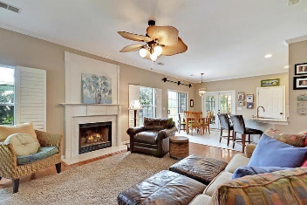
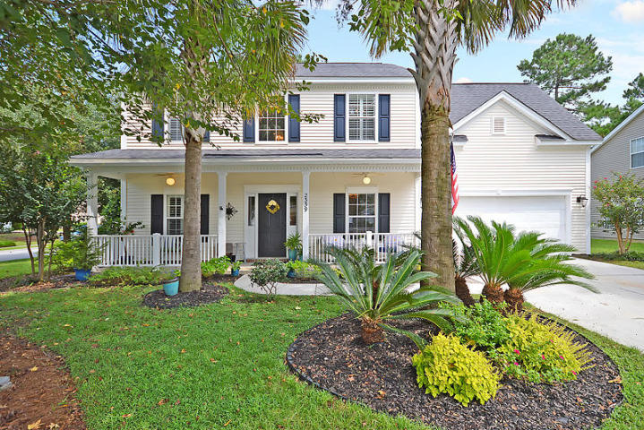
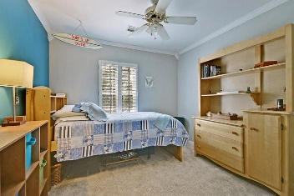
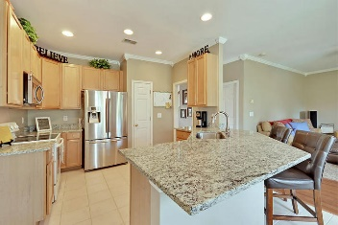
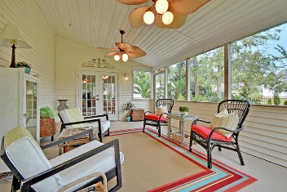
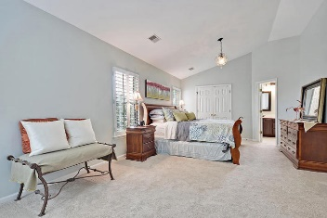
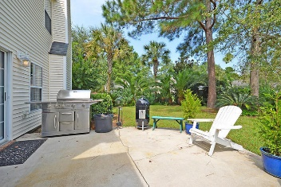
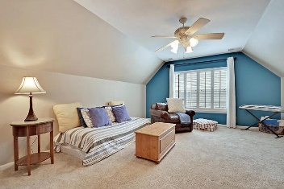
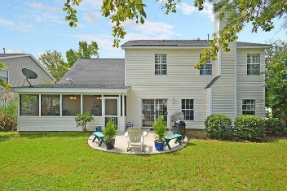

2339 Parsonage Woods Lane
Mount Pleasant, SC 29466
MLS# 17025476 · $415,000
4-5 Bed 3 Full Bath
in Arlington, Park West!
4-5 Bed 3 Full Bath in Park West!
GORGEOUS meticulously maintained 4 bedroom 3 bath home on a professionally landscaped lush corner lot. This home features plantation shutters throughout, wood floors and heavy molding downstairs. Enter into a grand 2 story foyer with a formal dining/flex room to the right and an office with a beautiful updated full bath to the left, which could be used as a 5th bedroom. The large family room has an abundance of natural light and a wood burning fireplace and is open to the gourmet kitchen with granite countertops, a farmers sink, breakfast bar, and eat-in dining area for easy entertaining. Double patio doors lead to a wonderful, relaxing screened porch that is perfect for a morning cup of coffee or reading a good book in the afternoon while overlooking the big backyard with patio/grilling area. There is also a laundry room downstairs. The spacious master bedroom is upstairs & has his and hers closets and a cozy sitting area. The spa-like master bathroom has a vanity with double sinks, soaking tub, and a separate shower. There are three additional bedrooms upstairs, one which is very large located over the garage and could be used as a game or media room that share a bathroom with a tub/shower combo and vanity with double sinks. Park West amenities include 2 pools, play park, several tennis courts, club house, miles of walking trails, outstanding schools and recreation fields. Park West is only 7 minutes to the high school, and 5 minutes to either a Harris Teeter, Publix, or Walmart, and is a short drive to downtown Charleston with 5-star restaurants, world class shopping and iconic history as well as a short drive to the beaches, the airport, Boeing and Daniel Island. Come take a look because you will not find another home that offers as much as this one!
Stan Huff
843-670-2835
stan.huff@agentowned.com
Jill Marcacci
843-297-5590
jill@agentowned.com
www.agentownedrealty.com
AgentOwned Realty Co. Preferred Group, Inc. | 824 Johnnie Dodds Blvd | Mt Pleasant, SC 29464

