Slide 1
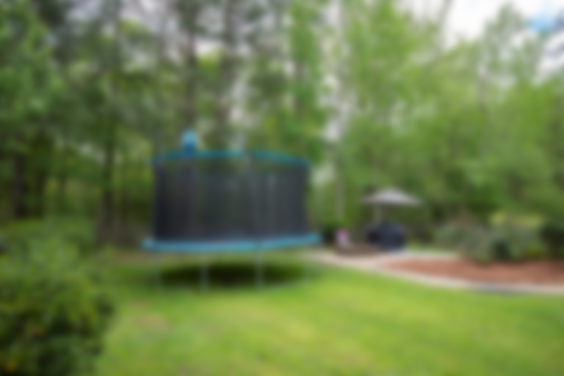
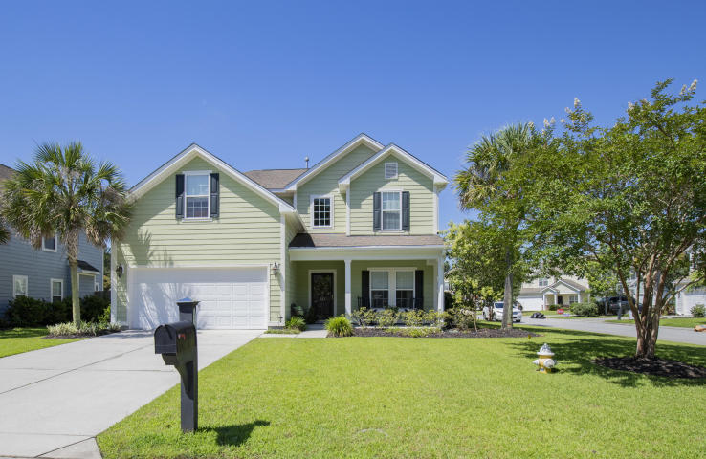
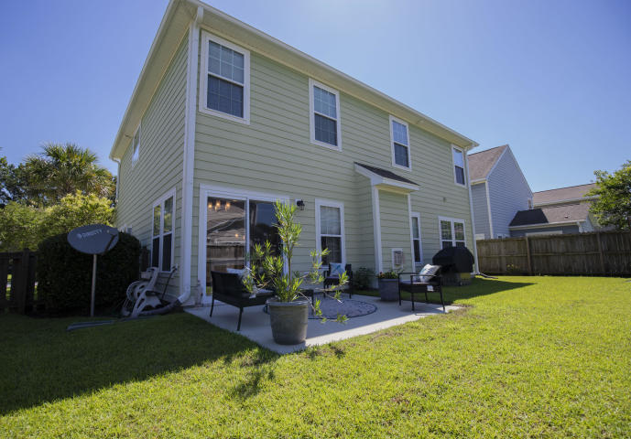
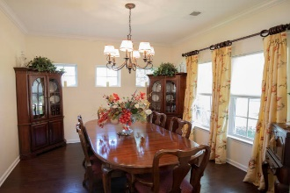
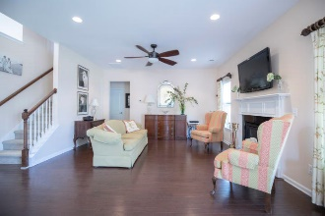
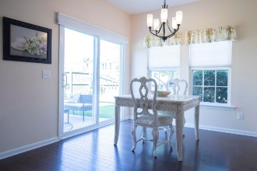
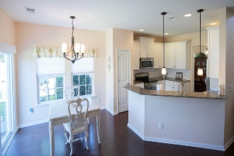
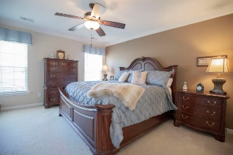
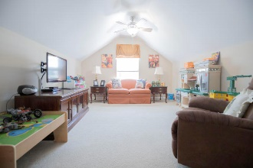
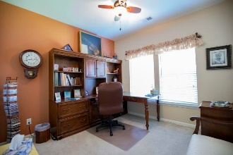
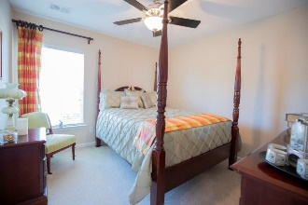
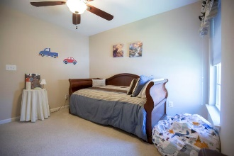
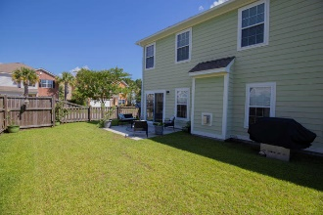

Just Listed! 5 Bedroom 3 Bath In Nelliefield
233 Nelliefield Creek Drive
Nelliefield Plantation | Charleston, SC 29492 | MLS# 20014880 | $379,000
Pride of ownership with this beautiful home situated on a nice corner lot. HVAC replaced in 2020! Open floor plan features hardwood floors, crown molding, recessed lighting, solid surface counter tops and 42 inch kitchen cabinet. Downstairs you will find a formal dining room, kitchen with eating area flowing nicely into the family room. You will also find a downstairs bedroom with full bathroom. Upstairs you will find the master suite featuring garden tub, separate shower, and a large closet. There are three additional bedrooms upstairs that share a full bathroom and one of those bedrooms can be used for a great media or playroom. Backyard is nicely landscaped and fully fenced.
Marthe Teixeira (917) 325-8033
marthe@agentownedrealty.com
Scott Fulton 843-324-8845
scott.fulton@agentownedrealty.com
AgentOwned Preferred Group · 824 Johnnie Dodds Blvd · Mt Pleasant, SC 29464

