Slide 1
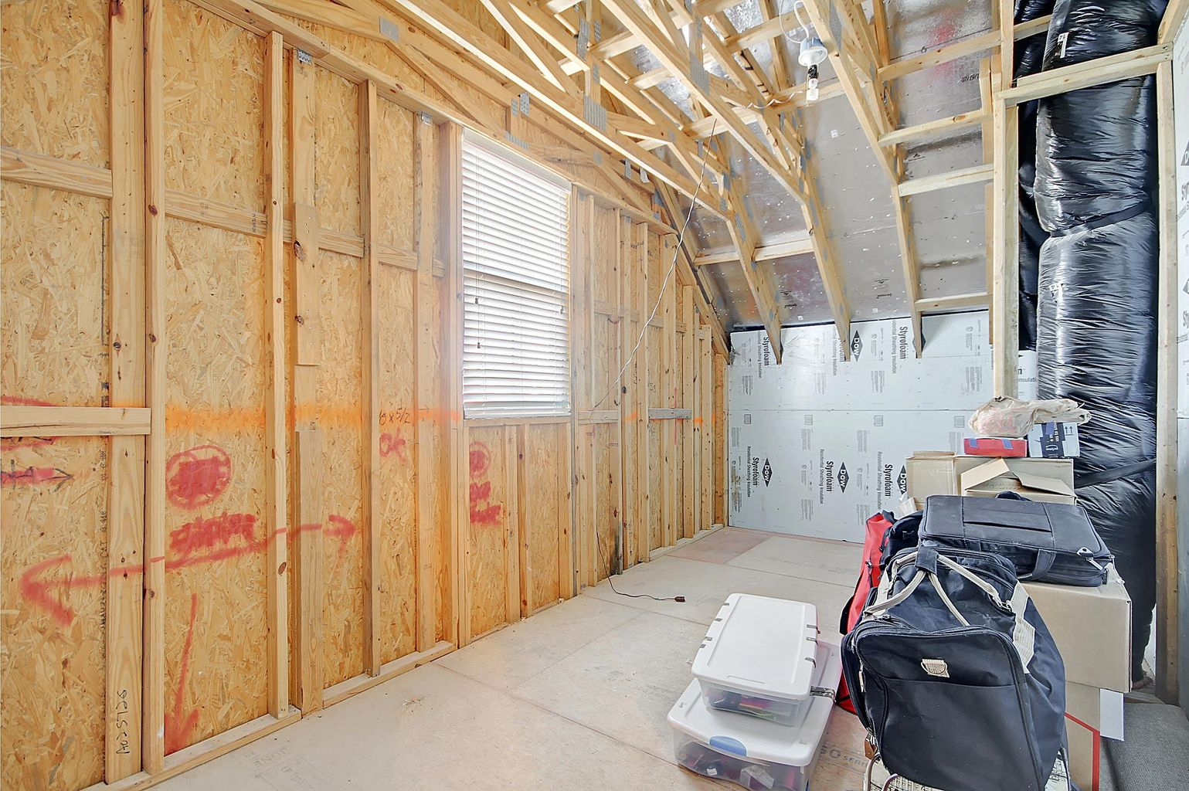
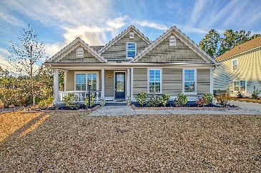
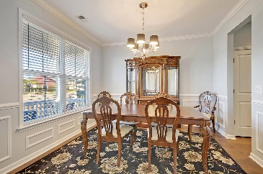
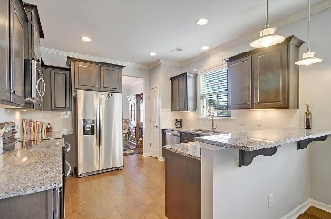
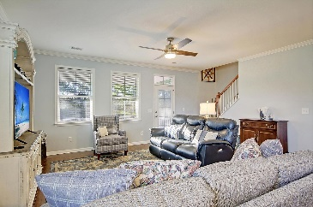
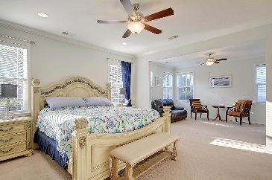
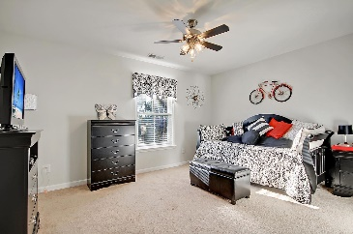
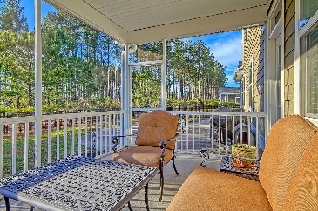
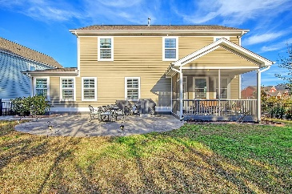

233 Calm Water Way
Cane Bay Plantation · Summerville, SC 29486
MLS# 22001380 · $595,000
New Listing-Walk-In Storage!
Beautiful 4-5 bedroom, 2.5 bath, 3 car garage home with wonderful curb appeal! Upon entering the home you are greeted with new stunning wood floors, open floor plan, custom lighting, and an abundance of natural light. The foyer is large and inviting, to the left is the dining room/flex room with a back doorway to the kitchen. Continuing in is the oversized family room that is open to the chef-inspired gourmet kitchen featuring 42" cabinets, granite countertops, stainless steel appliances, gorgeous tiled backsplash, breakfast bar, pantry, and eat-in area. The grand master bedroom suite is on the main level and has an attached sitting room, walk-in closet, spa-like ensuite master bath with relaxing soaking tub, luxurious tiled shower with frameless glass door, dual sink vanity, and custom tiled floors. Finishing off the first floor is a laundry room and half bath. Upstairs there is a HUGE bonus room with french doors that could be an ideal game room, office, media room, or 5th bedroom-so many possibilities. There are 3 additional nicely sized bedrooms upstairs that share a full bath with dual sink vanity. In addition, off the third bedroom is a fantastic walk-in 200 sqft storage area that can be finished off or used for easily accessible storage! The private fenced backyard has a charming screened-in porch that is perfect for reading a good book or enjoying a cool beverage after a long days work. The super-sized patio can comfortably hold a table with chairs, grills, and a sitting area making it great for entertaining family and friends. Last, but not least is the three car attached garage with utility sink and room for more storage. The Coves in Cane Bay Plantation in Summerville is a wonderfully landscaped community with walking and biking trails, lake, dock facilities, clubhouse and community pool (across the street). The neighborhood has local shopping, schools, YMCA, grocery stores, multiple exits, and is a short drive to downtown Charleston with 5-star restaurants, world class shopping and iconic history as well as a short drive to the beaches, the airport, Boeing and Daniel Island. Come take a look because you will not find another home that offers as much as this one!
Take a video tour: https://vimeo.com/668393114
Stan Huff
843-670-2835
stan.huff@agentowned.com
Jill Marcacci
843-297-5590
jill@agentowned.com
www.agentownedrealty.com
AgentOwned Realty Co. Preferred Group, Inc. | 824 Johnnie Dodds Blvd | Mt Pleasant, SC 29464

