Slide 1
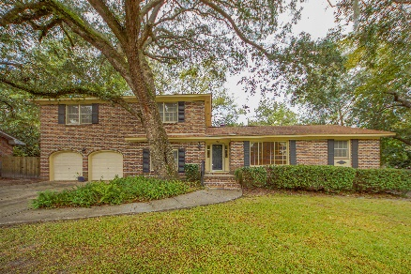
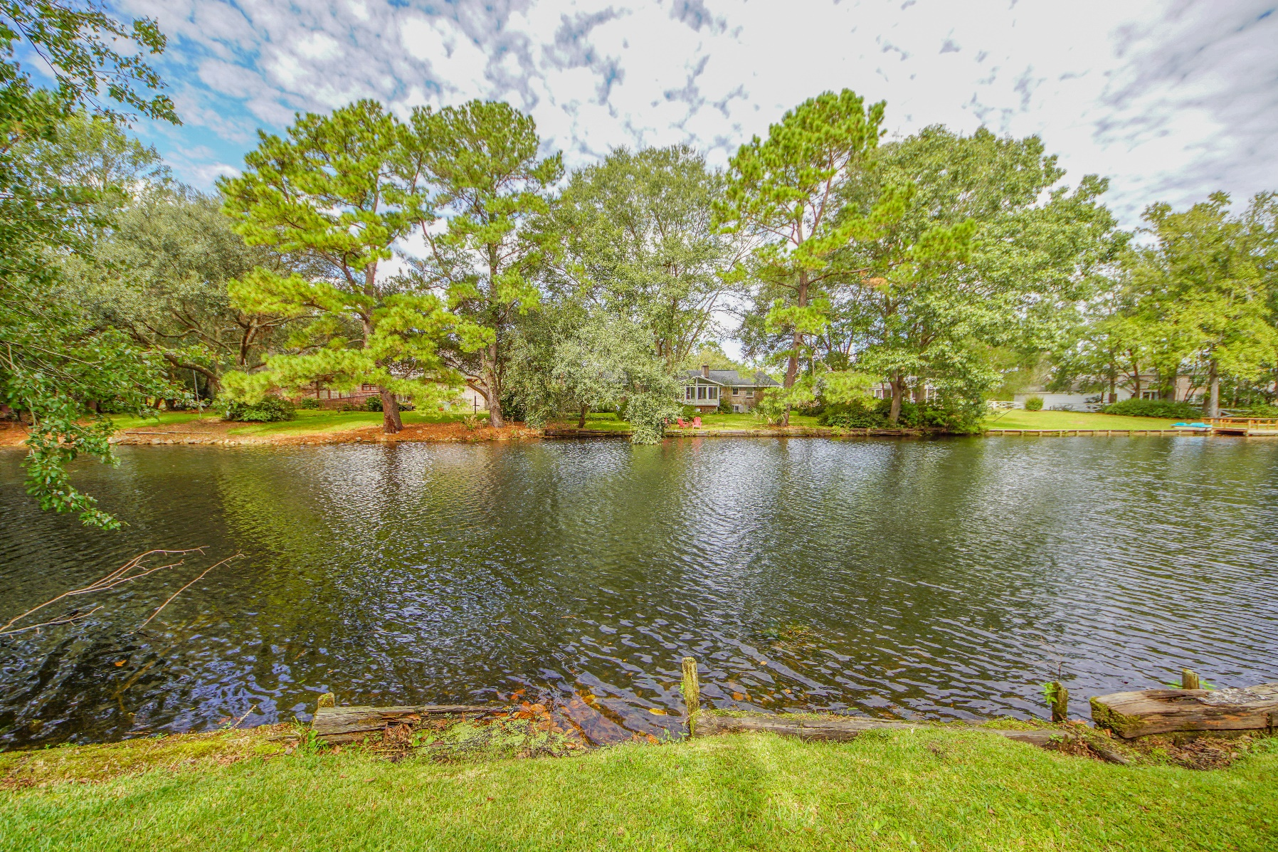
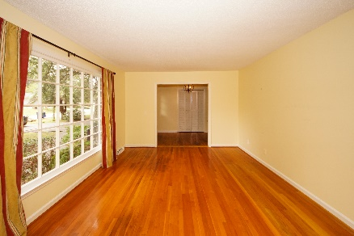
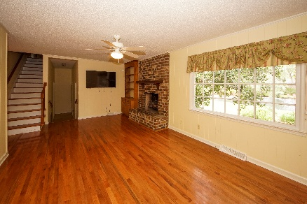
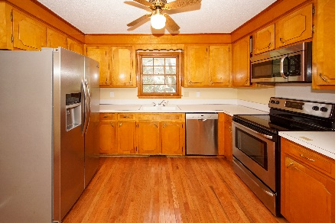
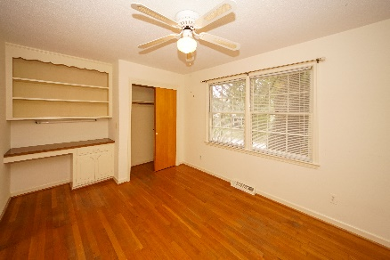
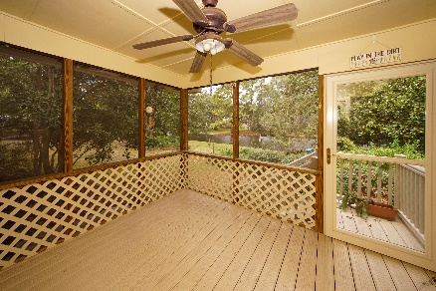
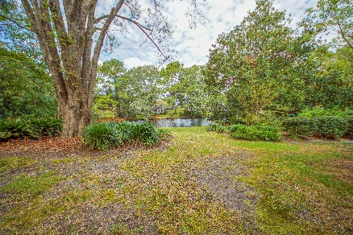


$1,000 BUYER'S AGENT BONUS
2341 Wofford Road Drayton On The Ashley | Charleston
MLS# 19031956 | $330,000
BUYER'S BONUS GOOD THROUGH 3/17
Large home on ON THE LAKE! .41 acre lot with beautiful views.
Brick home with professional landscaped yard with mature plantings and lovely trees. There is one bedroom and half-bath on the first floor. Roomy floor plan with formal living room and dining room plus a Family Room with fireplace - even comes with its own flat screened TV! Large Kitchen with an area that could be an eat-in area. Stainless appliances. Door from the kitchen that leads to the screened porch overlooking the peaceful lake. Upstairs are 4 additional bedroom and 2 baths. Wood floors through most of the house except the 1 bedroom downstairs. Large 2-car garage with tons of extra space for storage or work space. Roof 2011 and HVAC in 2017.
Susan Weeks
(843) 813-0495
susanweeksdesign@gmail.com
www.copperroofproperties.com
Copper Roof Properties, LLC
13 Yeamans Rd.
Charleston, SC 29407

