Slide 1
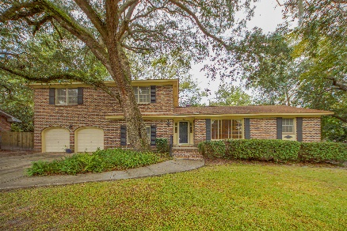
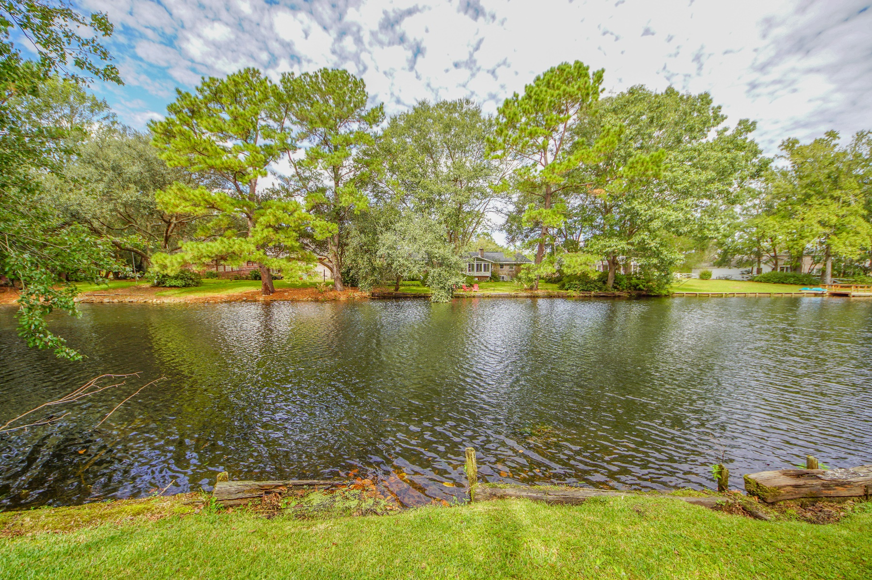
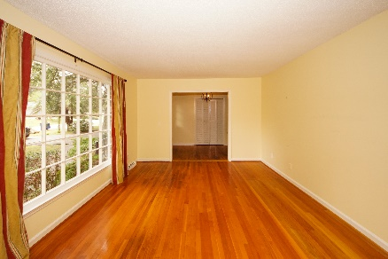
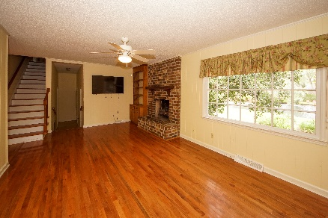
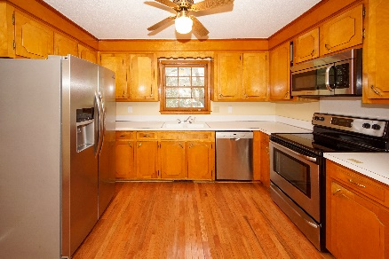
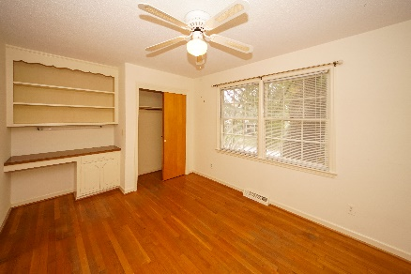
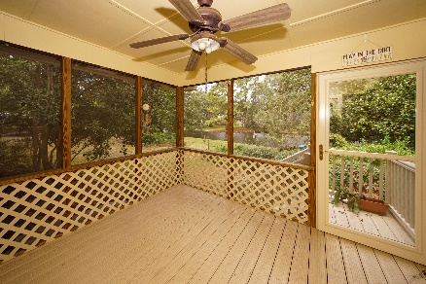
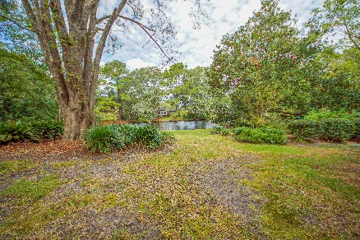


BACK ON THE MARKET
Buyer Financing Fell Through
2341 Wofford Road
Drayton On The Ashley | Charleston
MLS# 19031956 | $330,000
$1,000 Buyer’s Agent Bonus!!
Large home on ON THE LAKE! .41 acre lot with beautiful views.
Brick home with professional landscaped yard with mature plantings and lovely trees. There is one bedroom and half-bath on the first floor. Roomy floor plan with formal living room and dining room plus a Family Room with fireplace - even comes with its own flat screened TV! Large Kitchen with an area that could be an eat-in area. Stainless appliances. Door from the kitchen that leads to the screened porch overlooking the peaceful lake. Upstairs are 4 additional bedroom and 2 baths. Wood floors through most of the house except the 1 bedroom downstairs. Large 2-car garage with tons of extra space for storage or work space. Roof 2011 and HVAC in 2017.
Susan Weeks
(843) 813-0495
susanweeksdesign@gmail.com
www.copperroofproperties.com
Copper Roof Properties, LLC
13 Yeamans Rd.
Charleston, SC 29407

