Slide 1
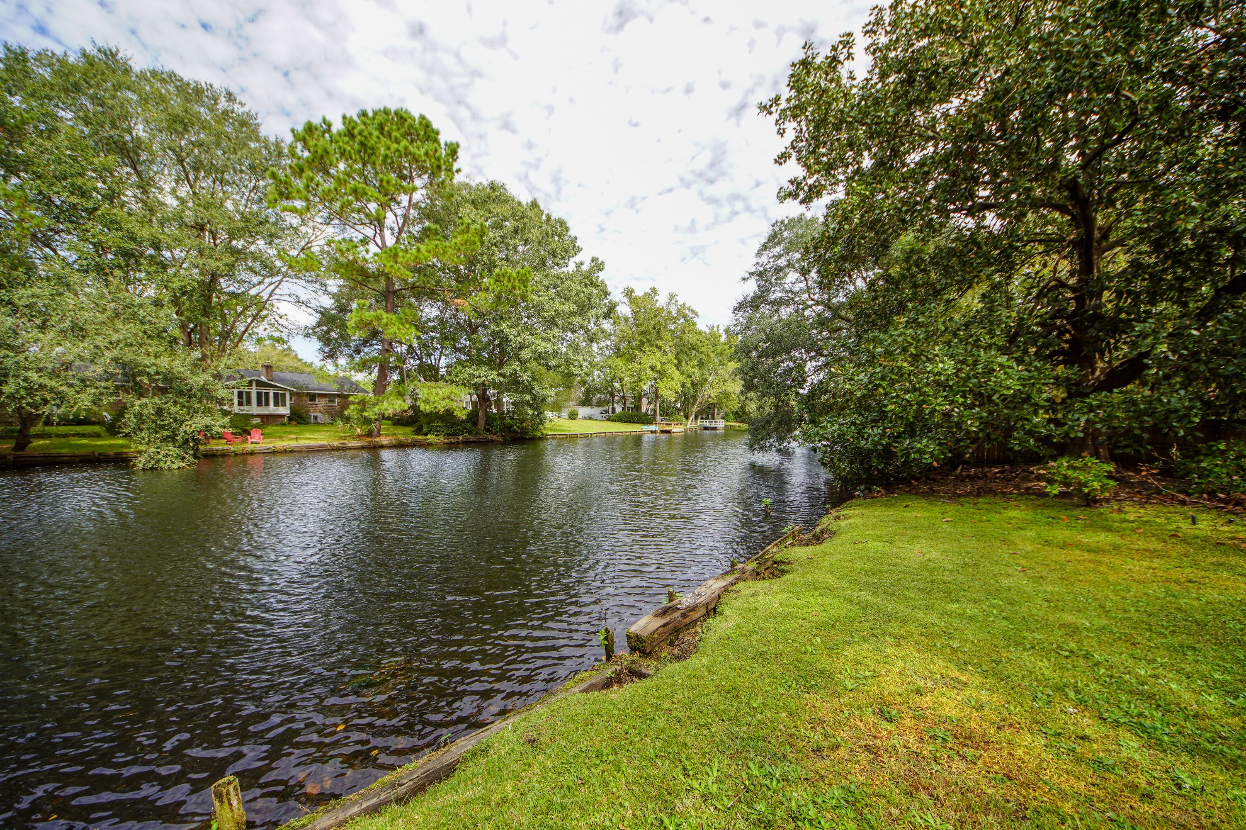
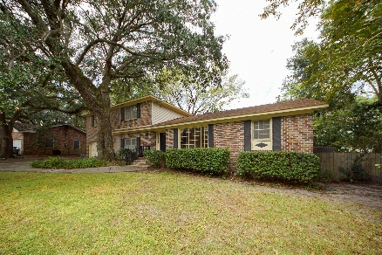
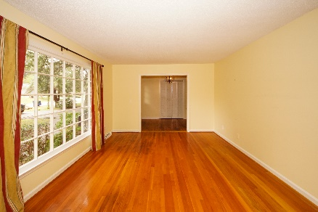
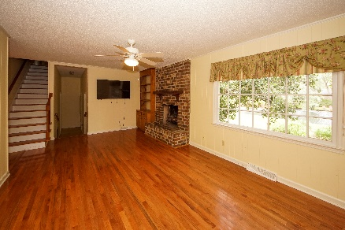
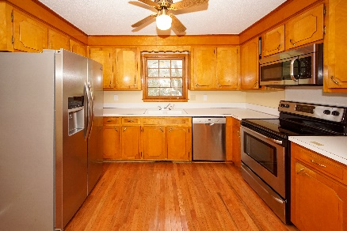
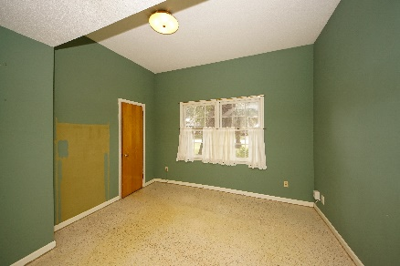
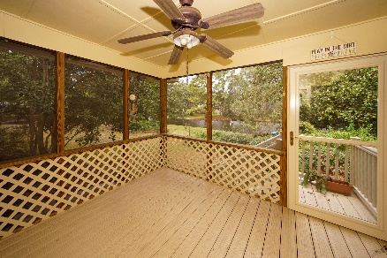
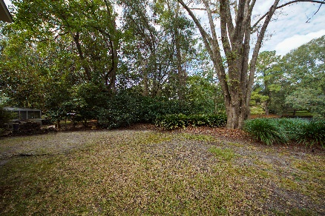


$1,000 BUYER'S AGENT BONUS
2341 Wofford Road
Drayton On The Ashley | Charleston
MLS# 19031956 | $330,000
BONUS WITH RATIFIED CONTRACT BY 12/31/19
Large lot on the LAKE with absolutely beautiful views from almost every room in this home.
Brick home with professionally landscaped yard you'll enjoy. There is even a nice sized bedroom and 1/2 bath on the first floor. This bedroom had carpet that was removed - new flooring will make it perfect! Roomy floor plan with formal LR/DR plus also a Family Room with wood burning fireplace with brick hearth and surround. Hardwood floors through most of the house. The wood floors upstairs need some love (priced accordingly) but New roof in 2011 and New HVAC in 2017. LOT .41 Ac size. 2-car garage with extra deep area for a work space.
Susan Weeks
(843) 813-0495
susanweeksdesign@gmail.com
www.copperroofproperties.com
Copper Roof Properties, LLC
13 Yeamans Rd.
Charleston, SC 29407

