Slide 1
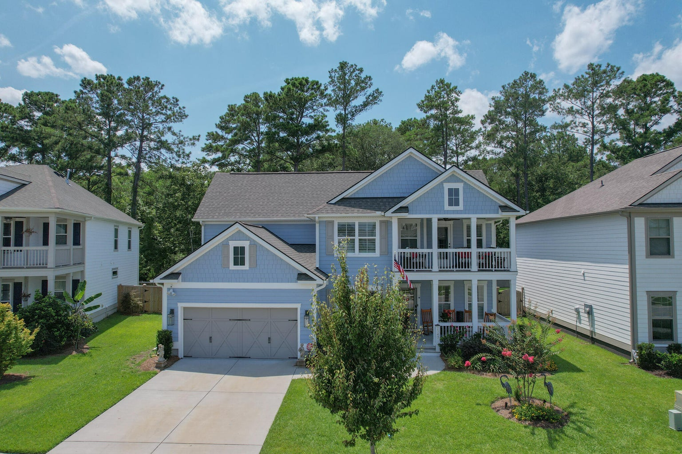
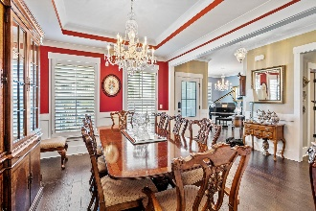
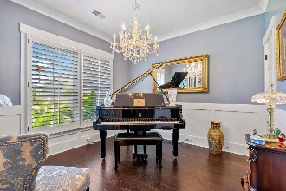
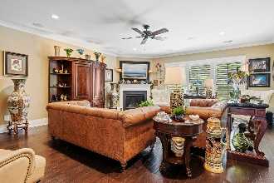
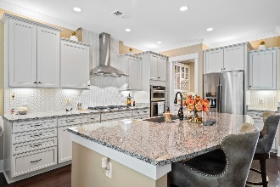
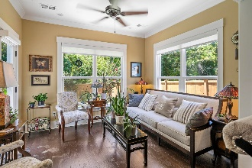
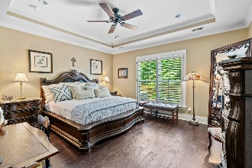
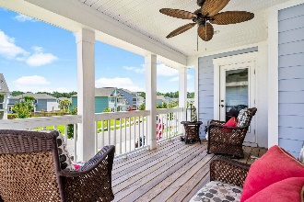
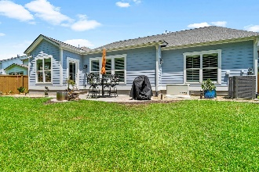

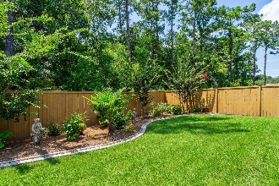

2343 Brinkley Road
Oakfield | Johns Island, SC 29455 | MLS# 23016353 | $865,000
Wild Dunes Swim & Social
Membership w/ Acceptable Offer
Motivated Sellers
Significant Price Adjustment
WELCOME to one of the most elegant homes in Oakfield. This beautiful 4 bedroom,3.5 bath home is located in one of the most desirable neighborhoods on John's Island. At construction, Owner's selected lovely custom features and continued adding more throughout their ownership. Upon entering you'll be greeted by a formal D/R, Music Rm. & Hallway leading to spacious kitchen with fabulous large Island for entertaining, & a well designed Butler's Pantry which compliments the kitchen's work space. In addition is an add'l dining area & living room & a ''study nook'' at bottom of stair case. Next, is a great hobby room, children's play rm. or home Office /Study along with the Master Suite all of which completes the first floor.
The second floor has a roomy loft which is the perfect place for a media room. In addition there is three B/R's and two full B/A's, along with a Porch Balcony, just made for enjoying the great outdoors.
This home is a "Jewel" ... Condition and Location could not be better.
Neighborhood offers great amenities to include a pool, playground and walking paths. Just a short 10 mile drive to the heart of Downtown Charleston, under 20 miles from Kiawah Island and its world class beaches and about 15 miles from Boeing and Charleston International Airport.
Linda Laird
REALTOR
M (843) 209-7571 | O (843) 886-8110
linda.laird@carolinaoneplus.com | www.lindalaird.com
Leading Real Estate Companies of the World
Carolina One Real Estate
1503 Palm Blvd
Isle of Palms, SC 29451-2280

